Slide 3
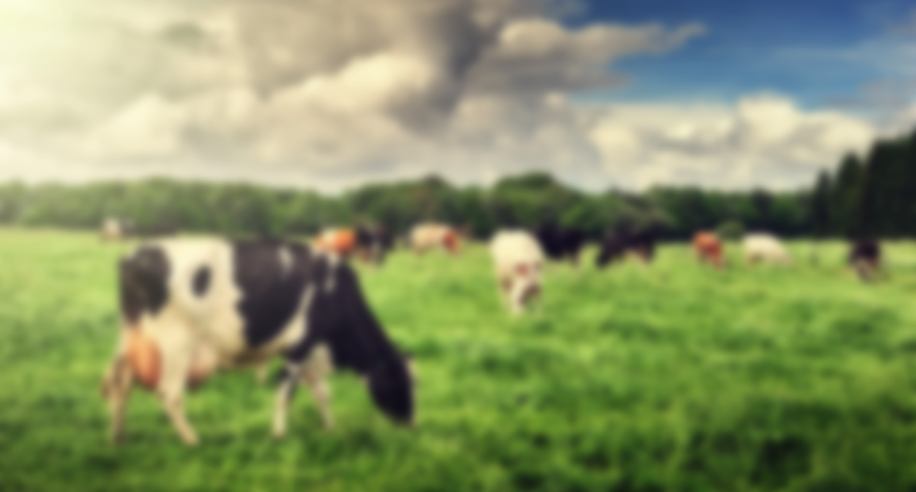
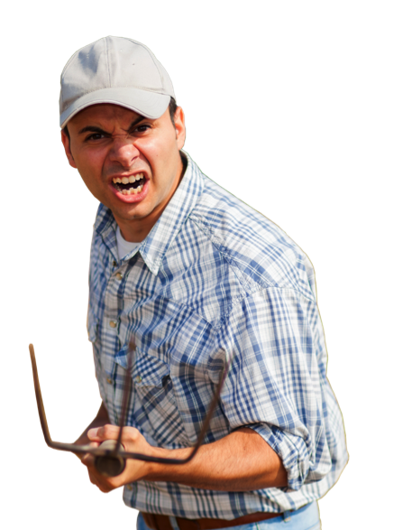
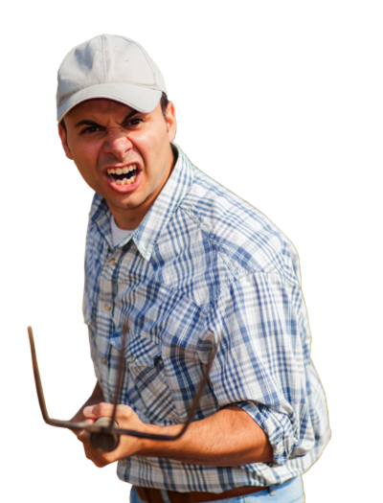

Slide 5
Who am I
2010
2001
2013
The Netherlands
The Netherlands
Switzerland
United arab Emirates
The Netherlands
2000
2017

Slide 6
Royal Friesland Campina Facts & Figures
12.1 billion
euros revenue
Facilities in 34 countries
23,675
employees
18,645
member dairy farmers
Export to over 100 countries
Every day millions of customers
Source: RFC 2017®

Slide 7
Nourishing by nature
Better nutrition
A good living for our farmers
Now and for generations to come
Better products
Responsible marketing
Clear information on labels
Awareness about responsible nutrition
Value creation for member farmers
Dairy Development Programme
Climate-neutral growth
Sustainable purchasing
Sustainable production
Animal health and welfare
Meadow grazing and biodiversity
Source: RFC®

Slide 8
Brands top 100 2017
Total supermarkets NL
Rank 2017 | Brand | Turnover (EuroMM)
1 | Marlboro | € 455,45
2 | Coca Cola | € 298,27
3 | Campina | € 265,53
4 | Heineken | € 263,34
6 | Unox | € 217,64
19 | Mora | € 99,79
20 | Optimel | € 99,21
21 | Spa | € 98,87
47 | Fanta | € 66,99
48 | Maggi | € 66,23
49 | Milner | € 65,35
50 | Aviko | € 63,84
Rank 2017 | Brand | Turnover (EuroMM)
54 | Kravan Cevitam | € 60,33
55 | Chocomel | € 58,90
56 | Duyvis | € 58,30
76 | Pampers | € 41,82
77 | Friesche vlag | € 41,74
78 | Bonduelle | € 41,52
83 | Old Amsterdam | € 39,13
84 | Tony ‘s chocolonely | € 38,83
85 | Mona | € 38,75
86 | M&M’s | € 38,70
100 | Remia | € 31,82

Slide 9
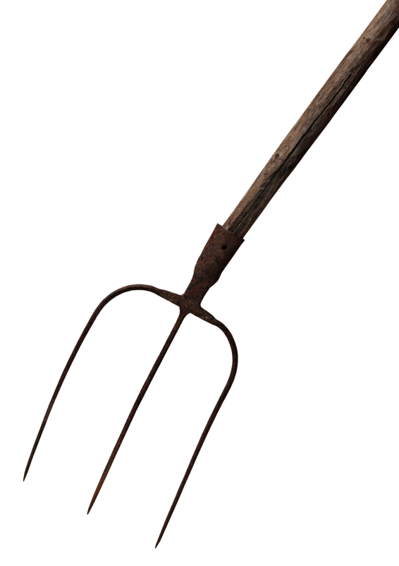
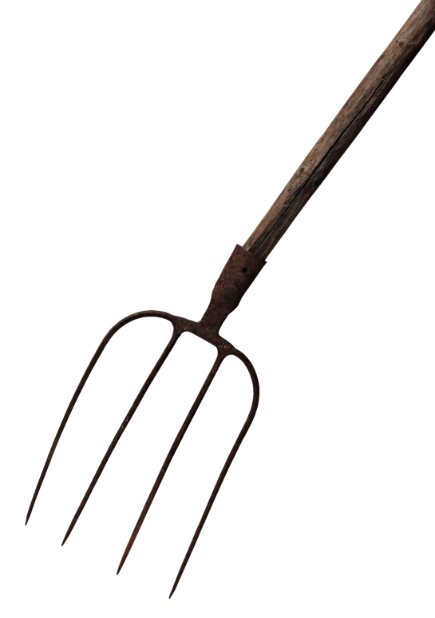
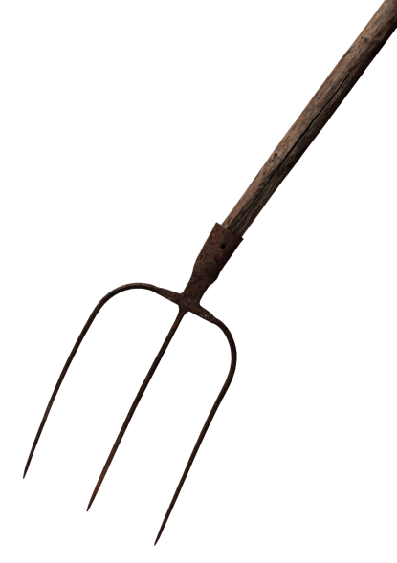

Slide 10
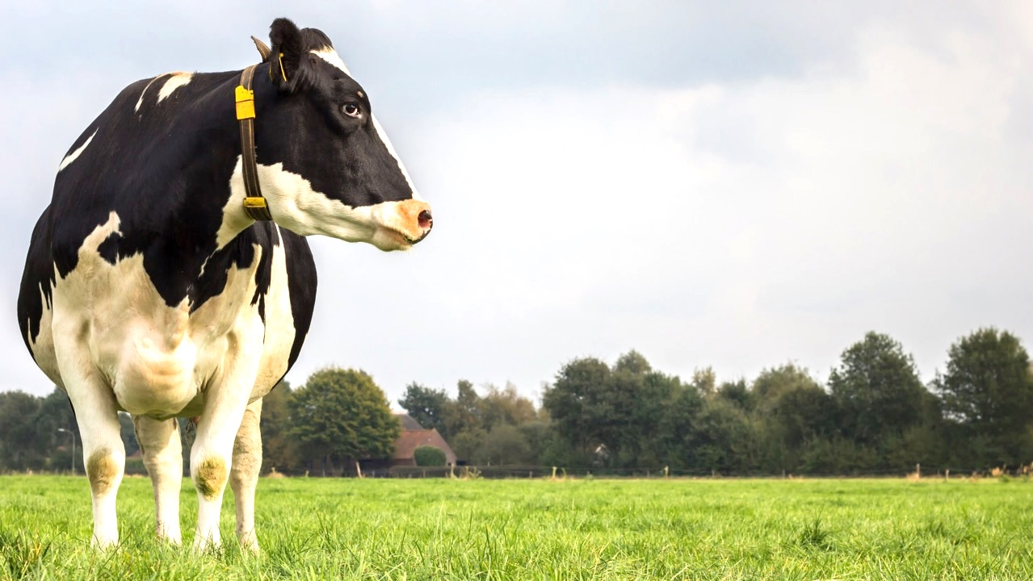
The cow is always on and gives milk 24/7
mY job is to valorize that milk at highest possible value

Slide 11
The cow is always on and gives milk 24/7
So where are we…?
mY job is to valorize that milk at highest possible value

Slide 12
2017: 2/3th of the promotions are GP positive
incremental this is only half % of the promotions..
Number of total positive GP promotions
Ratio negative and positive promotions
Negative GP
Positive GP
Number of total positive GP promotions
Ratio negative and positive promotions
Negative GP
Incremental
Positive GP

Slide 13
Intervention was needed
Automation
Optimization
Insights
control

Slide 14
Promotional strategy reset for 2018 and beyond
Define clearly per brand the required balance of pitch fork
Buy external insights in promotional effectiveness
Sharpen promotional guidance
Increase awareness on incrementality and promotional ROI
Train the organization on revenue management
Implement TPx to increase visibility and control
Define targets on promtoional effectiveness
Test and learn to prepare for the future

Slide 15
Insights generation
what the impact of the promotional activity had on the...
Did the promotion…
… attract new loyal customers
Brand investment other brands
Brand investment within brand
… sponsored loyals?
Loyalty bonus for regular buyers
… attract promo junks?
Defended market share
… short term only attract competitive users?
Fast Euro
… damage the brand?
Brand erosion other brands
Source: GFK®

Slide 16
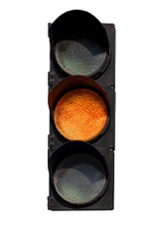
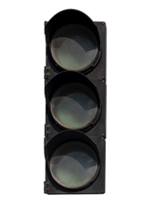
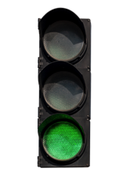
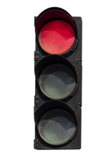
Fragile balance between short and longer term
Short term
Long term
Loyalty bonus for regular buyers
Defended market share
Brand erosion
Brand investment
Fast Euro
Promotion Optimization Institute | European Summit 2018 | Budapest, Hungary
Source: GFK®

Slide 17
For brand X
Brand Investment other Brands
23.2%
23.4%
43.4%
29.7%
22.6%
21.5%
Brand Investment within Brand
Loyalty Bonus
Defended Market Share
Fast Euro
Brand Erosion within Brand
Brand Erosion other Brands
22.7%
23.3%
14.7%
19.6%
22.1%
25.2%
Totaal
SPO
2e HP*
1+1
2 voor Y
3 voor Y

Slide 18
Next step was to anchor way of working
Automation
Optimization
Insights
control

Slide 19
RFC has chosen a partner that can help us to, over time, create a learning system with increasing data input.
Internal data
Data platform
External data
Product Master Data (SAP Native; excel; flat files)
Customer Master Data (SAP Native; excel; flat files)
Display BOM (SAP Native; excel; flat files)
Pricing Data (SAP Native; excel; flat files)
Ex-Factory/Sell-In (excel; flat files)
Demand Forecast (excel; flat files)
Budgets/Les (excel; flat files)
Predictive Analytics
Insights
Authorization & Security
Nielsen (CreCha; FFS)
IRI (Tape II)
(e)POS (flat files)
GfK (flat files)
Consumer Data (excel; flat files)
Brand Rating (excel; flat files)
Campaign Data (excel; flat files)
Folder Data (excel; flat files)
Pricing Scans (excel; flat files)
Weather (excel; flat files)
Source: Visual fabric®

Slide 20
Promo evaluation & guideline
Steps
1
2
3
4
5
Discipline on the workflow process
Low hanging fruit
Check development and get insight on differences
Start shifting small parts of the spend between
Guidelines
A&P cost alignment
Accounts
Number of promotions / promotional pressure
Explore absolute top and tail
Brands
Promotion types and mechanisms
Get into action
Determine reasonable target

Slide 21
TPM workflow makes evaluation possible at all stages of workflow
Year Plan
Promotion entry
Approval
Planning
Negotiate
Finalised
Settlements
Evaluation
Account Manager
Account manager/ Assistant
Responsible
Demand Planning
Account Manager
Customer
Before buy in period
During buy in & consumer period
Finance / Sales
Trade Marketing
Promotion Year Plan
Promotion entry
Approval by AM
Approval by DP
Proposal finalised
Approve by customer
Planned
In progress
Rebates & Payments
Finished
10
20
New Version
40
50
60
70
80
90
100
110
120
130
Rejected
Reject
30
Deleted
Create Rebates/ Accruals
Book Costs against Accruals

Slide 22
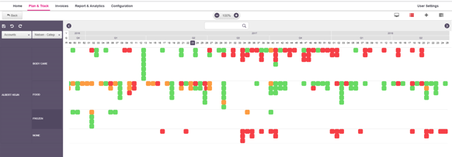
ROI per promotion in account plan possible

Slide 23
ROI classification triggers action and is part of approval flow
ROI classification
NA
Incr. GP / € invested
Incr. NSV / € invested

Slide 24
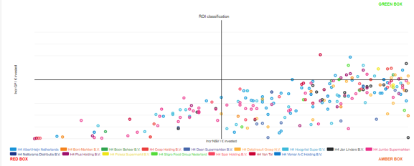
Account X 2018 promo plan allows for improvements

Slide 25
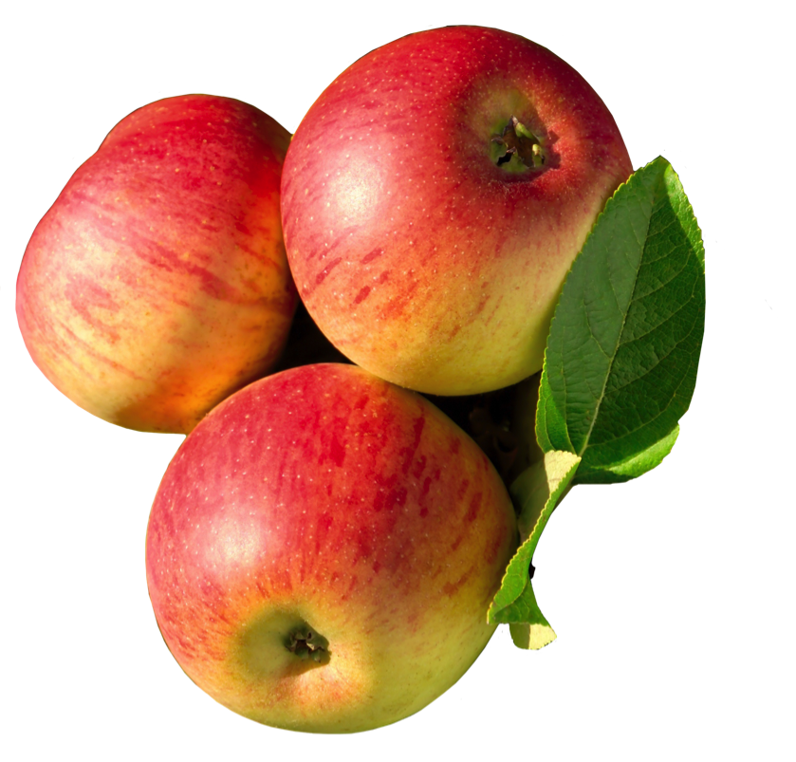
2. The low hanging fruit
a. Are all categories or Brands paying the same for a broadsheet?
Create a simple report (list) with:
Promotion ID
Promotion Name
Plan account
Category / business unit (split on buyers at retailers)
Media
Media Spend
Compare spends and negotiate with the retailers towards the lower spends
Extra quantum discount possible based on the total spend at this retailer?
Create a simple report (list) with:
Promotion ID
Promotion Name
Plan account
Category / business unit (split on buyers at retailers)
Media
Media Spend
Compare spends and negotiate with the retailers towards the lower spends

Slide 26
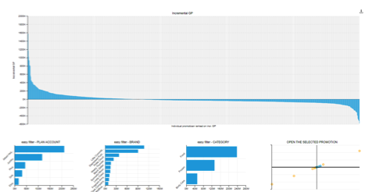
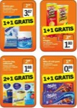
2. The low hanging fruit
b. What are those few big loss generating promotions?
Create the ranking for promotions based on the incremental GP
Find the Loss makers
Decide directly what to do with these promotions (status below 70 can be stopped, higher statuses shouldn’t be repeated)
Repeat this for the 3-5 best promotions
Source: Visual fabric®

Slide 27
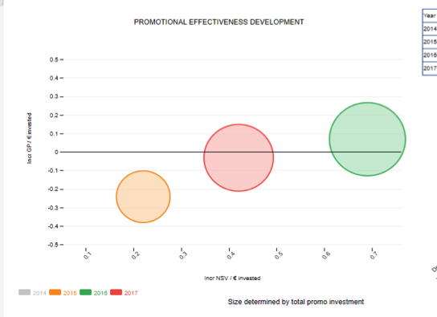
3. What is the development of ROI on promotions?
Is ROI increasing or declining?
Year | Total promo | ROI GP Ratio | ROI NSV Ratio | ROI Volume Ratio
2014 | 614,633.11 | -0.31 | 0.06 | 0.34
2015 | 30,480,775.29 | -0.24 | 0.22 | 0.31
2016 | 61,090,560.22 | 0.07 | 0.69 | 0.32
2017 | 50,956,994.8 | -0.03 | 0.42 | 0.29
Source: Visual fabric®

Slide 28
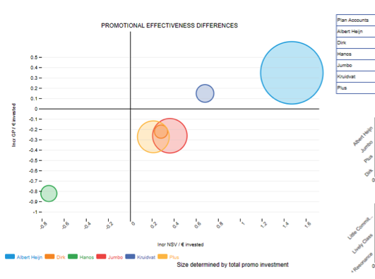
3. What is the development of ROI on promotions?
a. Try to shift (small) parts of the spends between Accounts
Plain accounts | Total promo | ROI GP Ratio | ROI NSV Ratio
Customer A | 28,505, 469.31 | 0.35 | 1.47
Customer B | 1,271,400.18 | -0.22 | 0.28
Customer C | 1,884,152.64 | -0.82 | -0.74
Customer D | 8,700,789.3 | -0.26 | 0.36
Customer E | 2,278,000.83 | 0.15 | 0.68
Customer F | 7,407,530.65 | -0.27 | 0.21
Source: Visual fabric®

Slide 29
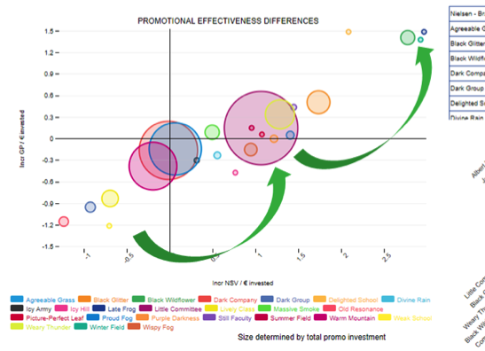
4. What is the best place to spend your money?
b. Try to shift (small) parts of the spends between Brands
Nielsen - Brand | Total promo | ROI GP Ratio | ROI NSV Ratio
Customer A | 525,987.04 | 0.05 | 1.4
Customer B | 4,560,161.32 | 0.51 | 1.73
Customer C | 1,721,878.35 | 1.41 | 2.77
Customer D | 29,598,196.94 | -0.16 | -0.02
Customer E | 874,834.3 | -0.95 | -0.93
Customer F | 10,601.59 | 1,49 | 2.08
Source: Visual fabric®

Slide 30
4. What do we change today?
c. Actively change planned promotions
GO TO
ROI CLASSIFICATION AND TOP & FLOP
Source: Visual fabric®

Slide 31
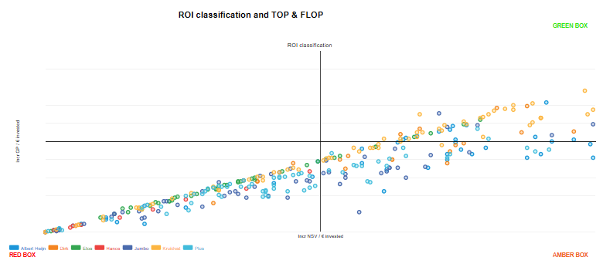
4. What do we change today?
c. Actively change planned promotions
GO TO
ROI CLASSIFICATION AND TOP & FLOP
Source: Visual fabric®

Slide 32
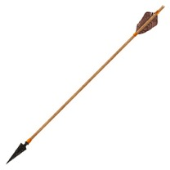
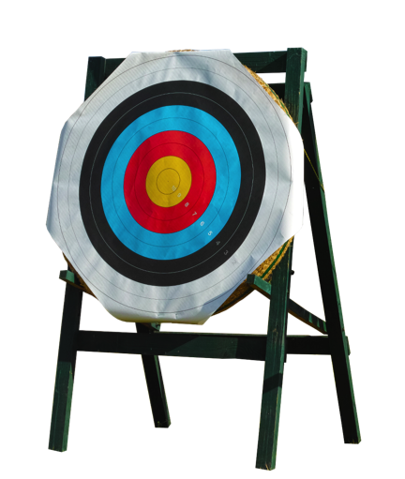
Guiding the different Customer teams via support & ROI targets
Promotion Optimization Institute | European Summit 2018 | Budapest, Hungary

Slide 33
Preparing for the future

Slide 34
Brand B: Digital insights to sharpen promotional strategy
82%
3%
3%
+0%
5,3%
4,2%
1,6%
1,3%
0,1%
0,1%
0,0%

Slide 35
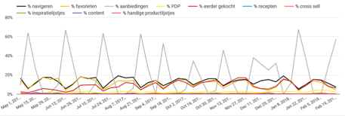
Brand C: Digital insights to sharpen promotional strategy
30%
10%
8%
40%
2,5%
8,8%
+0,0%
0,5%
0,2%
0,1%
0,0%

Slide 36
Differentiate offerings based on postal code

Slide 37
A/B testing for real-time measurement of promo effectiveness
A/B testing is a great way to measure promo effectiveness:
Formulate overall theme per number of weeks to take differences between brands in to account (for example single buy versus multi )
Determine funnel KPI’s such as in image below
Orders per buying customer per period (#)
A
B
1.03
1.02
Spend per buying customer per period (€)
Spend per order (€)
Average price per unit (€)
A
B
A
B
A
B
€1.36
€1.33
€1.09
Spend per customer per period (€)
€2.28
€2.22
€1.13
A
B
€0.187
Customer penetration (%)
Conversion rate (%)
Units per order (#)
€0.178
A
B
A
B
A
B
13.69%
22.11%
1.21
7.80%
12.38%
1.97
Example product X: 25% SPO (A) vs 2nd half off (B)
Conclusion: Significantly less consumers buy product when promotion is a multi-buy written as a percentage discount.
View rate (%)
A
B
61.90%
62.97%

Slide 38
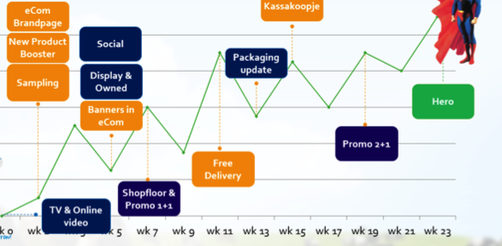
From hero to zero; role of promotions in total package of assets with NPDs
Commercialized Digital Assets

