Slide 1
Analytics Maturity Evolution for RevMan

Slide 2























Our Path to Creating Flexible, Open Architectures
Support Traditional
Environments
Follow
Best Practices
Support New
Technologies

Slide 3
Understanding the “Advanced Analytics Continuum”
The power of an integrated data and analytics framework
Value to the Enterprise
Decision Science
Prescriptive
Predicting areas of concern. Artificial Intelligence. Machine learning. Take recommendations versus what was actually done to continue improving recommended actions.
Insight Generation
Predictive Analytics
Business Intelligence
Descriptive Analytics
Through an integrated analytics framework and by applying business rules, statistical models, visualizations, and industry specific context derive advanced analytics & actionable insights to predict areas that need attention.
Managing Data
EDM, DI, MDM, DW, Big Data
Provide a comprehensive data reporting/dashboards framework, architecture and governance to deliver appropriate, timely and actionable information
Provide a comprehensive data management framework, architecture and governance to achieve a “single version” of truth
Data Driven Organization Maturity

Slide 4
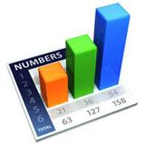
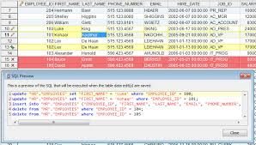
1st Create The Enterprise Foundation that will support all sources
Source Data
Consumption
  IRI
  Nielsen
Retailer POS
  Walmart
  Kroger
  Target
  CVS
  Metro, etc.
Master Data
Trade
Shipments
COGS
Orders
Forecast
BlueSky Integration
Studio
Tableau
or Other tools: Qlik
Business Objects
Cognos, etc.
Process Control
Data Foundation
BIS
POSmart
DSR
BlueSky Analytics
Pre-designed
Retailer & Integration
Processes
BIS
  TradeSmart
Stage
Conform
Harmonize
Validate
Cleanse
Data
Control Center for Data Management
PromoPro
Complex Source Data
Automated Harmonization
& Integration
BlueSky Analytics & PromoPro
Feed Other Systems

Slide 5




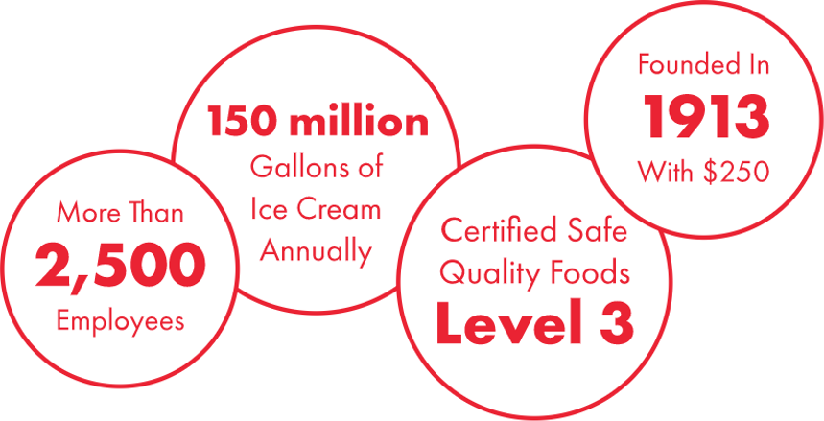
About Wells Enterprises
~ $1.3B Sales

Slide 6






Wells Revenue Management team
7 FTE… Over 50 years combined experience in Consumer Products and Retail
  Advanced Analytics, Pricing Strategy, Consumer/Shopper Insights, Brand Management and Merchandising
Advanced degrees in analytics, pricing strategy and consumer marketing

Slide 7
Revenue Management more than just Pricing
Revenue management is the application of disciplined, integrated analytics that predict macro and micro consumer behavior, and optimize product availability and price in order to maximize business goals.
Right Product
Right Consumer
Right Time
Maximize Sales and/or Profit
Adapted from https://en.wikipedia.org/wiki/Revenue_management

Slide 8
The RevMan challenge
Primary
Secondary
Develop data-driven pricing strategies and processes that maximize business goals while driving the analytical maturity of the organization
Build integrated analytics capabilities for Retail, and enable systematic Trade Promo Effectiveness for Wells and its customers

Slide 9
RevMan maturity
Pre 2015
Internally-focused, tactical pricing
2016
Challenging the status quo
2017-19
Capability enablement
Administrative work for sales
Cost+ / GM% mentality
Majority tactical and systems support
Basic reporting and ad-hoc analyses
Collaborative data infrastructure
Go beyond ad-hoc: insights + faster, reactive strategy shifts
Value-based pricing mentality
Smart pricing architecture
Holistic, data-driven decision making
Reproducible, integrated pricing analytics
Whitespace opportunities
Surgical approach and proactive price and investment adjustments
Fast, scalable analytical iterations
Data fluency for sales, marketing, category management
Chain revenue management (external)

Slide 10
Analytical maturity
Pre 2015:
Basic reporting
2016:
Advanced reporting/
essential analytics
2017:
Advanced analytics
2018+:
Prescriptive analytics
Operational
Rigid
Long dev cycle
Burden on IT
Self-serve, interactive (Tableau)
Descriptive / exploratory / diagnostic analytics for all internal and external data
Demand, elasticity modeling
ML techniques
Process automation (data acquisition)
Integrated data
TPE
Optimization of customer investments
Quasi-automation of promo plans

Slide 11
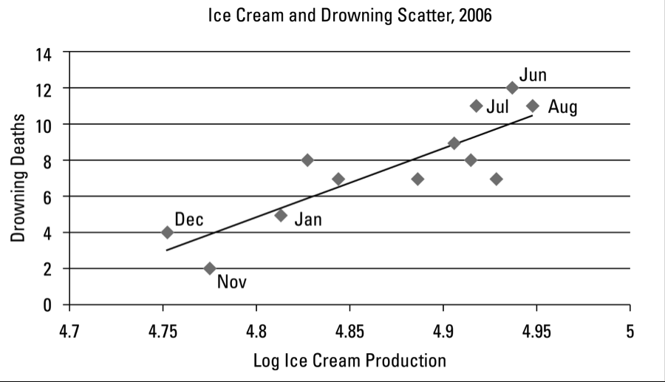
Consume with care…

Slide 12
Challenges remain
  Great coverage for retail…other business areas (e.g.: Food service) lagging consumption data
Data acquisition
Human capital
Time
  Often reactive vs. proactive
  Brain surgeons administering cold remedies
  Hard to find the “unicorns”

Slide 13


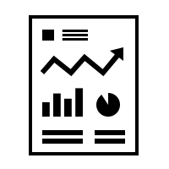

The CPG Data Hurdles
Submit reports
?
Inconsistent reports lead to questionable decisions
So productivity lost to gathering, cleaning, integrating, justifying
With most time spent gathering disparate data
Nielsen, IRI, NPD
Kroger
TPM-Demantra,
SAP, etc.
Metro
Costco
Walmart
Safeway
Shipments
Forecasts
Sales Forecasts

Slide 14

What makes it so difficult?
Gathering, Cleaning, Integrating and Justifying means…
Every Retailer Provides
Different Data Elements
You Are at the Mercy of
Retailer Decisions
Every Retailer Provides
Different Data Elements
Lack of Integration &
Manageability
Different Sources?
Different Reliability
Data Formats Vary
From Source to Source
Different Sources?
Different Reliability
Constantly Changing
Conditions
Everyone Wants to See
Data Differently
Data Frequency is
Inconsistent
Everyone Wants to See
Data Differently
Big Data, Omni-Channel
& New Data Sources
POS Not Always Available
& May Cost Money
POS Not Always Available
& May Cost Money
End User
Requests Change
End User
Requests Change

Slide 15



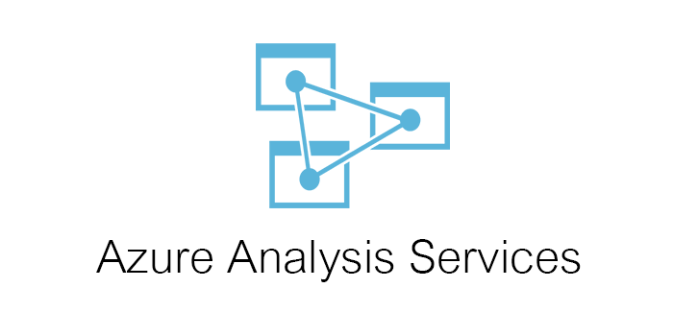




Pricing analytics evolution needed an integrated Data Warehouse
Flexible
Scalable
Performant
CONNECTIVITY = MULTIPLE TOOLS / SAME DATA
Blue Sky Analytics

Slide 16


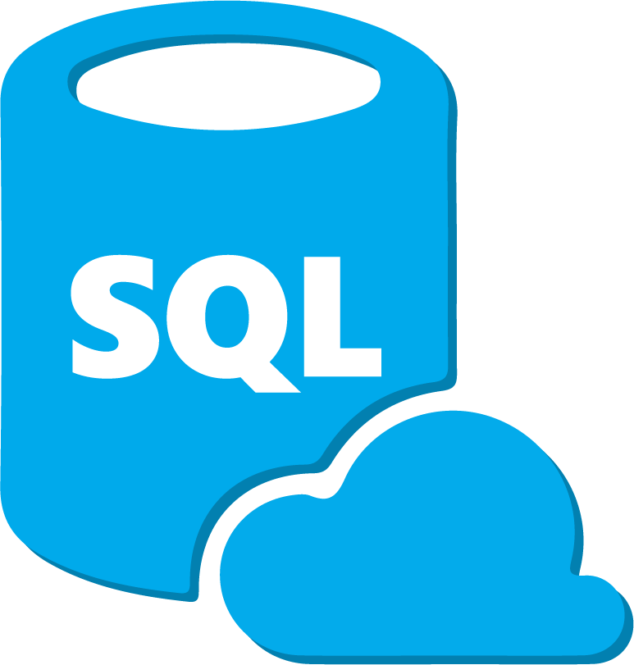



Using modern BI tools + open source
BI / analytics
Advanced analytics
Microsoft Azure SQL Data Warehouse
Fast, Cloud Based
Supervised & unsupervised ML methods
Blue Sky Integration Studio (BIS)
ETL Tool – Capable of connecting to many different platforms
Process automation / data acquisition
Tableau
Best in Class Analytics Software
Microsoft Azure Analysis Services
Cloud Based Cubes

Slide 17
Machine learning use cases
Using raw consumer response data (n=3000), determined drivers of purchase intent (RF model)
  Created significantly more accurate price-value maps to understand trade-offs
Conducted basic forms of NLP from social media commentary on own and competitive brands to understand impacts of pricing & product strategy shifts on consumer sentiment
Leveraged store level POS data to develop proprietary demand models (ensemble) that focused on accuracy vs. descriptive/coefficients
Built (vs. purchased) elasticity models
Automated external data acquisition via Python

Slide 18
TPE capabilities: ~ 85% trade $ coverage in Retail
Syndicated market data
Data cleansing: Missing / incorrect trade $ data imputed and corrected via analytical process
Master promo record: Variety of related offers systematically tied together (e.g.: shopper marketing, ad fees, short-term promo, long-term EDLP, etc.)
Flexibility: evaluate Wells or Retailer ROI at the week, market and UPC (product) level
Internal trade $
Integrated TPE Data
Trade Offer Details
Circular / ad data
Internal price, cost

Slide 19
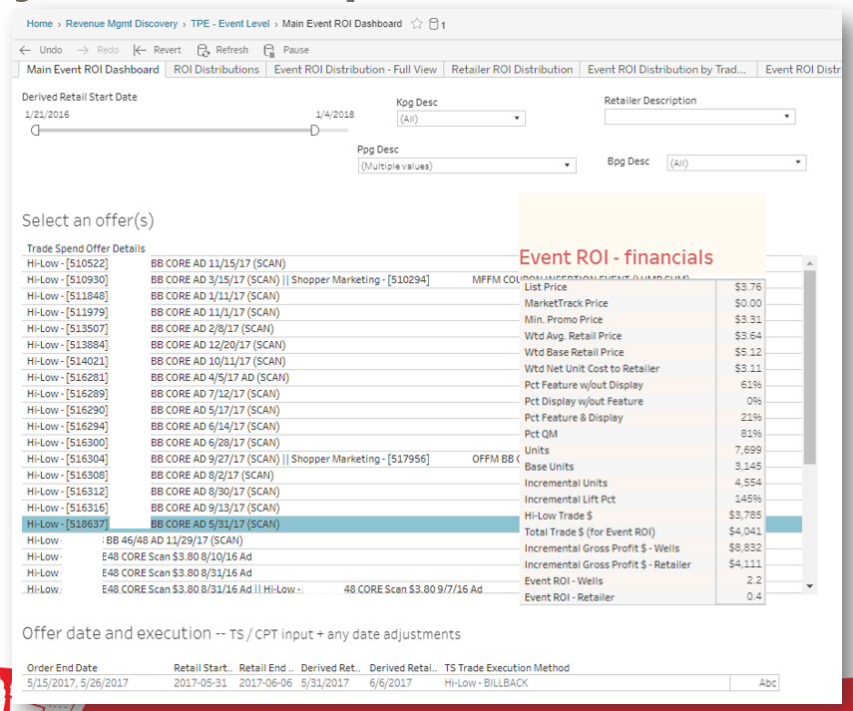
Ability to evaluate promotional ROIs for 1 event…

Slide 20
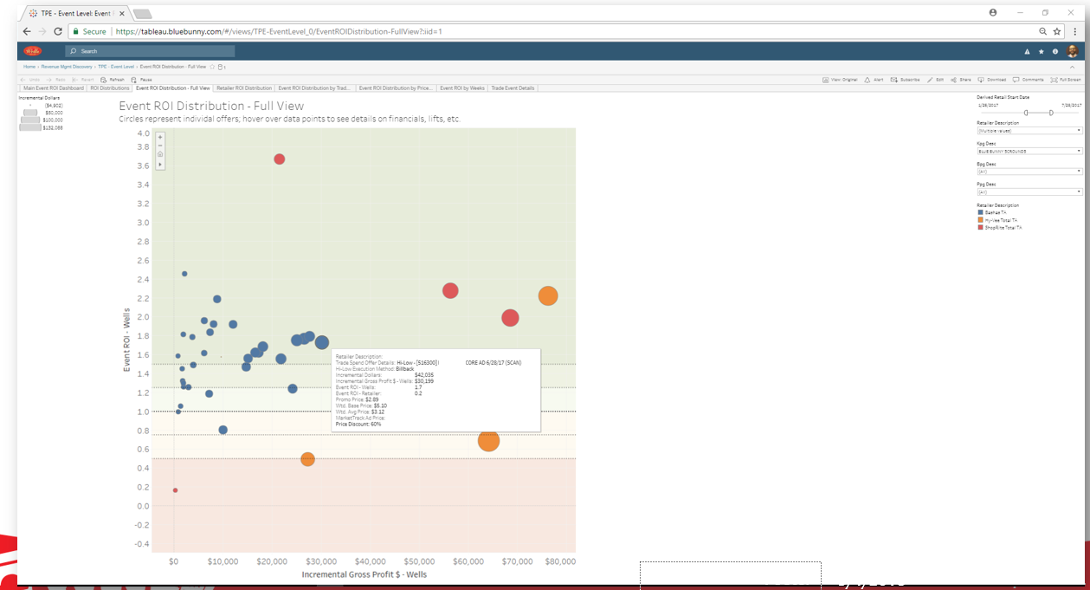
…compare and contrast many promo events

Slide 21
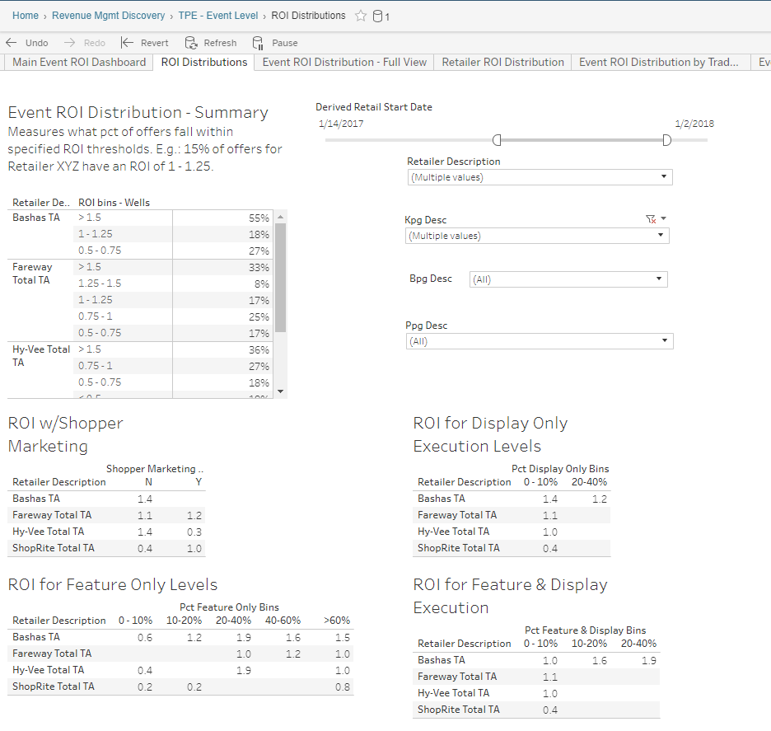
…and observe useful macro insights

Slide 22

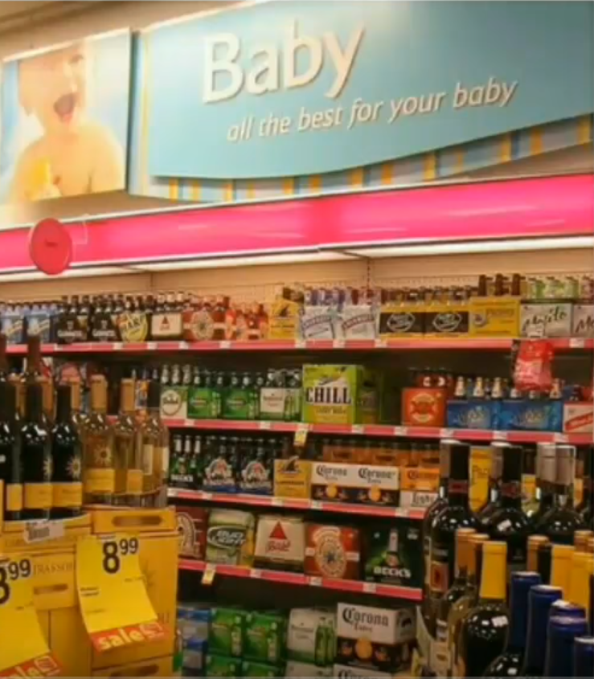
But of course, execution > analytical sophistication…

Slide 23

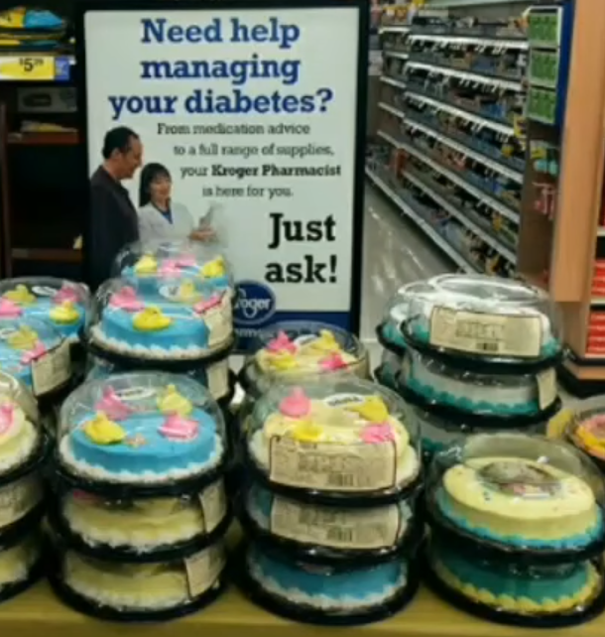
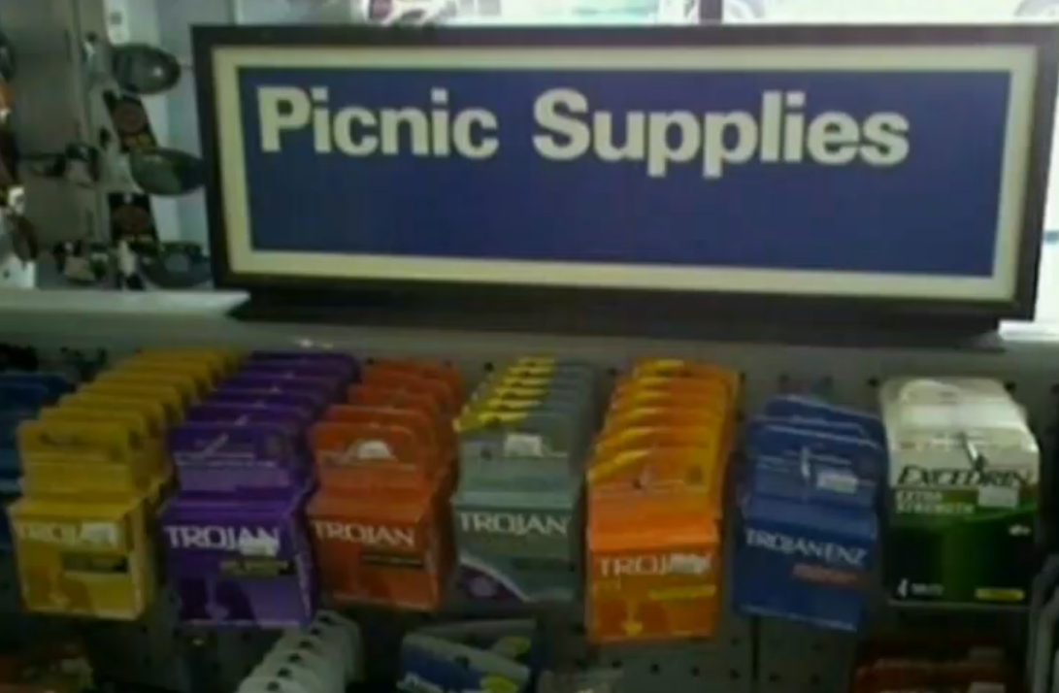

Slide 24
Thank You

