Slide 1
Journey to revenue optimisation
Chris Lemon, Coca Cola Hellenic
Nick Ryan, Acumen

Slide 2
Myth busting!
It doesn’t have to be perfect!
It doesn’t have to be a struggle!

Slide 3
Introductions

Slide 4
Where we were

Slide 5
We needed to act - 2012
KAM = Admin
Low forecast accuracy
All about liquid
Silos / blame game

Slide 6
Business efficiency
Spend effectiveness
100+ KAM days a year saved on forecasting
Weekly forecast accuracy improvement +13%
Time saving - 3 days vs 6 weeks pack re-engineering
Reduced clashes
Embedded across the business
Removed loss making promotions
Optimisation: +34% improvement identified
Reduction in over-buy: €1M identified in single customer
Removal of quarter end push
Customer fine-tuning (funding models / display impact…)

Slide 7
The journey

Slide 8
We have partnered on a journey
Need for control and transparency
RGM agenda to deliver
Top down sponsorship
Aligned organisation
RGM consulting expertise
In depth understanding of business challenges
Agile way of working
Modular solution

Slide 9
We have made progress every year
2013
2014
2015
2016
2017
2018
Implementation
Adoption
Embedding
Success requires a holistic approach
Tools / Insight
(Hand)
Process
(Heart)
Capability
(Head)

Slide 10
A working solution was in place in 16 weeks
 | Month 1 | Month 2 | Month 3 | Month 4 | Month 5 | Month 6
Project planning
Phase 1 implementation:
Implementation review + next phase plan
Engagement
Requirements
Data collection & validation
Initial configuration + phased UAT
Go live, training

Slide 11
2013: “What about this new Invest thing?”
2013
Implementation
Tools / Insight
(Hand)
Phased implementation
Trust + onboard
Visibility
Eureka moments

Slide 12
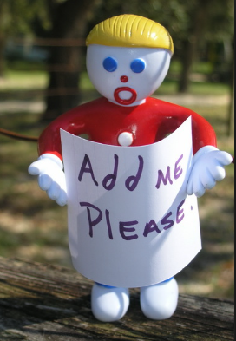
2014: “I can input stuff, but how do I make decisions?”
2013
2014
2015
Implementation
Adoption
Capability
(Head)
Tools / Insight
(Hand)
Process
(Heart)
Capability modules
Channel views
Scenario planning
More customers!

Slide 13
2014: “I can input stuff, but how do I make decisions?”
2013
2014
2015
Implementation
Adoption
Capability
(Head)
Capability modules

Slide 14
2015: “How do we really get the most out of the tool”
2013
2014
2015
Implementation
Adoption
Capability
(Head)
Tools / Insight
(Hand)
Process
(Heart)
Optimising promo
management process
Formalised promo
guidelines / approvals
Capability modules
Budget: bottom up

Slide 15
2015: “How do we really get the most out of the tool”
2013
2014
2015
Implementation
Adoption
Capability
(Head)
Tools / Insight
(Hand)
Process
(Heart)
Embedding in the business process
Clear criteria for promo approval
Criteria | Checks the promotion
Depth of discount | Is in line with strategy
Incremental profit >£0 | Is cash generative
GP % > X% floor | Drives % margin
Uplifts within +/-x% | Forecast is robust
Negative GP | Is cash generative
Optimising promo
management process
Formalised promo
guidelines / approvals

Slide 16
2016……Big Changes!

Slide 17
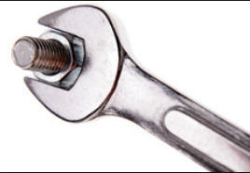
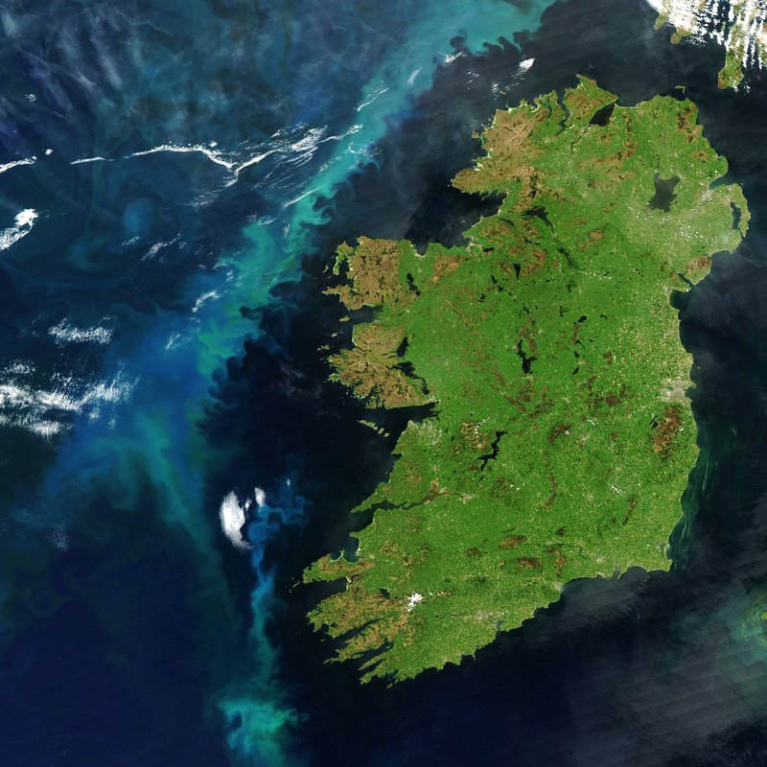
2016: “With all this change, lets focus on making better decisions”
2013
2014
2015
2016
2017
Implementation
Adoption
Embedding
Capability
(Head)
Process
(Heart)
Capability modules
Adjusted promo
pre approvals
Total business
decision making
Extended planning
horizon

Slide 18
2017: “Are we really making the best decisions?”
2013
2014
2015
2016
2017
Implementation
Adoption
Embedding
Capability
(Head)
Tools / Insight
(Hand)
Process
(Heart)
Capability modules
Promo optimisation
Display effectiveness
Live month discount
optimisation

Slide 19
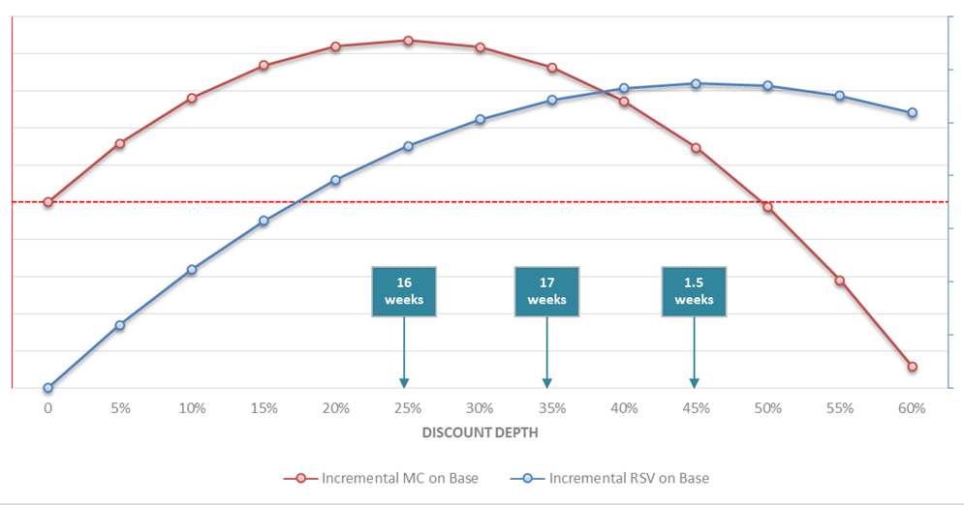
2017: “Are we really making the best decisions?”
2013
2014
2015
2016
2017
Implementation
Adoption
Embedding
Capability
(Head)
Tools / Insight
(Hand)
Process
(Heart)
Identifying optimal promo mechanics
Promo optimisation

Slide 20
2018: “Lets hit the accelerator – Sugar tax could change it all!”
2013
2014
2015
2016
2017
Implementation
Adoption
Embedding
Capability
(Head)
Tools / Insight
(Hand)
Process
(Heart)
OPMP #2
Invest integration to
KAM curriculum
Revised evaluation
process
Optimising ROI

Slide 21
Value delivered

Slide 22
We have made huge progress over 5 years
Revenue Growth Management Capability
Capability assessment
Approvals workflow launched
Promotion optimisation analysis
2015
2016
2013
2014
2017
2018
KAM capability
CCH IRE
Invest launch
Capability modules
Optimising the promotional management Process

Slide 23
Business efficiency
Spend effectiveness
100+ KAM days a year saved on forecasting
Weekly forecast accuracy improvement +13%
Time saving - 3 days vs 6 weeks pack re-engineering
Reduced clashes
Embedded across the business
Removed loss making promotions
Optimisation: +34% improvement identified
Reduction in over-buy: €1M identified in single customer
Removal of quarter end push
Customer fine-tuning (funding models / display impact…)

Slide 24
My personal journey

Slide 25
Learnings

Slide 26
We have taken many learnings from the experience
It’s not about the tool, its about how you adopt and embed
Don’t get hung up on the functionality
Adoption through demand not push
Enabling and supporting
Relentless leadership commitment
Continuity

Slide 27
Any questions?

Slide 28
Happy to talk some more!
Christopher.Lemon@cchellenic.com
nick.ryan@acumenci.com

Slide 29
Thank you

