Slide 1
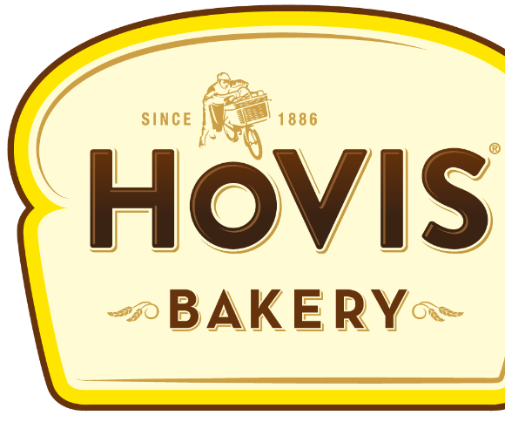
Building an RGM Organisation… Collaboratively.
Applied AI to Drive Trade Effectiveness
Harry Watts:
Optimisation Manager, Hovis Ltd

Slide 2
Background Embedding
Delivering
Developing
Notes:
I’ll talk a bit about the background for the implementation,
How we went about embedding RGM principles into the organisation.
I’ll talk about some of our delivered benefits that we have enjoyed
And also about some of the areas that we are working on further developments and enhancements to our business processes and capability.

Slide 3
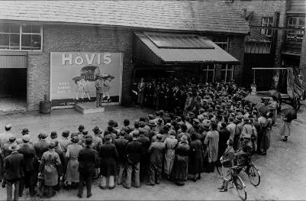
1886
Ridley Scott’s
“Boy on
a bike”:
1973
Team Meeting: 1935
Notes:
The Hovis brand itself dates back to 1886 and during this long history, amongst many other innovations, created what has been voted Britain’s favourite ever television advert: “Boy on a bike” directed by Ridley Scott, who went on six year later to film “Alien”. During our time there have been several changes in ownership, including being part of Premier Foods…

Slide 4
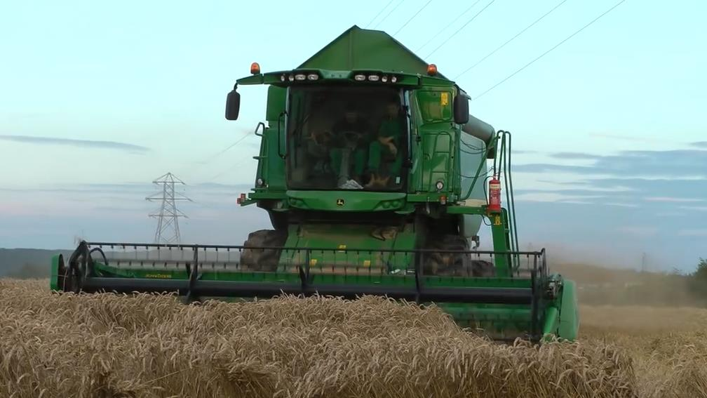
18
Sites
3.5k
Employees
900k
Tonnes
a year
Notes:
We have 3.5k employees across 18 sites, including 9 bakeries and 6 mills where we use about 900,000 tonnes of wheat per year. To put that into perspective the entire Scotch whisky industry uses only 800,000 tonnes of barley a year

Slide 5
10 million
Loaves baked every week
Notes:
In terms of scale at Hovis we bake 10m loaves per week. End to end this equivalent per month to more than the length of the Great Wall of China.
It would take about five months for us to reach the moon!

Slide 6
2014
Notes:
A majority share of the Company was sold in 2014 to the Californian head quartered Gore Group, essentially leaving Hovis as a standalone company.

Slide 7
2017
Notes:
And we were at the POI in Amsterdam last year where we spoke about our business transformation project and how working with UpClear we deployed a solution that was drives all of the Cash flow and financial processes from month end/Accruals posting to payments and invoicing management and reconciliation to Revenue Management capability across promo efficiency, pricing and Trade Terms management to S&OP and demand planning integration
Last year, Hovis joined UpClear at the POI in Amsterdam where myself and our IS Director, Dom Howson, spoke about our business transformation project with UpClear.
We described the positive impact we’ve seen to our financial processes at month end, our accrual management streamlining, our cash flow improvements and how it all ties into our revenue management capability, especially our ability to measure promo efficiency and adjust our forward planning accordingly.
We also spoke about the implementation, the legacy system that we needed to replace and how we integrated Blueplanner into our growing cloud business platform.

Slide 8
People & Process
Solution
Data &
Insights
Legacy System
UI &
UX
NewCo
Capability
Notes:
Last year we focussed on how that solution addressed the core problems that we faced as a business, which we grouped into People and Process AND Solution. It is the people and process piece, with the enabling technology that has enabled us to become an RGM organisation and which I will talk about today.

Slide 9
Background Embedding
Delivering
Developing

Slide 10
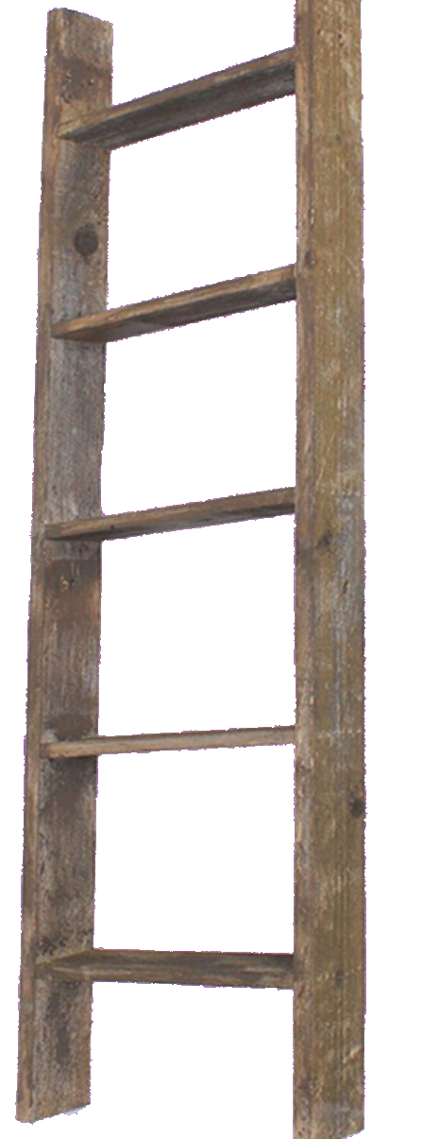
Pricing Ladder
Notes:
Pricing Ladder
Conditionality around channel payments, distribution and logistics
Enabled a pricing structure to be put in place with which to build a defendable pricing ladder for all customers and SKUs

Slide 11
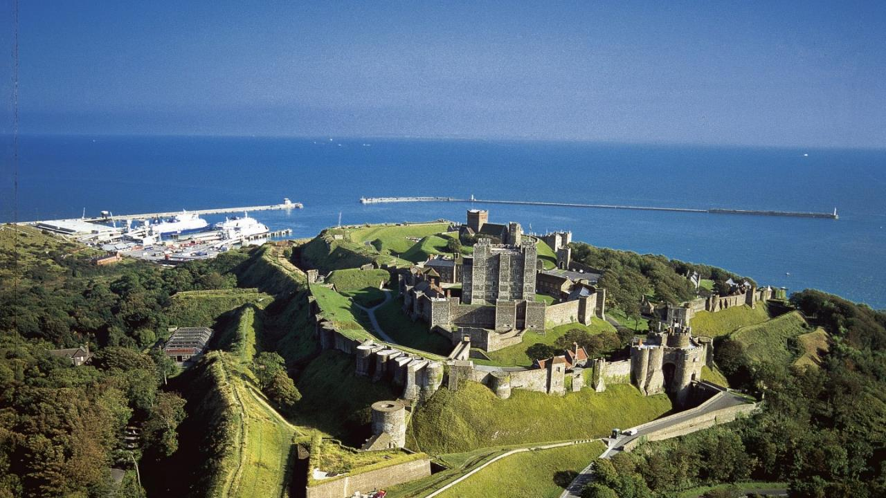
Pricing Ladder
Dover Castle, Kent, England.
Notes:
This defensibility is especially important in the UK at the moment with a number of big name mergers from Sainsbury’s and Asda to Tesco and the countries biggest wholesaler Booker. This blurring of channel distinctions makes the management of pricing across customers vital.

Slide 12
Terms Review
Notes:
Trade Terms Review
Created conditionality and promotional spend buckets to link trade investment to tangible deliverables, driving mutually beneficial activities for Hovis and our customers
This has helped significantly with our ability to articulate which sorts of spend typed and activities are impacting our P&L and thus know where we have levers we can pull to influence our profitability and areas where we do not and it is simply a cost of doing business.
We can tell which spend types are based on conditions that the customer must meet, such as volume levels or activations in store, and which elements are part of the customer’s base margin and cannot be changed outside of a terms reset.

Slide 13
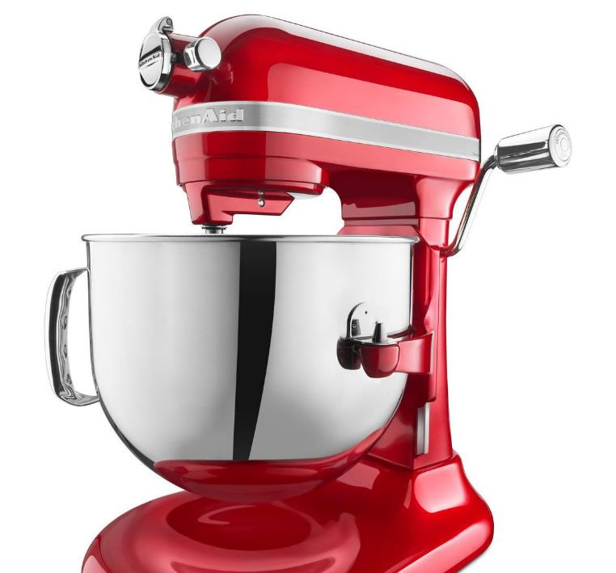
Promo Mix
Notes:
Promo Mix
Increased visibility of the true impact of our promotions with respect to:
Base subsidies
Cannibalisation

Slide 14
Promo Mix
Notes:
This allowed us to stop doing some activities, which I will speak more about in a bit, and focus on value accretive promotions. For example we stopped two major retailer promotions in Q1, because we could see immediately that they had a negative ROI and the savings from this pretty much paid for our annual UpClear subscription fees.

Slide 15
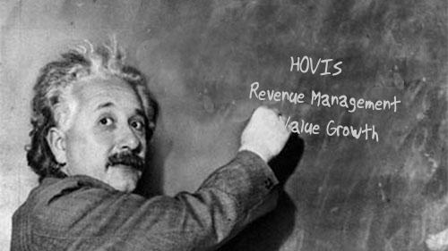
People
Notes:
The other element that was essential was the “People” element, and P&L Training to ensure
Understanding and knowledge of the P&L to ensure NAMs understand the implications
Ensuring the correct allocation of spend to the right “buckets” based on clear conditions
Enabling the business to have insight into significant drivers of spend across the P&L and knowing which buckets can be directly influenced

Slide 16
Background Embedding
Delivering
Developing
Notes:
So what has all this delivered for us?

Slide 17
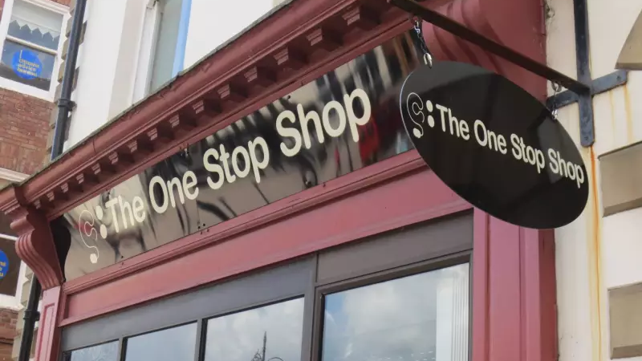
User-Centric
Notes:
For the commercial teams we now have thanks to UpClear a “One Stop Shop” solution where they can manage and have visibility of all their promotional spend across both short term activities and long term over riders. We have even had account managers thanking us for deploying the new solution…
It has:
Brought all the data into one system to drive plan / execution and evaluation
Systemized forecasting, removing off-line workarounds, to give complete visibility
Increased efficiency: Removing multiple system log in, improving Ways of Working

Slide 18
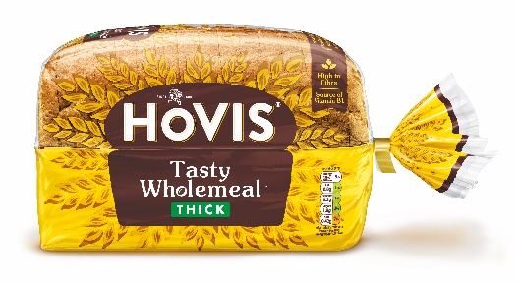
Account Planning
J
F
M
A
M
J
J
A
S
O
N
D
Notes:
… if for nothing else they can now plan their annual promotional activities in an hour rather than six weeks it took previously.
Also though as a business we are able to get complete visibility of all the planned activity and have the ability to align this across retailers for example with Above the Line marketing events to ensure that we have true Through the Line promotions.

Slide 19
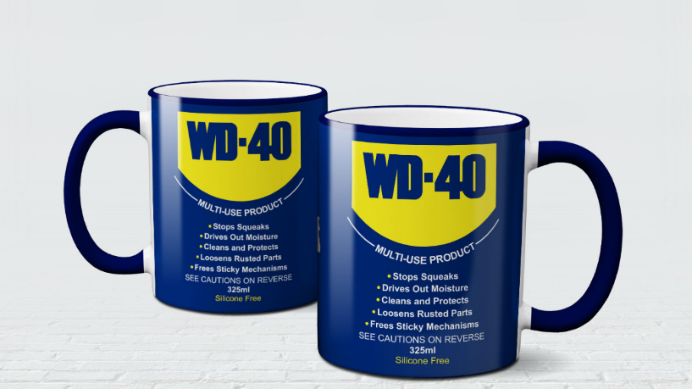
Supplier Agreements
Notes:
It has also help the commercial teams to create their annual supplier agreements (JBPs), by giving the ability to have fact-based discussions with their buyers, oiling the process and driving collaboration.

Slide 20
Optimisation
33% Less Promo Spend
Notes:
Number of promos reduced 2018 vs 2017 by 1/3rd
Top line held
Bottom line growth

Slide 21
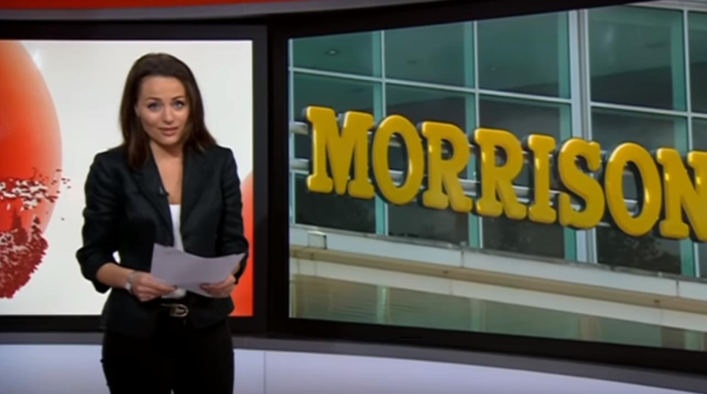
Reporting
BUSINESS NEWS
HOVIS HAVE VISIBILITY OF THEIR TRADE SPEND ACROSS ALL CHANNELS AND CUSTOMERS ■ DEPLOYING UPCLEAR’S REVENUE MANAGEMENT SOLUTION HAS ENABLED HOVIS TO OPTIMIZE THEIR PROMOTIONAL PLANS ■
Notes:
One of the major issues that we were having specifically was due to having spreadsheet workarounds to manage over-riders and lumps sums. These gaps in our financial reporting didn’t allow us to have full visibility of the P&L without a lot of manual work, which limited the time available gain insights from post-promotional evaluation.
This is now no longer the case and we can quickly financialise changes to the forecast for example and have complete visibility of the commercial P&L.

Slide 22
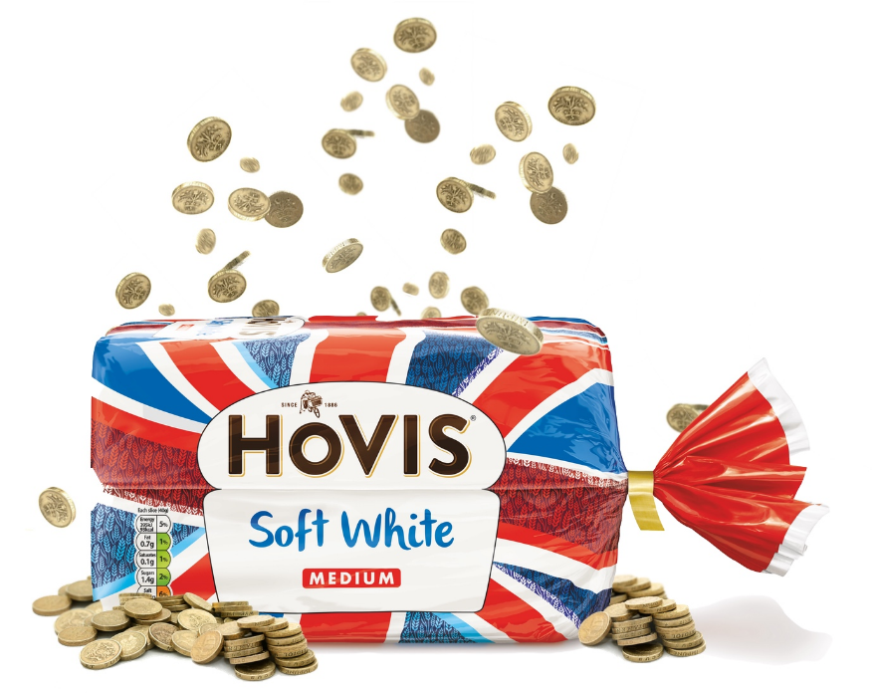
Cash Flow
Notes:
Control and visibility around accruals and releases.
Tighter Accruals
Managing the trade spend in the system that manages our Accruals
Output at month can be interfaced directly with Hovis balance sheet
Accruals are managed more closer to Actuals to allow better cash utilisation
Quicker Payment Process
Allowing better balance of unmatched accruals
Improving control over accruals
Accounts Receivable and NAMs able to quickly process documents
Reducing Aged Debt
Important measure for cashflow and lending facilities

Slide 23
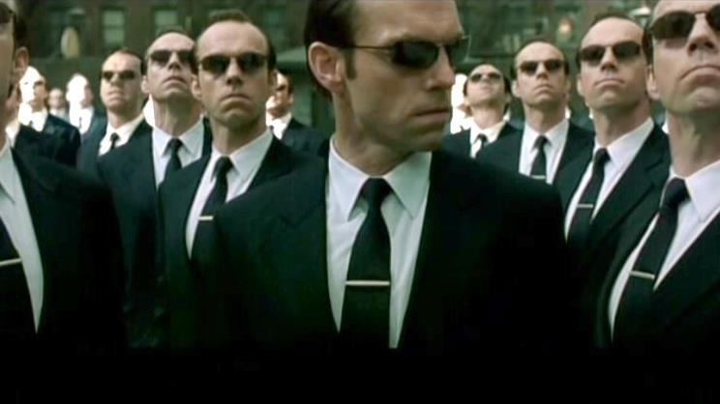
Auditors
Notes:
Governance and Control
- Auditors approval very strong – “step change in governance and control”

Slide 24
Background Embedding
Delivering
Developing
Notes:
So where are the next steps that we are talking about with UpClear…

Slide 25
R&O’s
Notes:
The first is around Risks and Opportunities… < HW to finish notes >

Slide 26
Top Down Planning
Notes:
UpClear are also developing some really good Top Down Planning functionality, which taking value and / or volume from a previous period can then be used as the basis for the coming year’s plan. This would allow us to create complete plans by channel quickly and efficiently based on a number of assumptions and growth buckets, which we can then use as the basis for the NAMs to start their bottom up planning process.

Slide 27
Price Tracking
Notes:
Pricing conditionality tracking
Volume targets / core distribution / logs efficiencies / front to back < HW to finish notes >

Slide 28
Promo Optimisation
Notes:
And when it comes to planning, we have been talking with UpClear about their RGM continuum, driving the capability of the business forward, to deliver full strategic functionality, including promotional optimisation, with intelligent “What if?” scenario planning. Given the opportunities that we have already taken to optimise our plans this could potentially be another step change in RGM and value capture terms for the business.

Slide 29
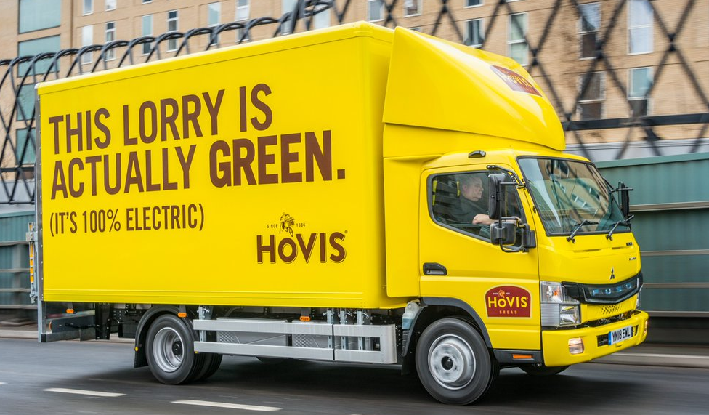
Notes:
And finally, with the information and insight that we now have from UpClear’s solution we are able to begin Supply Chain Optimisation… < HW to finish notes >

Slide 30
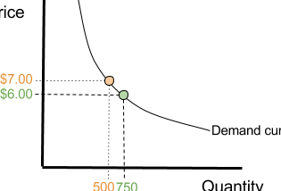
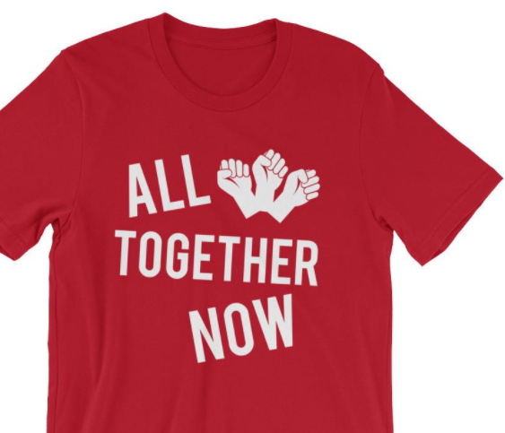
RGM Framework
Trade Promotion Management
Insights
Collaboration
Capability
Trade Promotions Administration (TPA)
Financial
Controlling
(O2C)
Post-Event Analysis
(PEA)
Joint Business
Planning
(JBP)
Integrated Business
Planning
(IBP)
Modelling and Optimization
(TPO)
Notes:
So in summary, working collaboratively what have we achieved in terms of building an RGM organisation? This is UpClear’s RGM framework and together, well we’ve achieved quite lot: we have the basics, in terms of trade promotion management, O2C and insights very much in place. The next steps are to take the information and visibility that we now have around not only trade spend but at individual customer profitability level and leverage further to optimise the P&L.

Slide 31
Thank you.
Initial project sold internally as:
“A vital step to enable business transformation towards trade spend and profit optimisation”
Since Deployment:
Dramatically reduced requirements for planning time leading to increased focus on course correction with significant ROI benefits realised as a result.
Notes:
Thank you.
Can I take any questions from the floor?

