Slide 1
Delivering Profitable Growth with Customers - Supporting Sales to Create Winning Plans
Tom Driver
Head of Commercial Transformation, pladis UK

Slide 2
Agenda
Brief overview & update
Crawl; Embed, Stabilise & Build Trust
Walk; Refine Processes & Understand the Data
Run; Change the way you go to Market
Notes:
This year we’ll focus on how the tool has landed, a couple of key learnings and how we are using the tool now to change how Sales build their plans.
So for today I’ll give you an overview of the project and an update to where we are I’ll then talk about how we are getting to grips with the new system and the way we are working with it

Slide 3
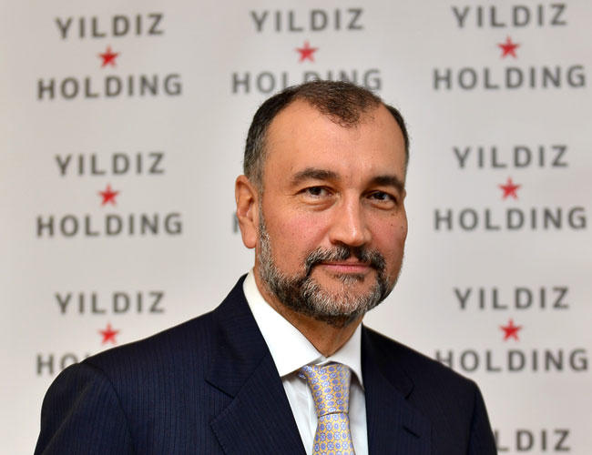
Let’s start right at the end….
GO LIVE
PHONE CALL
CIO TRAINING
CIO DEMO
16th Nov 17
5th Feb 18
6th Feb 18
7th Feb 18
Why have we spent £xxx on this project?!
I’m there in 2 days, tell me then

Slide 4
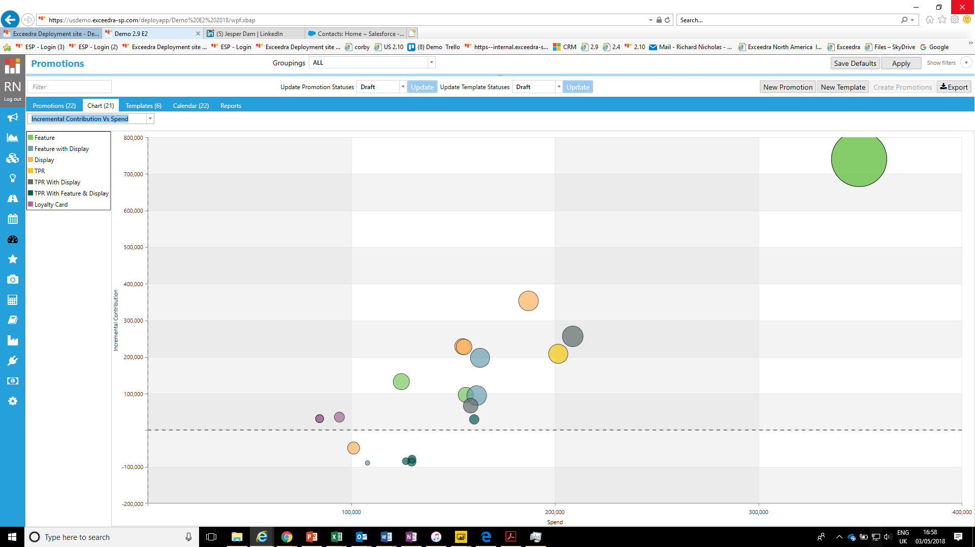
A couple of weeks ago….
I want to see Tesco Q2 promotions on Biscuits
Can you explain to me why we are losing money on these promotions?

Slide 5
How did we end up here?!

Slide 6
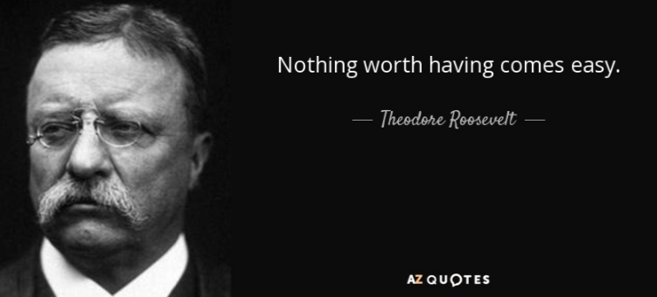
Notes:
I thought I’d start with our last slide from last year. These projects are not easy. They are complex, involve multiple stakeholders and agendas. It will involve compromise and changing the way the business works If I boil it down to its core, I would say this… on the road to success there are no shortcuts

Slide 7
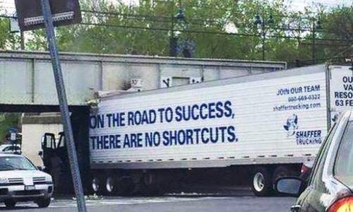

Slide 8
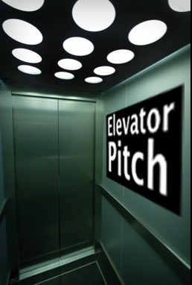
Project overview…
£240M TI
55%
-£££M
5,300
£8m
15%
90 days per wk
Full Time Team
67 workshops
18 months
1.3
Years
Notes:
So where did it all start... Well this is the only slide we used when getting our board to sign off the capex for the project and gives a brief summary.
So why is there a need to improve the way we manage promotions internally - We currently spend £240m of trade investment across 5,300 individual promotional activities, - The system we use to plan these activities and manage this spend was designed in the 1980s and is no longer fit for purpose - Despite a huge amount of effort our promotional forecast accuracy is just 55% which drives a £16m negative TGC swing between what we plan for our promotions to deliver and what actually happens - We spend £8m each year on overhead for a market leading sales team - Yet on average each member of this team only spends 15% of their time on customer facing activities - This is because a eye watering 90 days / week is spend by the sales team reconciling numbers from multiple systems, completing manual tasks that should be automated and generally compensating for the tools we currently give them to do their jobs
So clearly there was a problem to solve......
- The great news is that the business has committed a significant investment in a market leading promotional management system which will benchmark us against the best in our industry - The implementation of this is no small task and there has been a full time project team working tirelessly on this for over 18 months - And we are now beginning to track payback for the project investment which we believe will take a little over a year

Slide 9
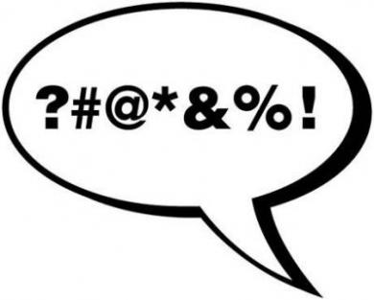
3 Key Learnings….
This is your chance to be a genius!
“Data” is not a dirty word Blackadder…
but “Customisations” is a positively disgusting word
Notes:
To touch on our key learnings I have 3 of them:
- Learn from others and plan accordingly… then make mistakes of your own!
We spent a lot of time right at the beginning speaking with other businesses who had done similar projects. Some were successful and some were not.
We took all their learning and put the key ones into our project plan
- Data is not a dirty word
All throughout Exceedra were warning us about our data and, as a business functional guy I took it for read that our technical guys would sort that.
How wrong could I have been
You must take the time to understand the data you are sending into the system as we caused 90% of all the issues we’ve had ourselves.
Understand what the masterdata is, who owns it and how it comes across to the system
- Customisations most certainly is!
We ended up being 5 months late due to customisations and the issues they gave us.
We ended up playing whack-a-mole with them as the knock on impacts caused many complications
Software companies do not want to say no and they love a challenge. However, more customisations means more time, resources and cost.
Right now, we are considering ripping out several of these customisations already. We should have been more challenging of ourselves.

Slide 10
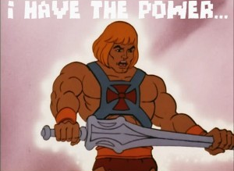
Update on our project
150 Users
116 Last Week
56 Daily
16th Nov 2017
Team Reintegration
Notes:
The update on our project is that we are now live, and went live on 16th November
We have high adoption rates with 130 users, of which 116 entered the system last week. We have 56 users who are in the system daily. This is great but also brings high levels of scrutiny The project team are now all fully reintegrated into the business so the expertise remains. This was one of our key learnings from others. And we are beginning to understand the power of the tool… we are at the very beginning of our understanding

Slide 11
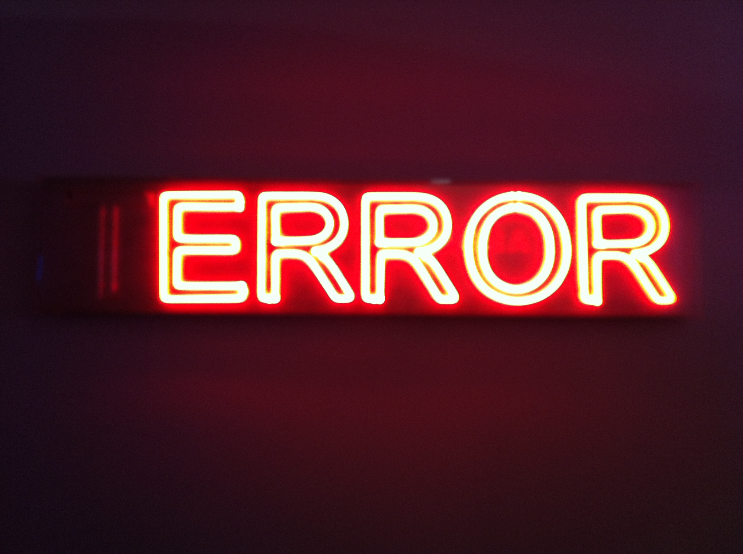
Some early successes…
Time forecasting has dropped from 20% of Sales time to 10%...
Error rates with accruals dropped from 19% to 4% … and that 4% is driven by late sign off
Notes:
Its early days but we have some successes against our business case.
Sales team are spending much less time forecasting, but we still need to refine our process
Accrual errors have dropped massively year on year, and getting it to zero is a real possibility

Slide 12
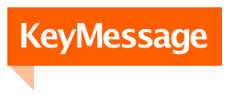
It will not change your world overnight but it will give a platform that you’ve never had before
What you choose to do with this will determine your success
Notes:
So here’s the key message; these types of projects and implementations will not change your world overnight but it will give you a platform, and therefore an opportunity, to make your business better.

Slide 13
Crawl; Embed, Stabilise & Build Trust
Walk; Refine Processes & Understand the Data
Run; Change the way you go to Market

Slide 14
Crawling…
Retain & Use Experts
Reintegrate Meaningfully
Avoid “help” desk
Extend Early Life Support
Get Stable; it may take time!
All departments will learn, sometimes painfully
You’ll cause most of your own issues
Avoid further systems changes
Build Trust
Rubbish in / rubbish out
Prove the calculations
Prove the system
Notes:
So your UAT and cutover goes well and you’re now live. We thought “job done” but we couldn’t have been more wrong! Of course you must embed the tool but with 130 users across 3 sites it’s not been easy. Users are still making basic mistakes or not understanding how the system works so is it best to get them to log a call with IT helpdesk? We decided not to, so we still have our experts about daily to help users during early life support. We of course produced user manuals and training. We also sent out top tips and videos but people will not retain the information and will seek out experts to help.
Stability is also key. We have had several stability issues over the last 4 months and for every 10 of them, 9 have been our own fault. We’ve had the company antivirus interrupt our overnight run and crash the system, we’ve had many bad data issues and a lack of communication around masterdata has been a key driver, we’ve had a massive restatement of actuals going back months cause a huge recalculation of the database that reset our outputs. In short, you have to give yourself a period of time to get stable. The length of this time is directly proportional to the complexity and customisations you’ve put into the system.
We’ve also found we’ve had to build trust by proving the numbers coming out are robust. This involves on-going work to fix the inputs into the system; rubbish in, rubbish out is extremely true when looking at TPM/TPO solutions. We have our pricing and promotion team reviewing baselines as post-evaluation has already shown some big variances that changes our understanding of promotional effectiveness.

Slide 15
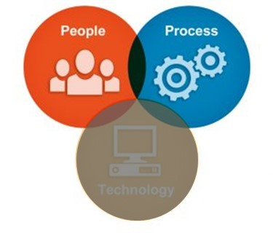
Walking…
Focus on People & Process
Colleagues will only want to talk system
Get the right people involved
Senior buy-in
Understand the Data
Big data sets
Analysis Paralysis
Start small & build
Notes:
We are getting close to walking. It’s important at this point to say this should focus on how we are using the system and how it’s being integrated into the S&OP cycle. In other words; focus on people and process. There is no point spending time on the system as that has been the focus for the past 18 months. We are now actively looking at improving some of our processes around forecasting; we have joint KPIs across teams and refining our S&OP process to maximise the opportunity we have.
The system has given us new data sets and new tools to view them in. We have built several reports to help our understanding and we are getting more and more information out. We are able to see all aspects of how a promotion performed, including our assumptions around cannibalisation and post-dip impacts. There is so much data we are now getting to grips with the important elements so we can improve our go-to-market plan

Slide 16
Running…
An example of how we can change the way we’ve gone to market…
Involves changing pricing, promotional plans & support and funding in a Top 6 customer this year
BEFORE
Manual Excel Process
Prone to Excel Errors
2 weeks minimum
Top line P&Ls only
By period / sub-brand
NOW
One system
Took a morning to run
Output at day/sku level
Robust retailer P&L
Easy to make changes
Notes:
Now I’ve shared that we are learning to walk at the moment, but we have had a couple of instances where we were able to stretch the legs of the system a little and this is around JBPs and a current merger in the market.
We have not fully trained the scenario planning capability yet but we have used a couple of real test cases to build our own understanding.
The first of these was in a top 6 retailer where we were able to model a new promotional plan and look at the impact of changing our investment from one portfolio to another. The prep work from Sales took a couple of hours; identifying which promotions and pricing to change. We took a copy of the current live plan for 2018 and made the changes. This took around an hour and a half. By lunchtime we had a side-by-side view of the impact to our P&L and the Retailer P&L for 2018. This could be broken down to a day level, sku level view with all lines of the P&L included. The account team then presented this to the Sales Director for sign off. So within half a day we had a different commercial plan and the ability to build the materials to take to the account. We believe this will improve our margin delivery by a couple of percent, whilst maintaining the margin delivery in the JBP.
We will measure our delivery against the new plan and that directly forms part of the payback to the business. The trick is how to get the business to use this capability to its fullest extent. Whilst we are still learning the system we wanted to wait before launching headlong into this area.

Slide 17
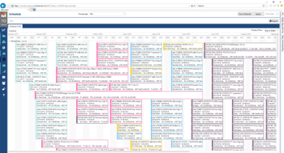
Running…
Preparation
Inputs
Inputs
Outputs
Outputs
Result
Result
Time Taken: 2 Hours
SKU pricing from & to
Promotional depth changes
Promotional funding changes
New promotions
Copy of current 2018 plan taken in Scenario Planning

Slide 18
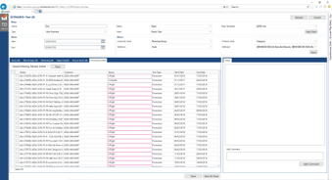
Running…
Preparation
Inputs
Outputs
Result
Time Taken: 1 Hour
New Promotions
Promo Changes
New Pricing

Slide 19
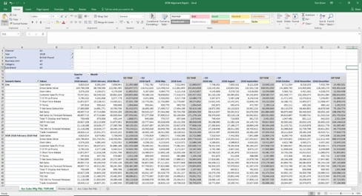
Running…
Preparation
Inputs
Outputs
Result
Time Taken: Live system, Live number!
Our P&L
Retailer P&L

Slide 20
Running…
Preparation
Inputs
Outputs
Result
Taken to the Sales Director next day and approved within 20 minutes
Plan delivers:
+1.5% TGC to pladis
Margin stable for retailer & in line with JBP expectations
Neutral volume
This is now being tracked as part of the system payback

Slide 21
It will not change your world overnight but it will give a platform that you’ve never had before
What you choose to do with this will determine your success

Slide 22
Video…

Slide 23
THANK YOU….

