Slide 1
“UTILIZING INNOVATION TO SOLVE KEY CUSTOMER CHALLENGES IN RETAIL EXECUTION”
Emmanuel Desert, SAP Hybris , Director Product management Sales Cloud
Timo Simon, mahiro GmbH, Director Products, Innovation and Business Development
May, 2018

Slide 2
What are the business Challenges and pain points
How do we support to solve these challenges with innovations?
Key points:
Data Insight
Machine learning
Customer case – Henkel
Retail Execution
maiTour route planning
set the right priorities
Image intelligence etc.
Conclusion in the end, future roadmap

Slide 3
How do we support to solve these challenges with innovations? - Market Trends -

Slide 5
WHAT‘S TRENDING IN THE INDUSTRY?
1.
2.
3.
4.
Brick and mortar stores are here to stay.
Sell experiences rather than products
Rapid expansion beyond traditional Western bases, demanding new levels of value and innovation
Building global scale by aggressively shaping their portfolios via acquisitions
5.
6.
7.
8.
Retail environments are highly competitive with niche players
CPG strategies and investments are heavily influenced by demographic shifts
Consumers are engaged and always connected.
A transforming workforce
Notes:
Trends
While online sales will continue to rise (capturing about 30% of total sales), brick and mortar stores are here to stay. Selling experiences rather than products
Retail environments are highly competitive with niche players
Leading CPG players have not simply followed economic and demographic trends but have actively anticipated them in their strategies and investment choices (The impact of demographic shifts, including aging on consumption patterns)
Connected and engaged consumers
Rapid expansion beyond their traditional Western bases, Aggressively shaping their portfolios via acquisitions leading to the need to Build global scale along every part of the value chain to maintain profitability
Asia will overtake the West as the main consumer market, demanding new levels of value and innovation from CPG companies (A billion new middle-class consumers in emerging markets, spending between $10-$100 a day. CPG companies needing to built a presence in the millions of small outlets where these consumers typically shop)
Endusers?
Inferences Drawn

Slide 6
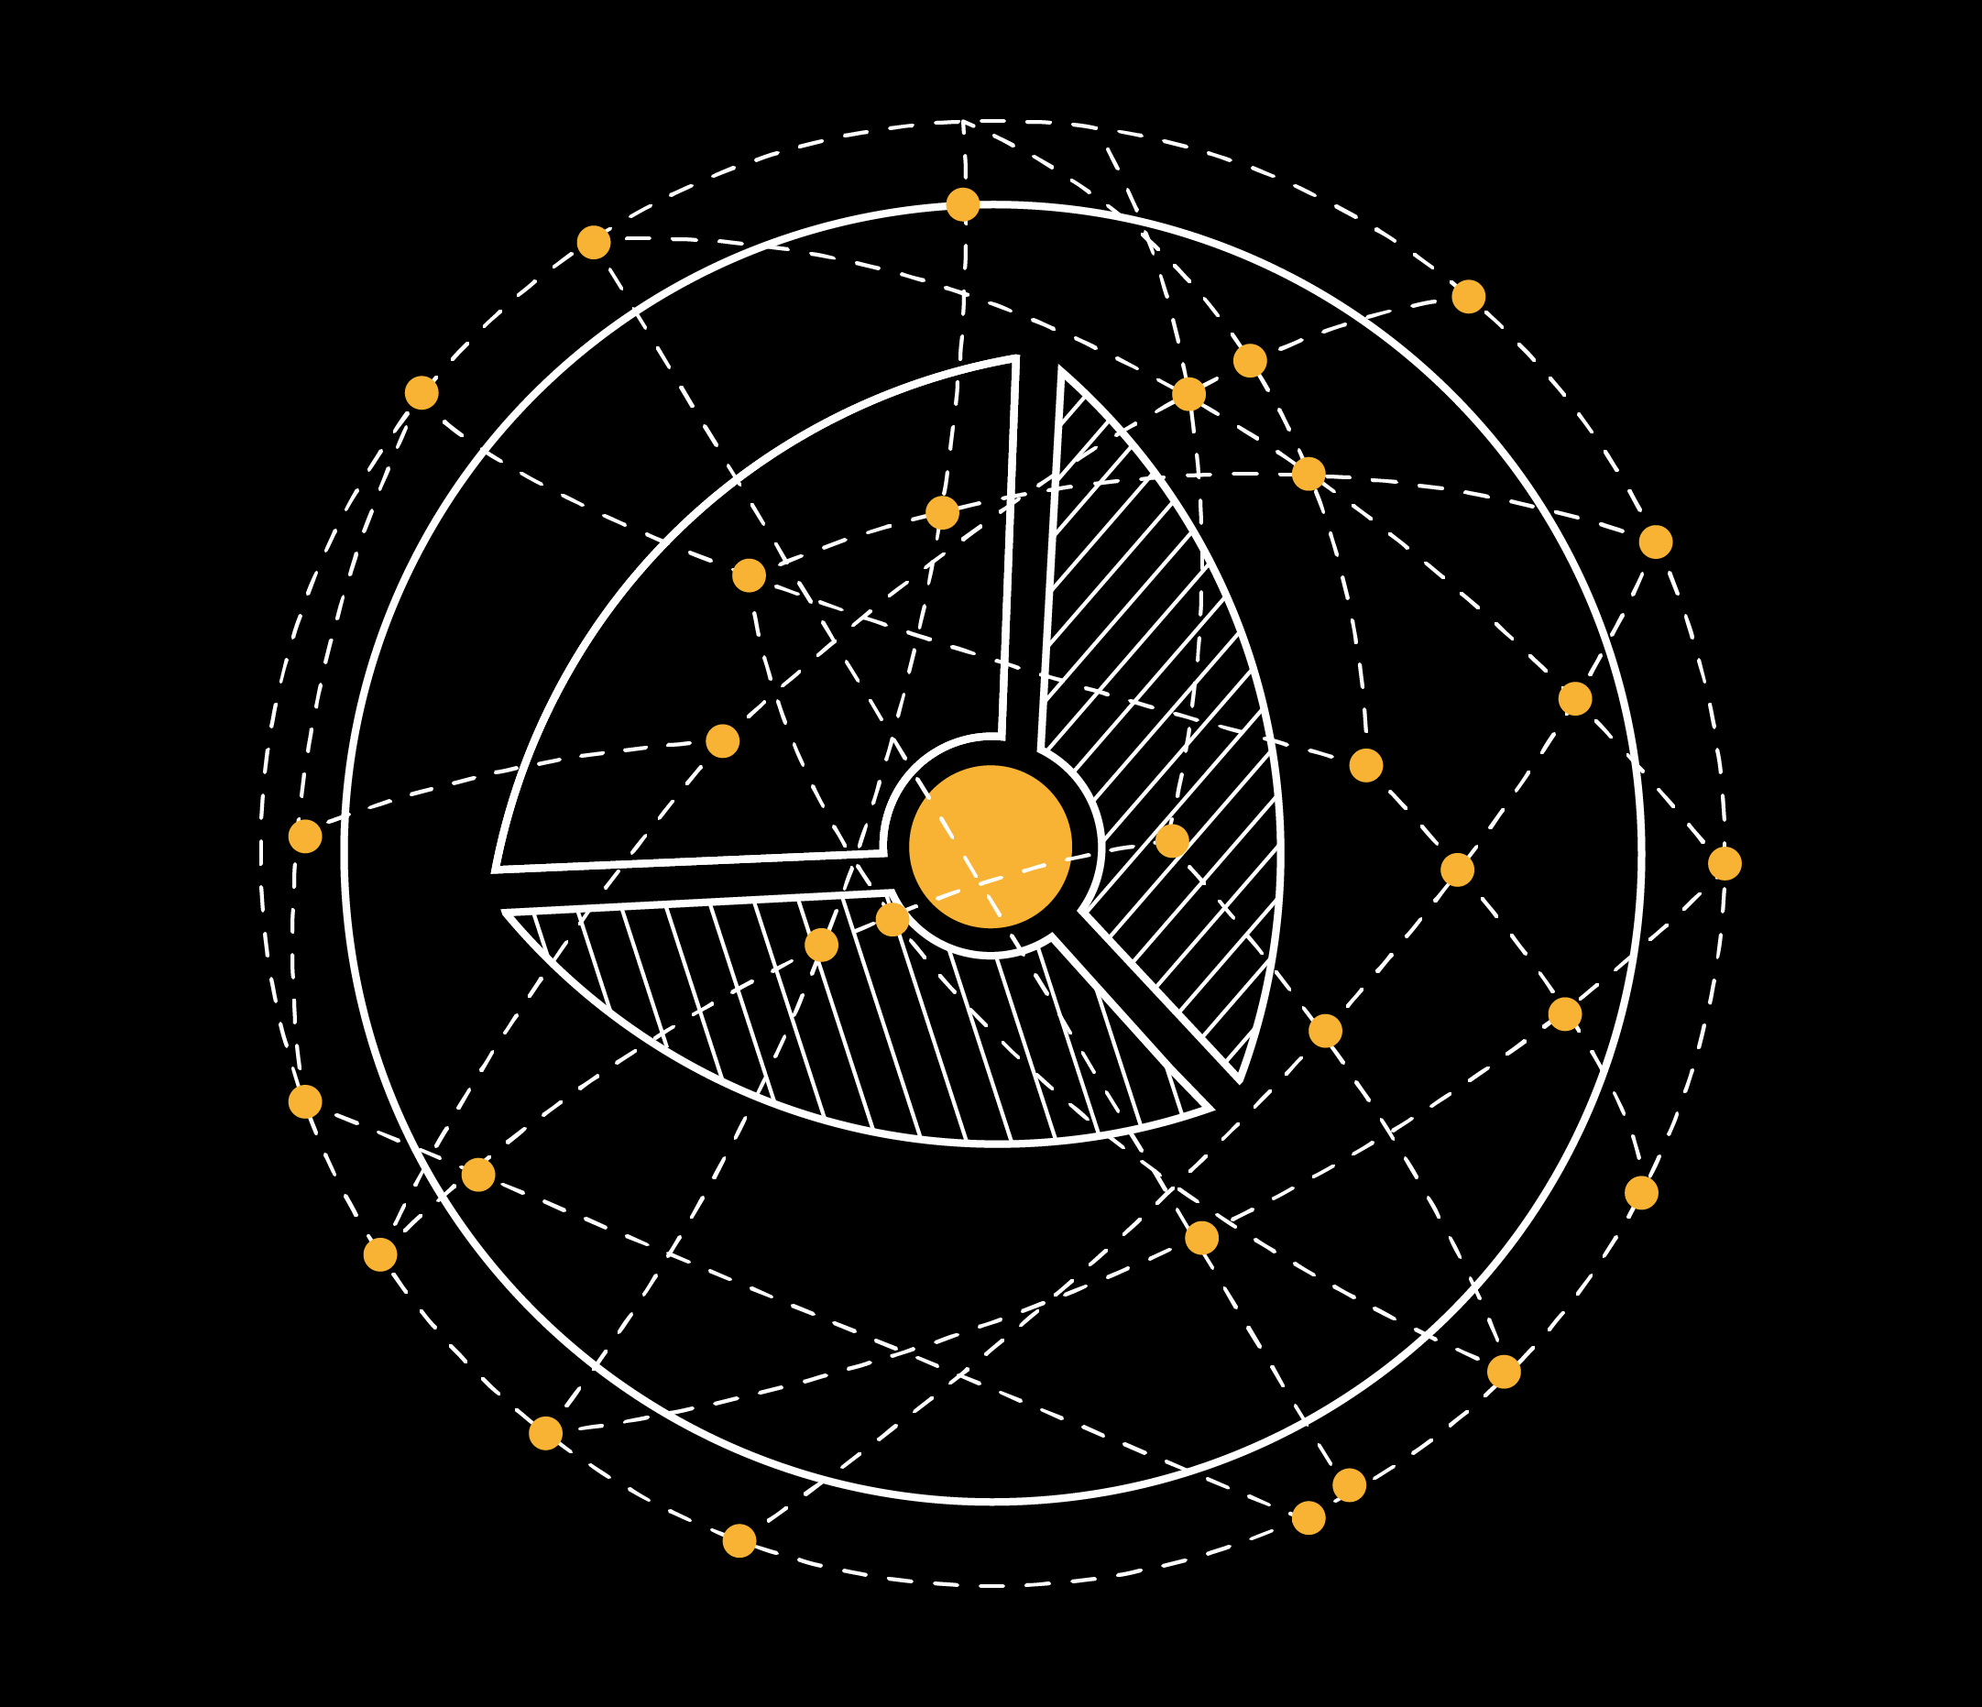
INFERENCES ON PRODUCT EVOLUTION
1
To Measure and Benchmark store experiences
2
A more Effective and Efficient REX, with assist functions to enable consultative selling
3
The NextGen Retail is SMARTER, with Predictive Capabilities
4
Need for a Global Standard (solution) that offers best practice guidelines
6
To build Deeper Collaborations with consumers, using crowdsourcing
5
To Engage the New Workforce with gamification and new collaboration tools
7
Address New Markets enabling distributor led sales execution
Notes:
Trends
While online sales will continue to rise (capturing about 30% of total sales), brick and mortar stores are here to stay. Selling experiences rather than products
Retail environments are highly competitive with niche players
Leading CPG players have not simply followed economic and demographic trends but have actively anticipated them in their strategies and investment choices (The impact of demographic shifts, including aging on consumption patterns)
Connected and engaged consumers
Rapid expansion beyond their traditional Western bases, Aggressively shaping their portfolios via acquisitions leading to the need to Build global scale along every part of the value chain to maintain profitability
Asia will overtake the West as the main consumer market, demanding new levels of value and innovation from CPG companies (A billion new middle-class consumers in emerging markets, spending between $10-$100 a day. CPG companies needing to built a presence in the millions of small outlets where these consumers typically shop)
Endusers?
Inferences Drawn

Slide 7
How do we support to solve these challenges with innovations? - Customers and Co-Innovation -

Slide 8
SAP HYBRIS SALES CLOUD
CUSTOMER ADVISORY BOARD
Notes:
Now, as you have seen throughout the day and the different sessions we have already conducted we are already offering quiet and extensive scope of capabilities.

Slide 9
SAP HYBRIS SALES CLOUD
CUSTOMER MOMENTUM IN CPG INDUSTRIES
Notes:
61% believe their existing IT systems supporting CRM / ERP and the sales environment lag behind the commercial company vision
four (25%) have consolidated analytics across all sales, marketing, commerce and customer services within their business
82% OF COMPANIES HAVE MORE CHANNELS THAN 12 MONTHS AGO
906 marketing, sales. Service, marketing, commerce leaders survey globally and across industires

Slide 10
How do we support to solve these challenges with innovations? - The solution for our customers -

Slide 11
SAP HYBRIS SALES CLOUD
DIFFERENT USERS, ONE SOLUTION
Sales Management
Key Account Manager
Sales Representative & Merchandiser
Service Management
Service Agents, Customer Service
Service Technicians

Slide 12
SAP HYBRIS SALES CLOUD FOR CONSUMER PRODUCTS
Enable field sales efficiency with efficient visit planning and execution
Improve decision-making and sales effectiveness by providing a 360 view of store
Enhance on-shelf availability and drive in-store priorities with flexible activity planning and routing
Help Sales Reps sell better with real-time pricing strongly integrated to SAP Back End Systems
Enable promotion compliance at store by ensuring near real-time availability of promotion information with native integration into SAP TM
Track and enhance field effectiveness and store performance with real time insights on in-store data

Slide 13
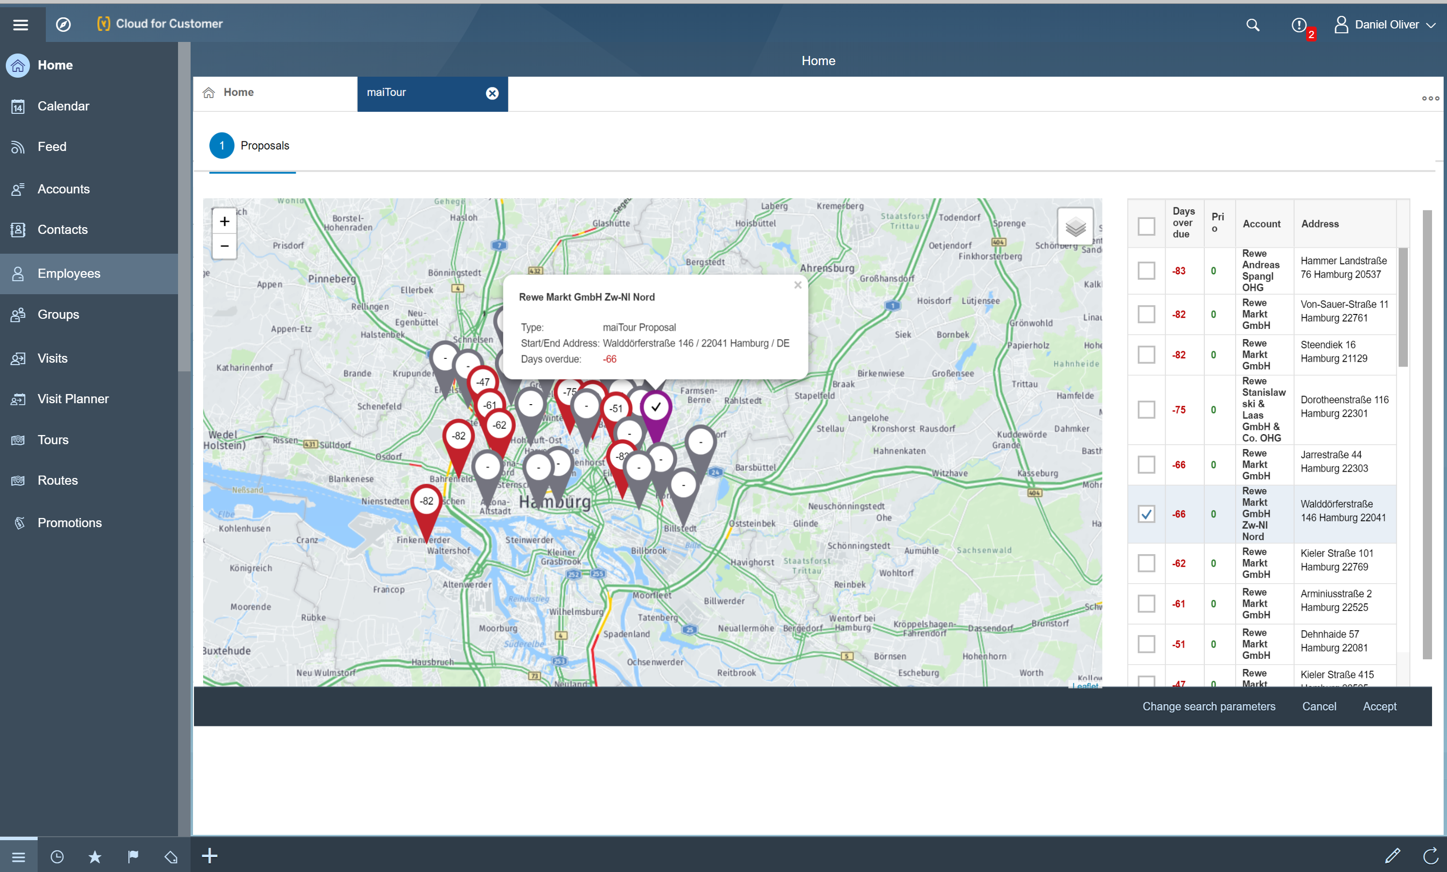
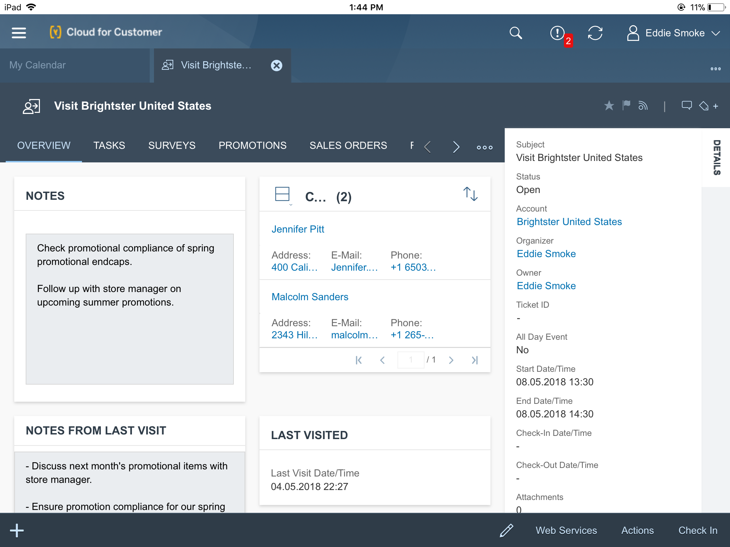
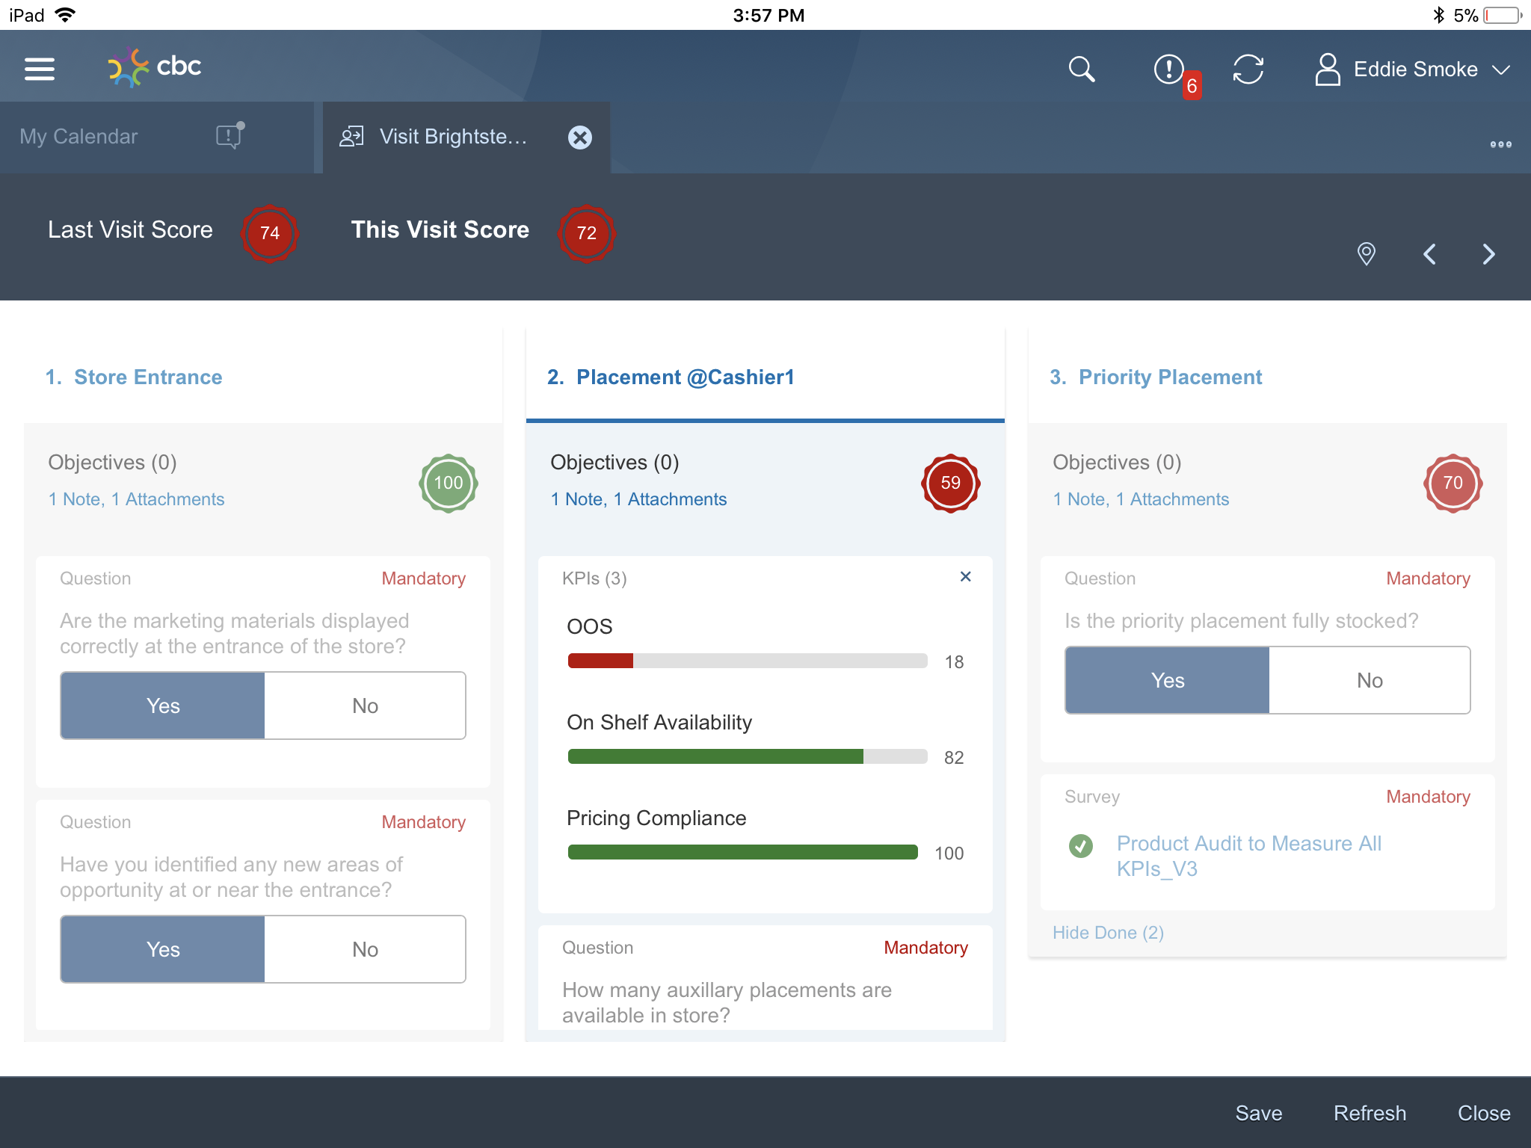
SAP HYBRIS SALES CLOUD
RETAIL EXECUTION
Planning
Preparation
Execution
Analytics

Slide 14
How do we support to solve these challenges with innovations? - Perfect Store – Perfect Experience -

Slide 15
WHY PERFECT STORE?
CONSUMERS HAVE TAKEN THE DRIVER
SEAT.
YOUR STORES HAVE TO ENABLE GREAT EXPERIENCES.
5

Slide 16
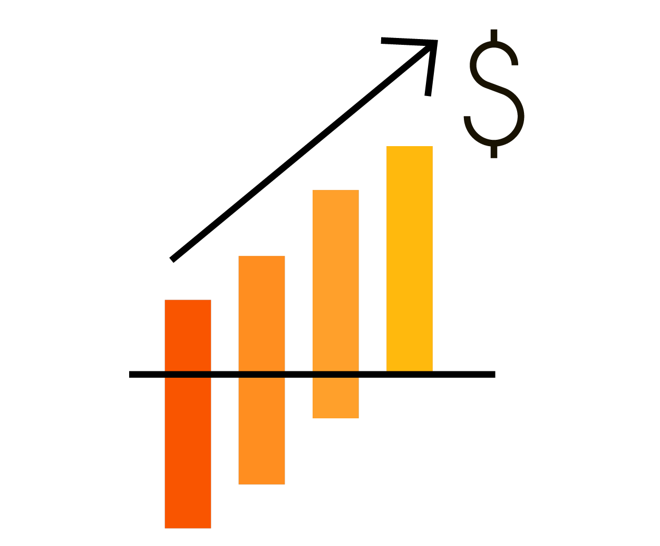
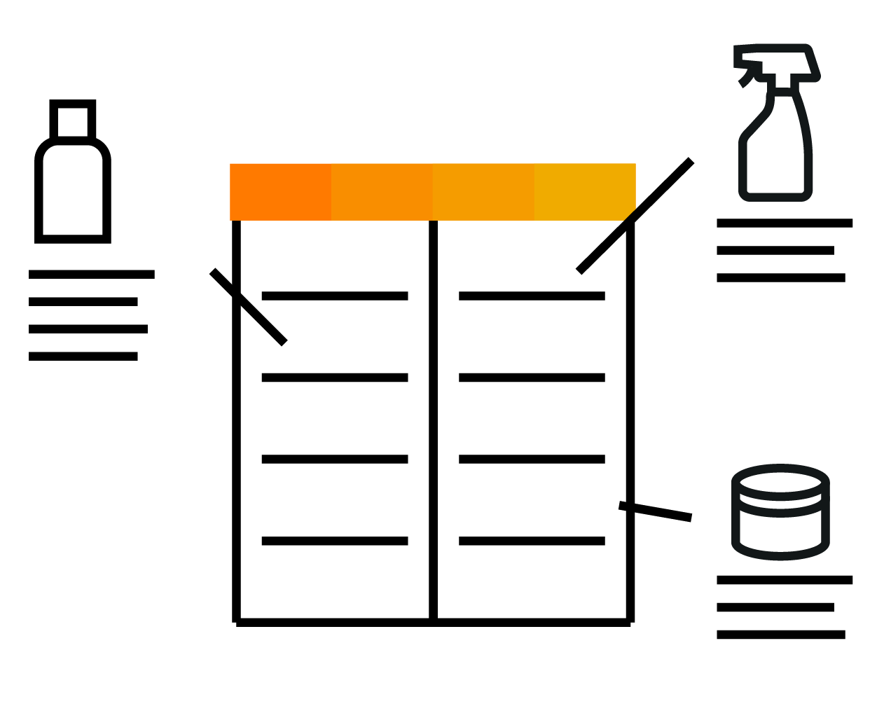
“PERFECT STORE EXECUTION” CHALLENGES
Inability to leverage best practice business processes at the retail level
Incompliant retail stores
Inability to monitor compliance of product distribution, plan-o-grams, trade promotions
Poor return on brand and promotion investments
Paper based and not integrated systems
Incomplete sales decision-making
Lost revenue and customer loyalty
Notes:
The Vision for Consumer Product companies is to achieve the ‘Perfect Store’ experience or have the ‘Perfect Store Strategy’.
The ‘Perfect Store’ is all about having the right product, in stock, at the right price, at the right time while personalizing the customer engagement and offering alternative paths to purchase. The ‘Perfect Store’ experience makes the most of right information at the right time and takes a highly disciplined approach to achieving maximum sales while delivered a personalized experience for the consumer.
Today’s best run consumer products companies have become consumer driven. Cloud for Customer’s Consumer Products value proposition is to help consumer products companies ‘win at the shelf and around it.’ The main focus will be to deliver to the consumer the right products, at the right price, at the right time. Additionally, we believe that personalizing the customer engagement and offering alternative paths to purchase enable the ‘Perfect Store’. These fundamental strategies will ensure better decision making, operational efficiency, and the omnichannel experience to drive revenue, growth, & profit, and support the perfect store strategy.
By becoming “best in class” in these areas, consumer products companies have an opportunity to distinguish themselves in the eyes of their customers and consumers. Consumer products companies position themselves to deliver – consistently – the Perfect Store experience.

Slide 17
Easy guided Wizard to check store compliance

Slide 18
Business User defines the questions and measures

Slide 19
Easy and interactive scoring and guidance after the visit

Slide 20
Sales Rep checks into SAP SALES CLOUD

Slide 21
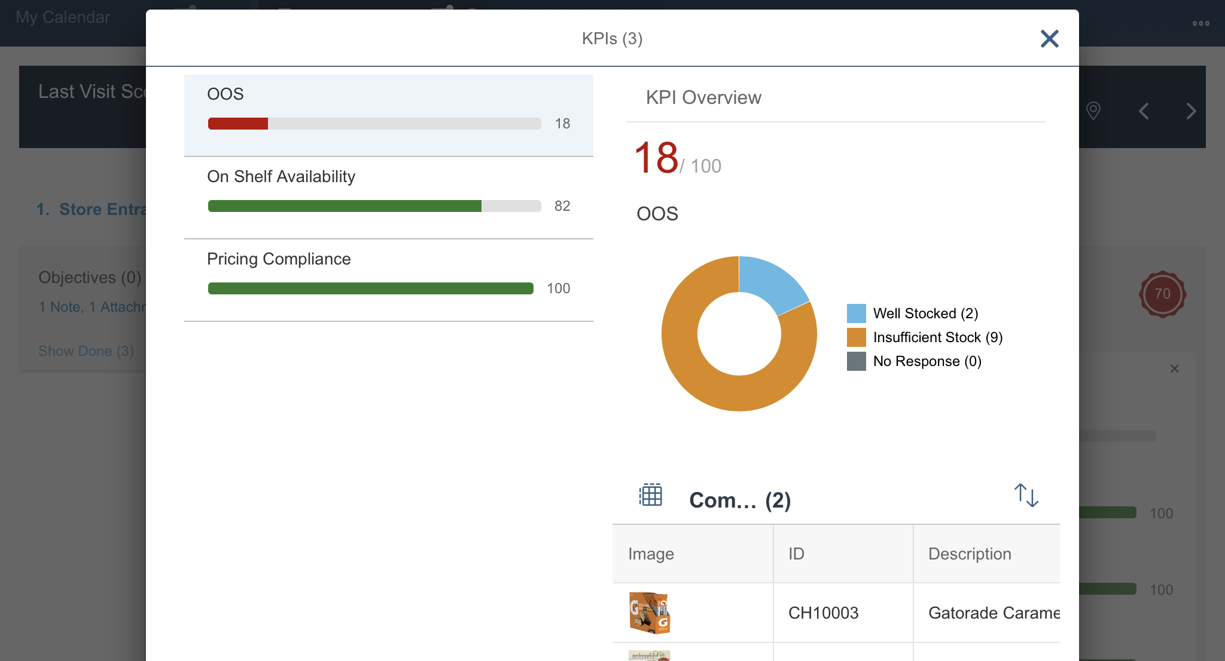
Store Compliance also on POS level visible

Slide 22
How do we support to solve these challenges with innovations? - Henkel and Route Planning -

Slide 23
“Simplify”: more value creation thanks to more efficiency in sales
Project profile: Henkel KGaA, Düsseldorf
Our customer
Project goal
Scope of the project
Founded in 1876, today a global supplier of branded goods and system solutions for consumers and industry
Strategic business areas: detergents and cleaning agents, cosmetics/body care, adhesives, sealants and surface technology
Around 51,000 employees in 120 countries
EUR 18.714 billion turnover in 2016
Introduction of a global Sales Force automation solution
Optimized and simple route planning with maiTour
Including trader and stock data
With online functionality for laptops and both online and offline functionality for tablets
International implementation of SAP Cloud for Customer (C4C)
Responsibility for agile projects: from business and functional design to implementation, to international roll-out
Coordination of the co-innovation program with SAP (for complex order generation processes in global, modern markets as well as traditional markets)
Photo

Slide 24
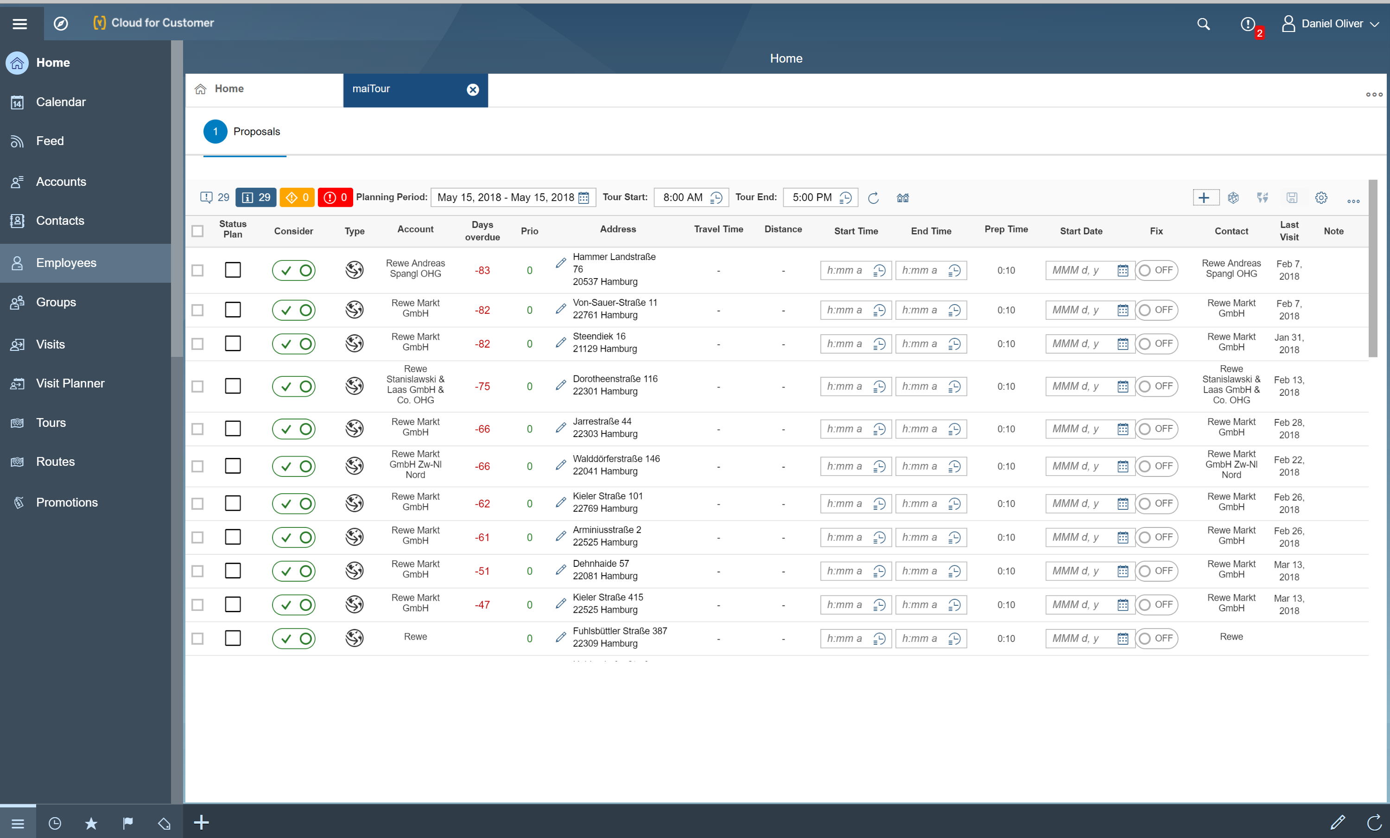
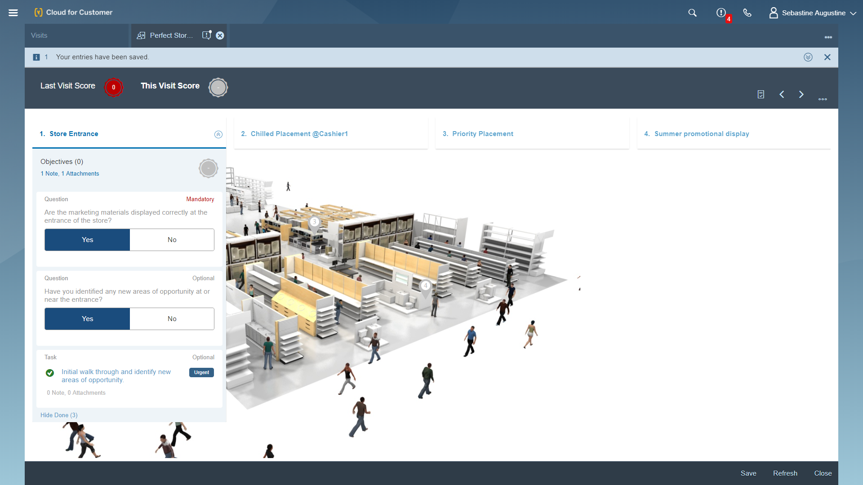
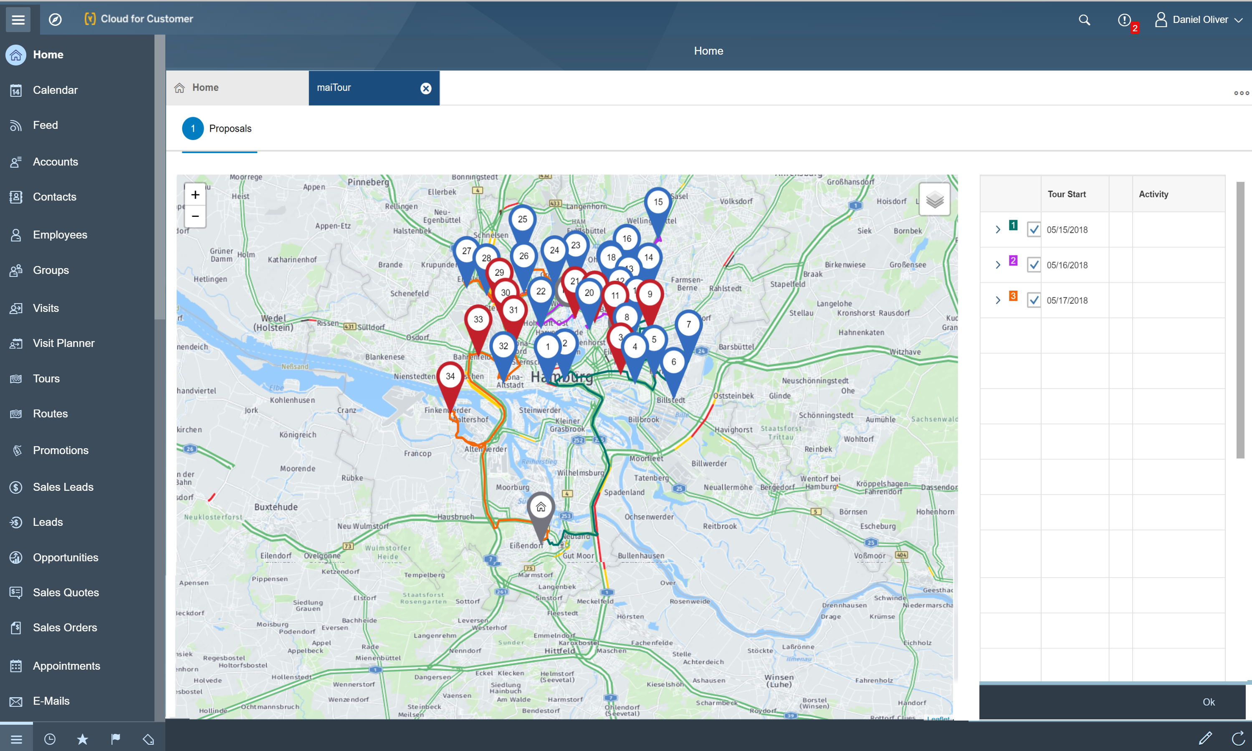
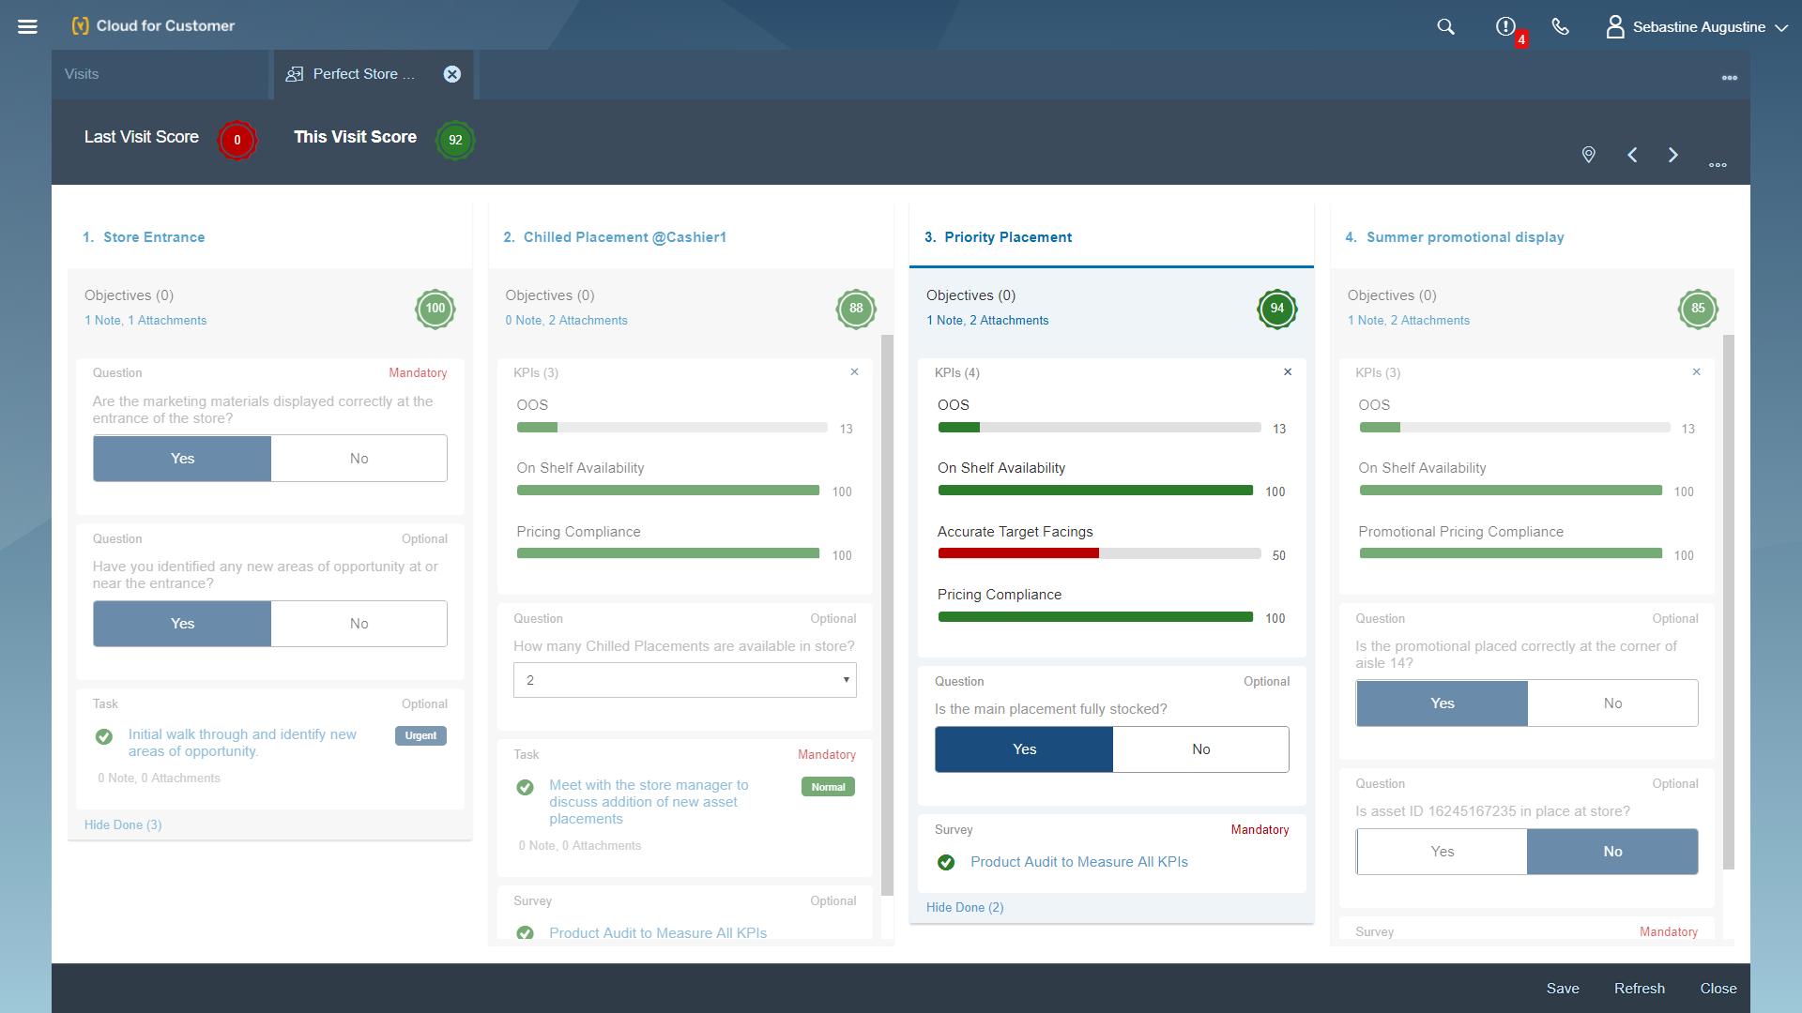
PERFECT STORE - Route Planning with maiTour (by maihiro)
Optimized user experience for route and tourplanning
Planning based on strategic sales targets, business goals, front and back office rules, perfect score value and marketing guidelines
Usage of real-time and historical traffic information
Uses premium geo-optimiziation services of PTV (member of the Porsche SE Group)
Easy planning arround fixed appointments
Co-Innovated with customers

Slide 25
Simple business case and value for tour planning

Slide 26
Predefined list of POS based on e.g. perfect score or priority

Slide 27
Promotion View within the tour and route planning

Slide 28
Support of Ad-Hoc Planning and GPS supported next best visit

Slide 29
Optimal Tour based on Strategic and Sales Reps criteria

Slide 30
+
Short demo of a innovative scenario

Slide 31
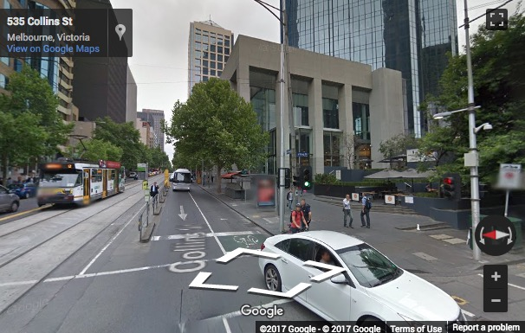
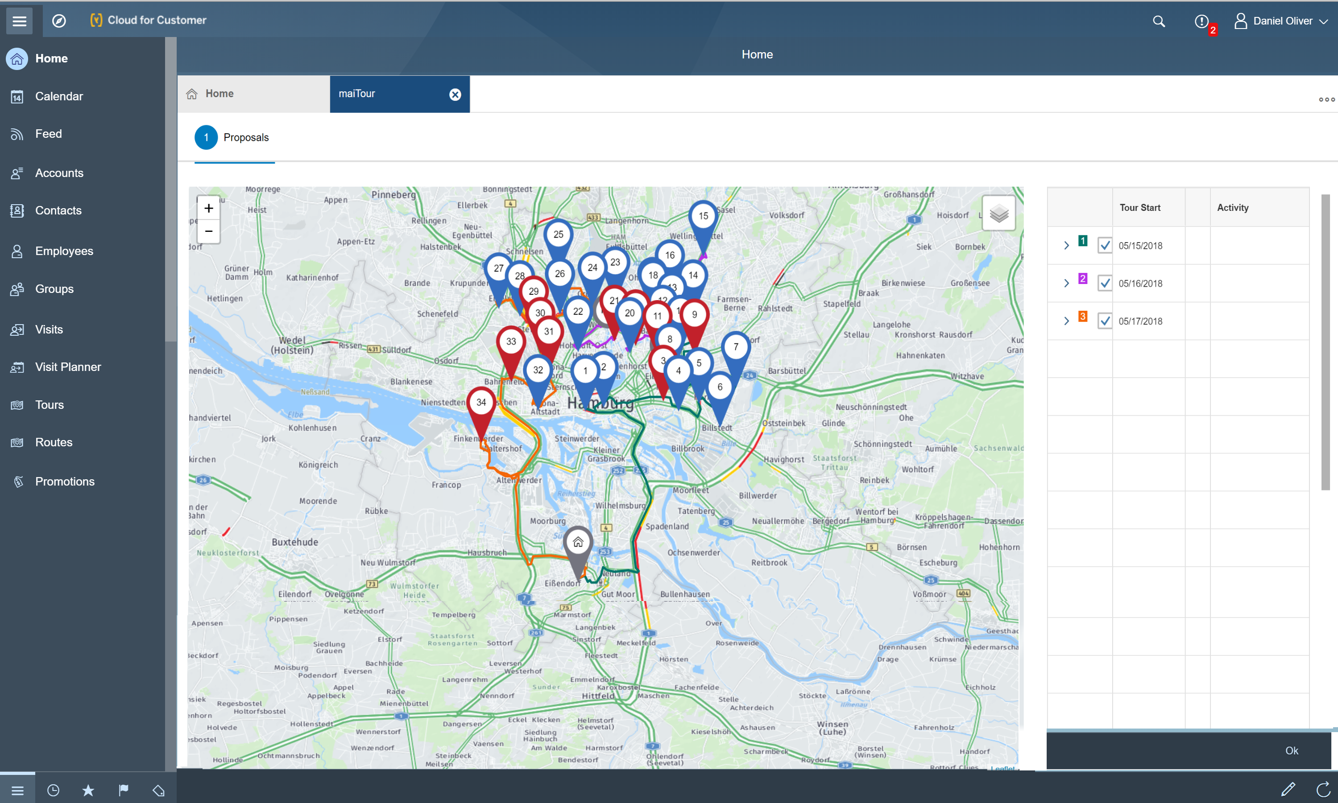
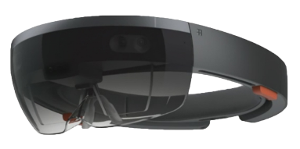
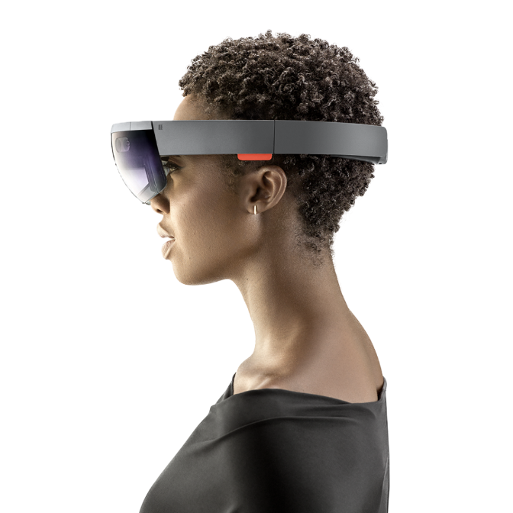
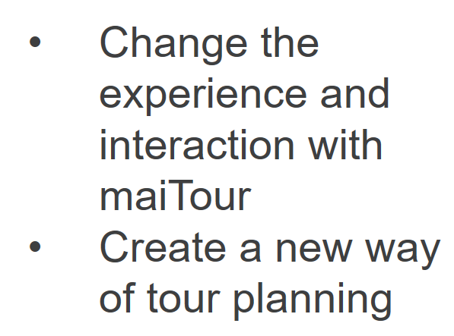
+
maiTour and Microsoft Hololense

Slide 32
How do we support to solve these challenges with innovations? - Image intelligence-

Slide 33
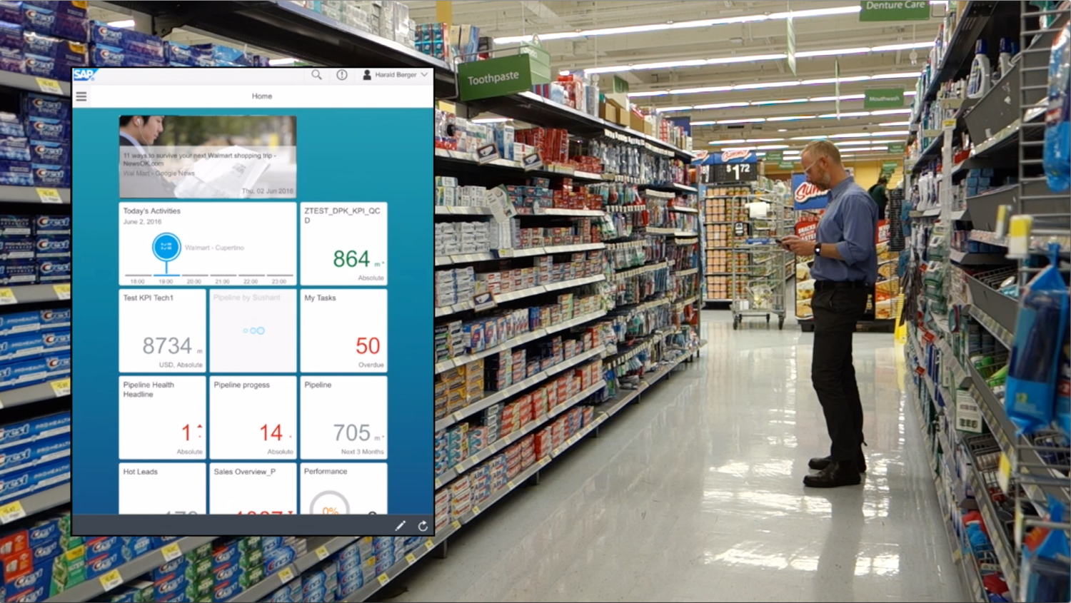
Sales Rep checks into SAP SALES CLOUD

Slide 34
Sales Rep enters/faces the Toothpaste Aisle in Walmart

Slide 35
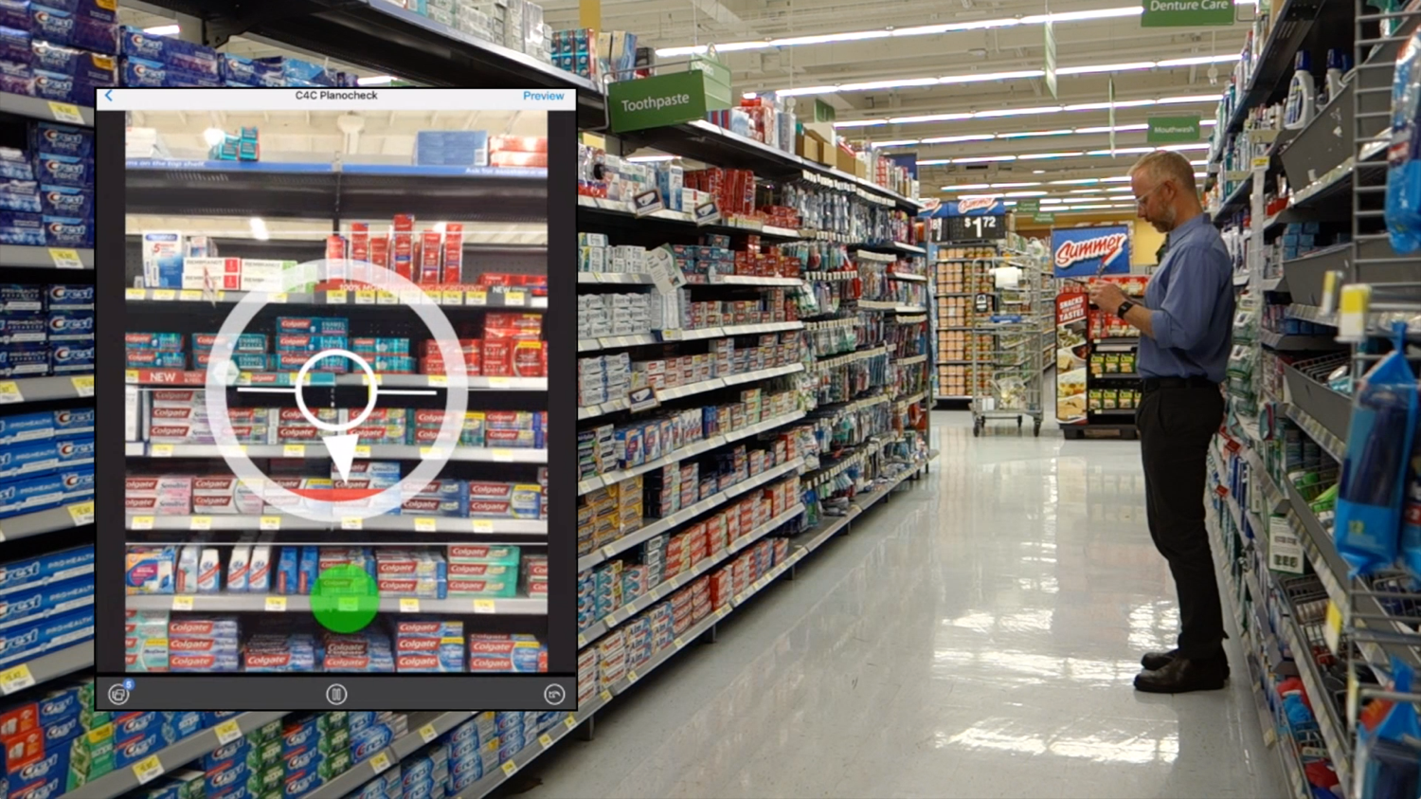
Sales Rep captures images of the shelf by following the green ball

Slide 36
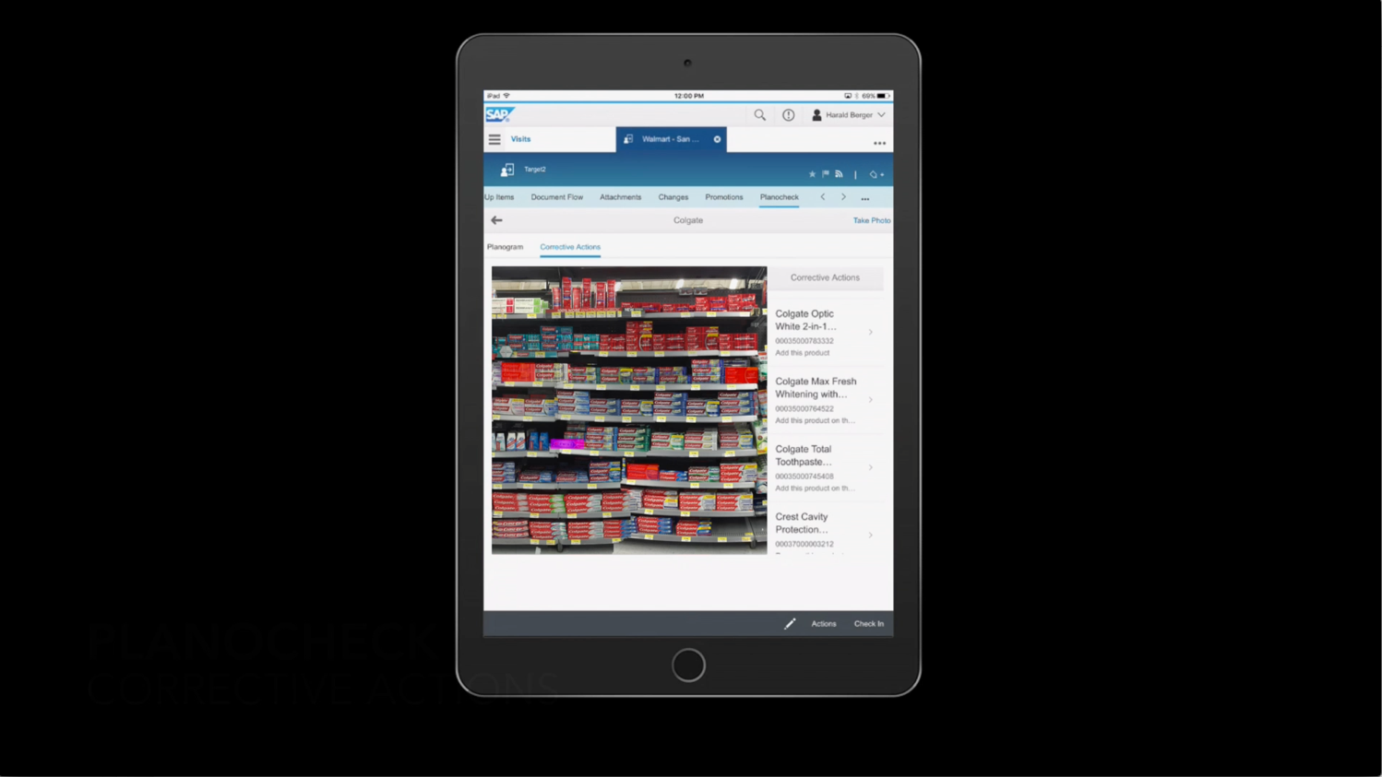
Sales Rep reviews issues highlighted in the RED and PURPLE shadow boxes

Slide 37
How do we support to solve these challenges with innovations? - Conclusion in the end, future roadmap -

Slide 38
“To Be the SMARTEST, Most Effective & Efficient Field Sales Solution in the Market”

Slide 39
ROADMAP
SUBJECT TO CHANGE
Data Driven Execution (ML/AI)
AUDIT OPTIMIZATION
PREDICTIVE ORDERING
VISIT PRIORITIZATION
Consultative
Selling Tools
ENHANCED PERFECT STORE EXECUTION
CONTENT RECOMMENDATION
AUGMENTED REALITY
CORRECTIVE ACTIONS
Enhanced Sales Effectiveness
PROMOTION SIMULATION
GAMIFICATION CONTENT
SALES ASSISTANT BOTS
Operational Efficiency
ADVANCED IMAGE RECOGNITION
GEO FENCING
CONTINUOUS UX ENHANCEMENTS
VOICE BASED ORDERING/ EXECUTION

Slide 40
THANK YOU
Emmanuel Desert
Director Product Management
SAP Sales Cloud
SAP Switzerland AG
P: +41 79 753 95 70
E: emmanuel.desert@sap.com
Timo Simon
Director Products, Innovation and Business Development
maihiro GmbH
P: +49 175 722 68 63
E: timo.simon@maihiro.com

