Slide 1
Driving Sales with Teams in a Dynamic Retail Environment with an RGM Focus
Rob Schram (Cornerstone Capabilities)
Michael Dwyer (PepsiCo Canada)
27-September-2018

Slide 2
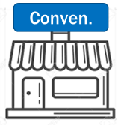
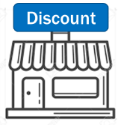
Market Overview - Canada
Highly Consolidated Retail
Limited Growth
Consumer Dynamics
Top 5 Customers
=
~85 ACV
~1.5% TL ACV
CAGr

Slide 3
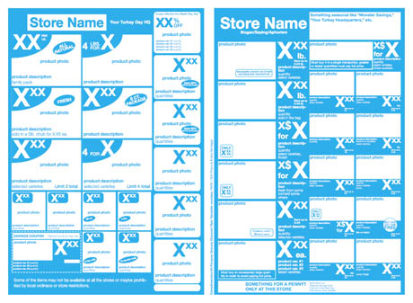
Category Overview
Highly Developed
Heavily Promoted
Pressured Pricing Realization
… But Under Pressure
Low Incrementality Of Additional Promotions
Limited Inflation
Margin Opportunity
HHP
Trips

Slide 4
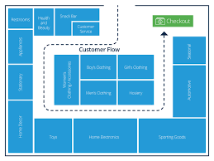
Strategic Objective – Sustainable Growth In CPG
Consumer Led
Joint Retailer Partnerships
insights
innovation
Pack/Price & Architecture
Excel In Execution
Singles
Take Home
Multi-pack
Multi-serve
Stock Up
Light User
planning
moment of choice

Slide 5
... Ares of focus
Pack/Price & Architecture
Excel In Execution
Singles
Take Home
Multi-pack
Multi-serve
Stock Up
Light User
planning
moment of choice

Slide 6
..The Market and Traditional CPG Objectives Do Not Appear Aligned
What The Market Is Indicating
Traditional CPG Objectives
Low Market Growth
Highly Consolidated Retail Trade
Consumers Migrating To Discounters
Lower Inflation Potential
Revenue & Share
Balanced Growth
Balance Margin w/ Consumer Value
Pricing To Cover COGs
Utilize Technology In New Way
Measure Effectiveness Of Every Single Historical Event
Test
Market Scenarios Before Deploying
(Minimize Risk)
Demonstrate Credible Effectiveness To Secure Buy In
Monitor
Compliance & Performance Vs Expectation

Slide 7
This Required The Ability To Merge All Available Data
Retailer / Market Data
Internal Data
Single Source
Scans
Pricing & Promo
VPOs
Distribution (Sales)
CWW / WIV
Weekly
Historical
Retailer P&L
Shipments
Planned Pricing & Promo
Net Price & COGs
Fill Rate / In Stock
Distribution (Shipped)
WIV
Hourly
Historical & Forecast
Internal P&L
All Data Merged
Consolidated P&Ls
Standardized Reports
Customized Reports
Scenario Planning
Credible with Retailers
Credible Internally
Dashboard Reporting & Scenario Modelling

Slide 8
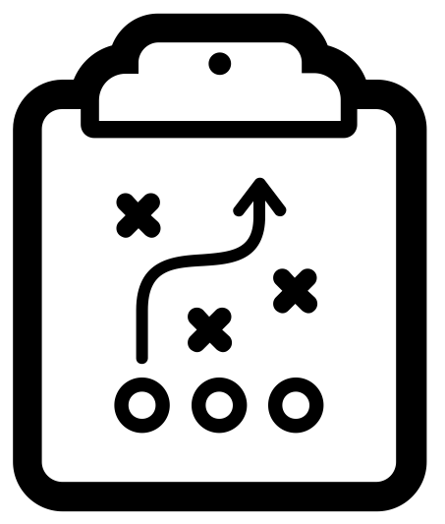
Revenue Management Planning Cycle
Optimal Strategy
Potential Barriers
The Playbook

Slide 9
What Both Retailers & CPG Companies Seek
1
2
3
Improvement In Trade Spend/Investment Management
Faster Alignment To Plan & Target Setting
Accelerated Development Of Talent

Slide 10
Strategy & Planning Flow – Annual Promo Optimization
Spot Trends
Test Potential Plans
Align & Deploy Win-Win
Measure Impact
Flowback & Incremental
Rank every single event executed for Retailers and Company
Sort by ROI, incremental, package, banner
Aggregate promo levels by market or customer
Test potential strategies at the package level
Deploy new strategy in “the market”
View cross package elasticity & scenarios test competitive response

Slide 11
In Year Planning Cycle
Deploy Plan
Align During Annual Account Builds
Quarterly Review Of Account
Period Review Vs Forecast
Weekly Out Of Plan Trade Spend Alignment

Slide 12
Case Study
The Need:
Deliver Sustainable & Profitable Net Revenue Growth
For Company & Retail Partners
Balance Topline
Pricing (COGs) and Volume
Balance Mix
Item Vs Portfolio
Balance Profit
Company & Retailer
We engaged in creative writing for the category and data discussed in this exercise
“ACME“ sells many items, one SPINNERS

Slide 13
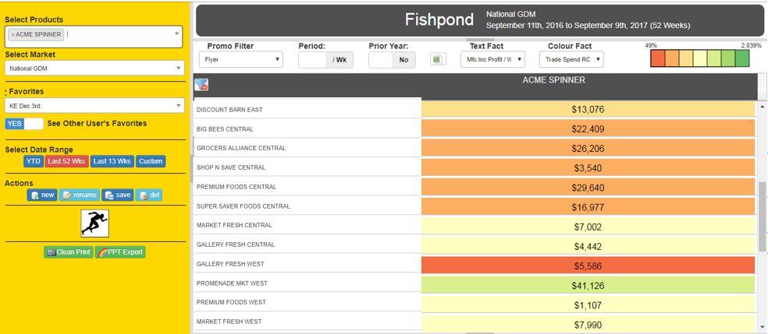
Stack Rank Events By ROI & Profit

Slide 14
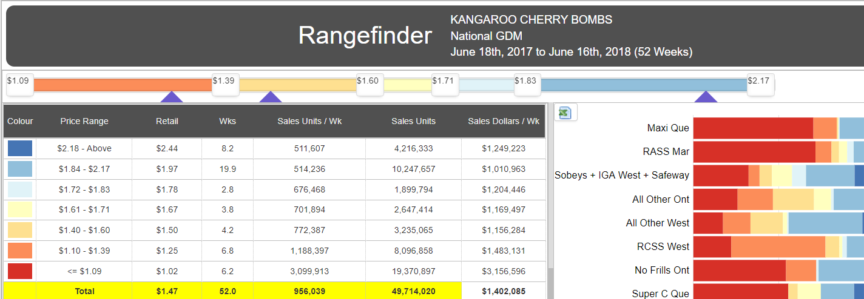
Case Study – Identify The Opportunity Across The Market
Theory:
Eliminate $1.97 Events…
less productive than E $2.44… move all back to $2.44
2) Eliminate $1.50 Events…
less productive than $1.67, move all to $1.25 (offset volume risk from above)

Slide 15
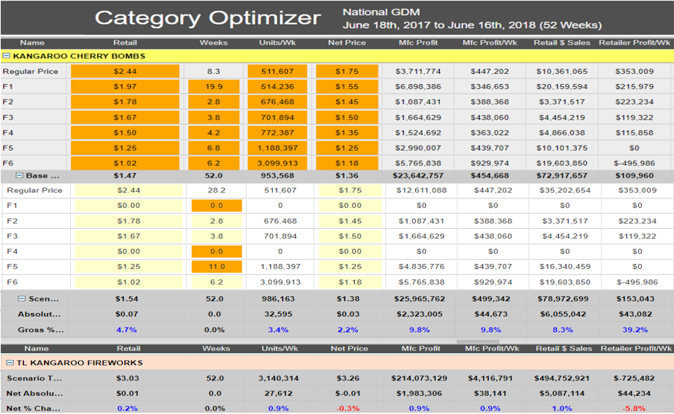
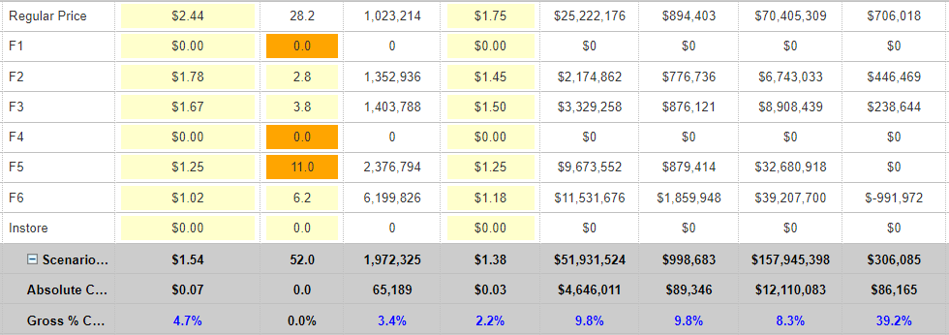
Validate Assumptions & Measure Flowback
Actions
Eliminate 19.9 WIV $1.97 Add back @ $2.44 8.3→26.2
Eliminate 4.2 WIV $1.50
Add back @ $1.25 6.8→11
Outcome
Item Sales +$12M
TL Category Sales +$10M
Kangaroo Profit
Item Profit +$4.6M
TL Profit +$4.1M
Retailer Profit
Item Profit +$86K
TL Profit +$88K
1
2
3
1
2
3

Slide 16
Summary & Outcome
Accelerated Planning
Credible Solutions
Capability
Auto Generation Of Event Performance
Company & Retailer P&L
Scenario Modelling
Company
Category
Competitive
Total Category Scope
All Available Data Incorporated
3rd Party Sourcing / Validation Drives Trust
Cross Package Subsidization
Measure True Incremental
All Levels / Functions Sharing Same Data Source
Improvement In Trade Spend/Investment Management
Faster Alignment To Plan & Target Setting
Accelerated Development Of Talent

Slide 17
The Promotion Optimization Institute would like to thank the following sponsors for their support of the Promotion Optimization Institute and the Retail Execution Summit

