Slide 1
How empowering your team through better processes and technologies drives measurable benefits In-Store
Simon Dechent
Global Market Development SAP Sales Cloud – Retail Execution

Slide 2
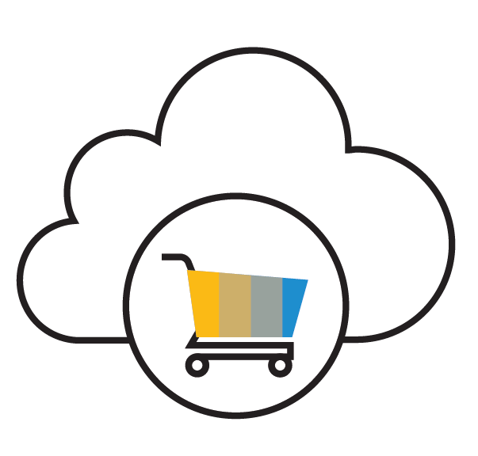
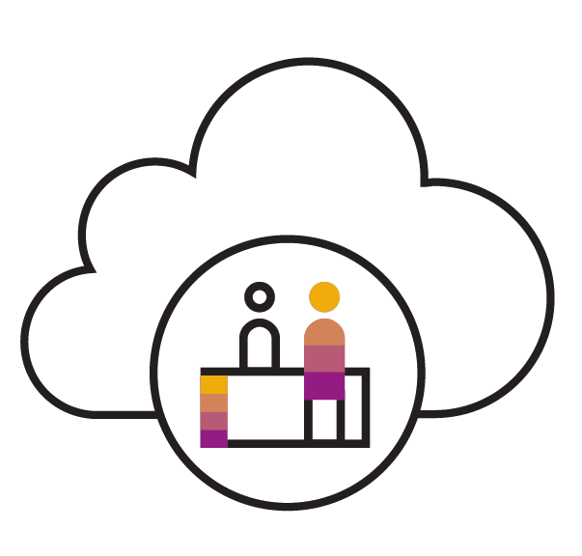
4th Generation Customer Experience Suite SAP C/4HANA
Unified Intelligent User Experience
Conversational, Contextual and Intelligent UX
Built-in Intelligence
SAP Marketing Cloud
Market with Intelligence in the Moment
SAP Commerce Cloud
Personalized Shopping Experience across Touchpoints
SAP Sales Cloud
Build Relationships and guide Customers throughout their journey
SAP Service Cloud
Make Customers happy
SAP Customer Data Cloud Build Customer Trust and Loyalty
SAP Cloud Platform Cloud-native Microservice based universal Innovation and Agility Platform
Microservices
Extensions
Internet of Things
Machine Learning
Integration
Blockchain

Slide 3
Challenges in Consumer Products Industry
28%
Engaging entire path to purchase
Reaching consumers across channels
Repeat purchases and brand loyalty
Build volume, maximize revenue & profitability
Maximize overall spend & mitigate lost sales
Deliver high service levels
Lack smart recommendations to reduce out of stocks*
25%
Lack tools and real-time information to make business decisions*
20%
Lack visibility to product, price, promotion and placement*
Notes:
These are the challenges in CP industry.
Challenges:
Engaging with consumers throughout the entire path to purchase
Reaching consumers with relevant information and offers across physical and virtual channels
Improving consumer sentiment and consumer mindshare to drive repeat purchases and brand loyalty
Optimizing promotions to build sustainable baseline volume, maximize revenue and profitability
Align promotions with marketing to maximize overall spend and mitigate risk of lost sales
Deliver high service levels to customers and consumers across service delivery channels
In a recent study from Consumergoods.com, they found that 28% of consumer products companies lack smart recommendations to increase penetration, assortment and reduce out of stocks
While 25% of consumer products companies lack tools and real-time information to make business decisions and 20% of consumer products companies lack visibility to product, price, promotion and placement.

Slide 4
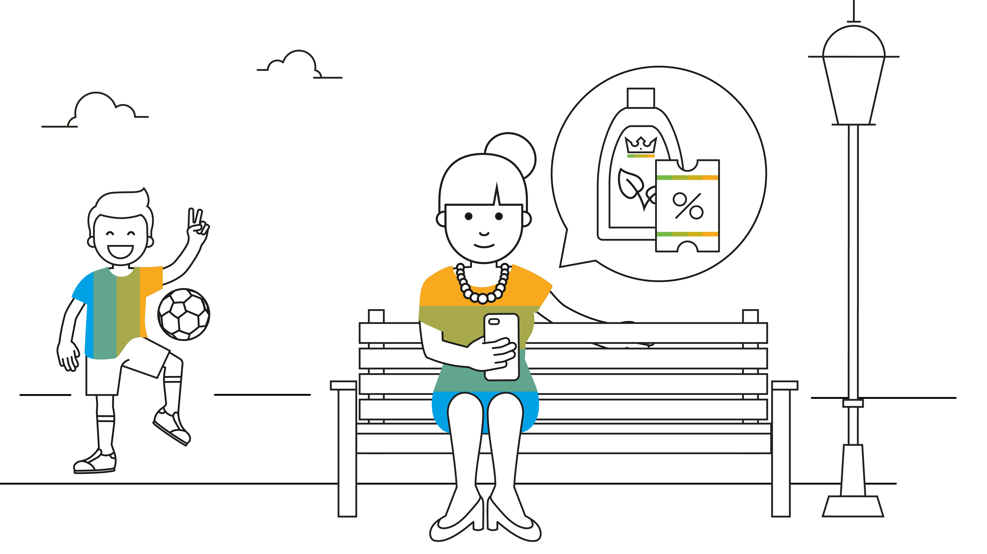
Notes:
Meet Michelle. She is a loyal customer to King Products and she receives an email promotion for the new eco-friendly detergent with a coupon. The email tells her to look for the promotional banner. She downloads the coupon to phone to use when she goes to grocery shopping tomorrow at the ABC store.

Slide 5
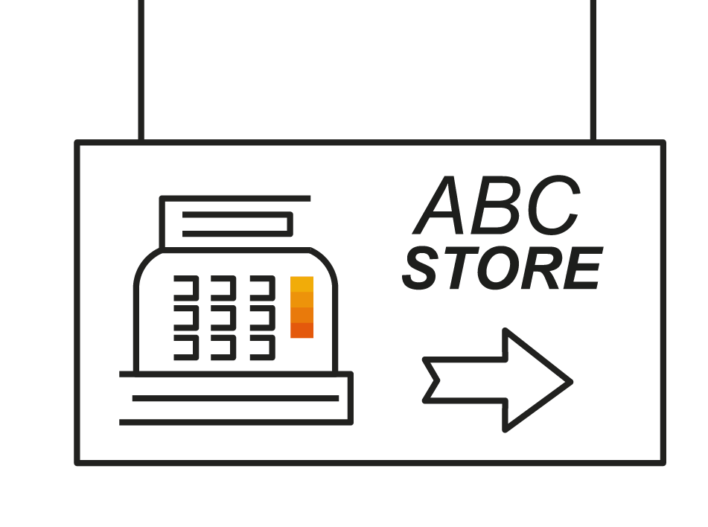
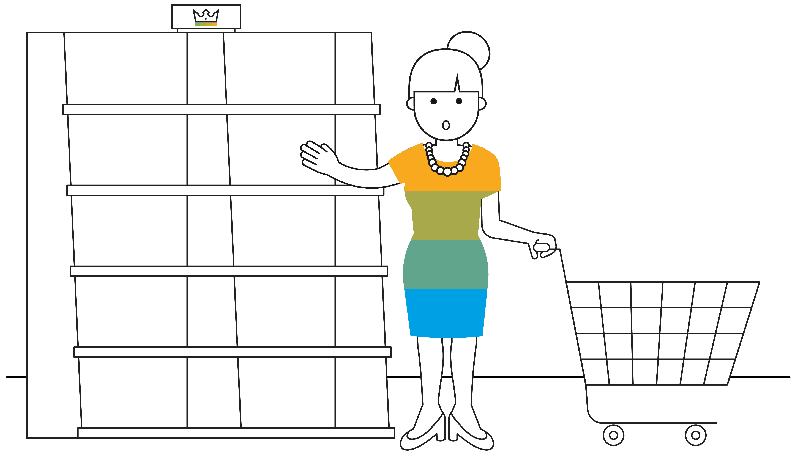
Notes:
Michelle is in the ABC Store and is looking around for the promotional banner and new laundry detergent on the shelves. No laundry detergent nor banner with the promotion is set up. Out of stock on the detergent. She is standing in front of this display to empty shelves.

Slide 6
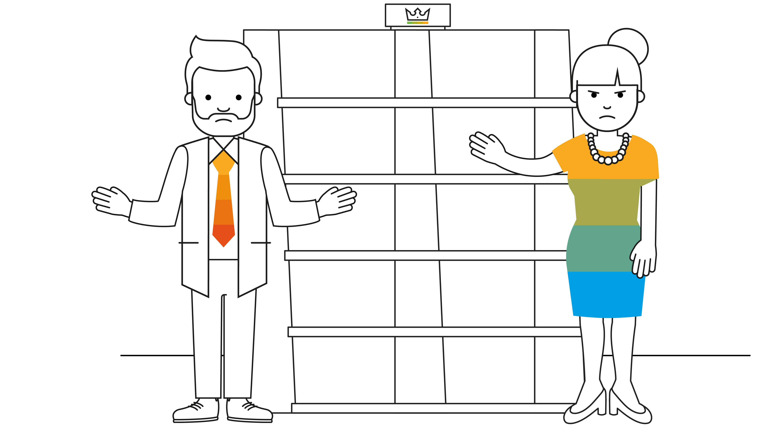
Notes:
An annoyed Michelle is talking to the store manager asking where the new laundry detergent is. The ABC Store manager tells her the promotional display has not yet been set up and the shelves have not yet been stocked.

Slide 7
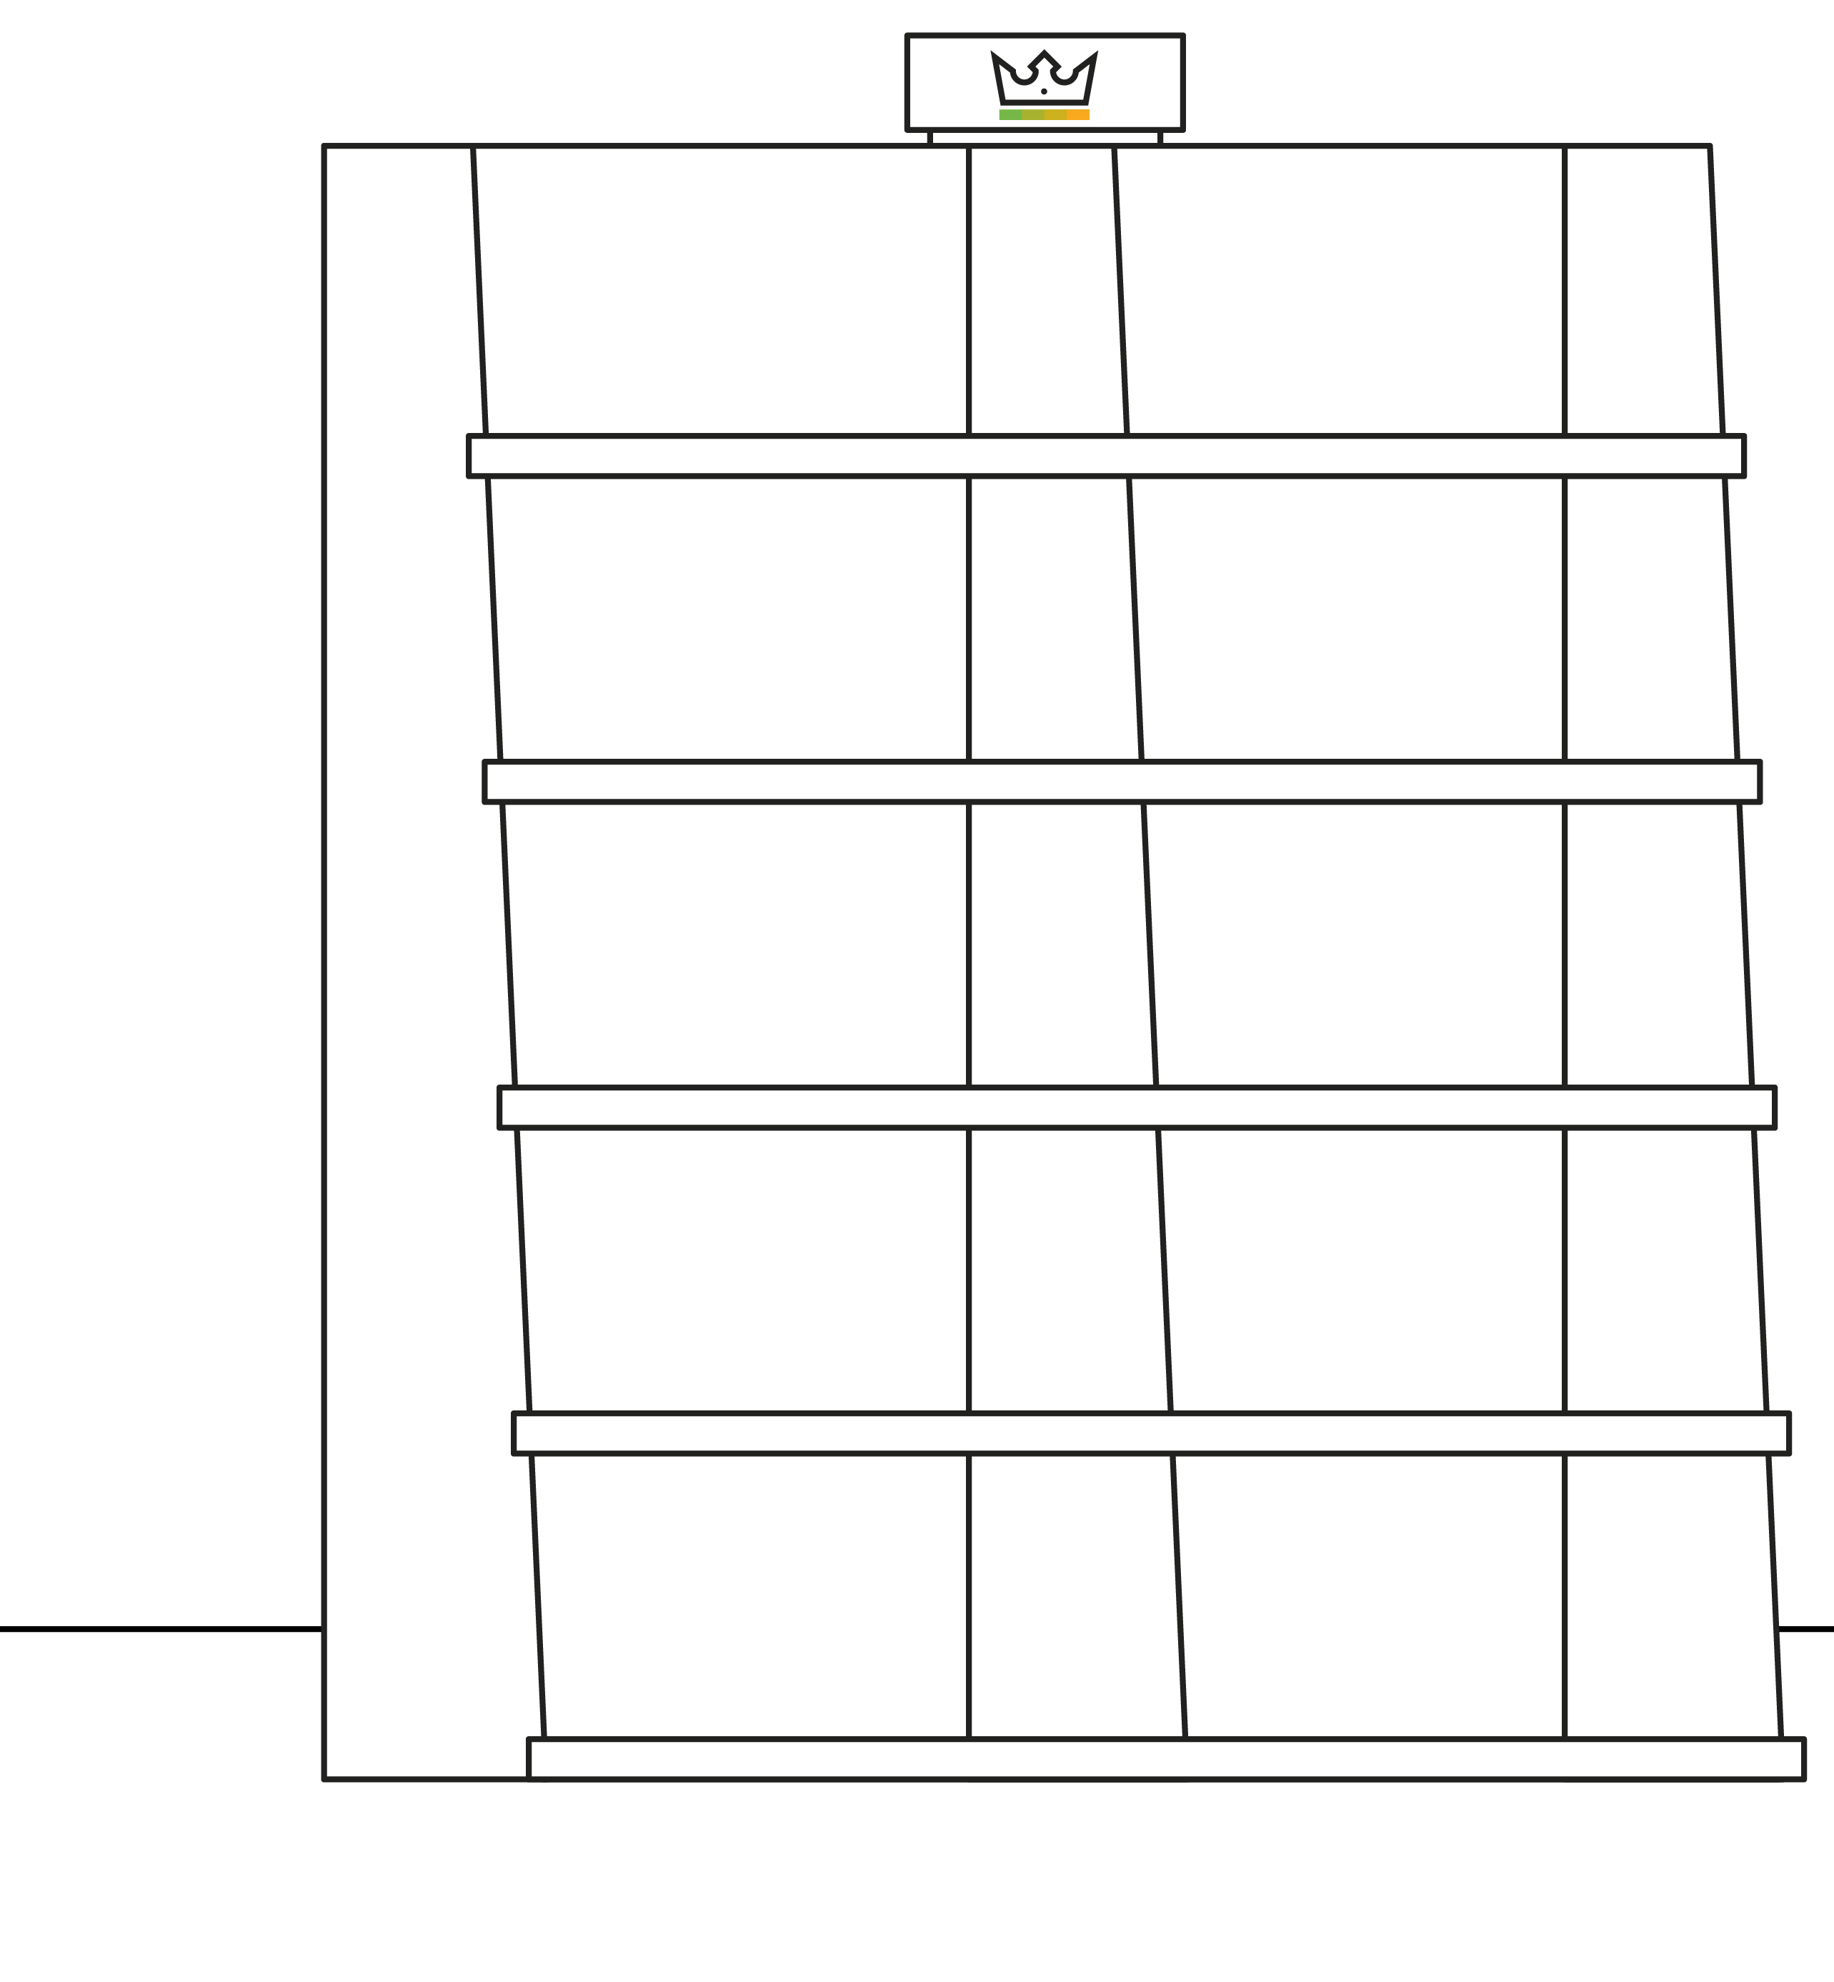
Notes:
Michelle grabs a competing laundry detergent right beside the empty shelves of the new King eco-friendly laundry detergent with a “not-so-happy” look on her face.

Slide 8
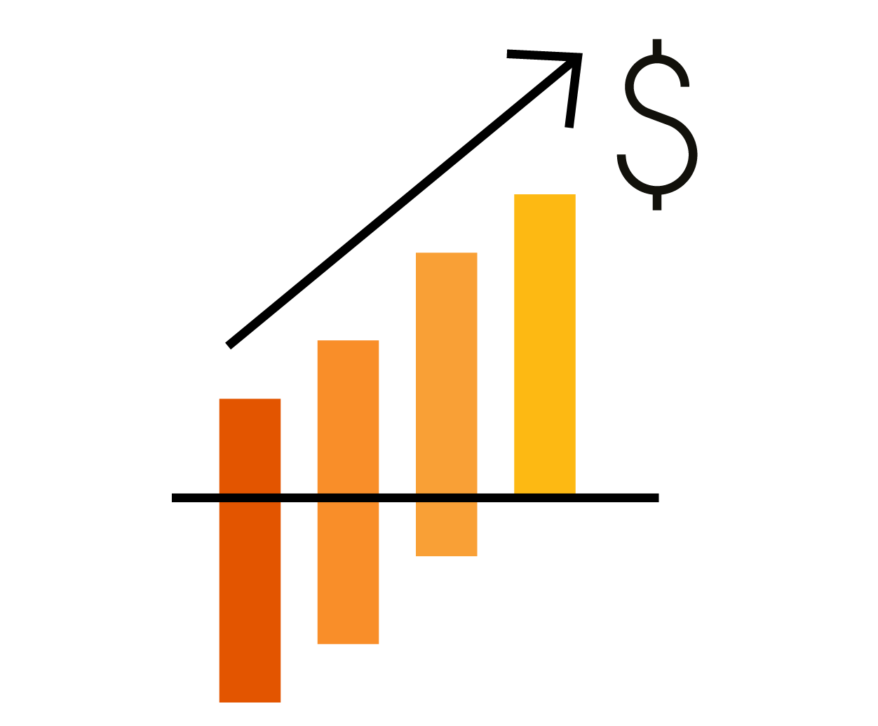
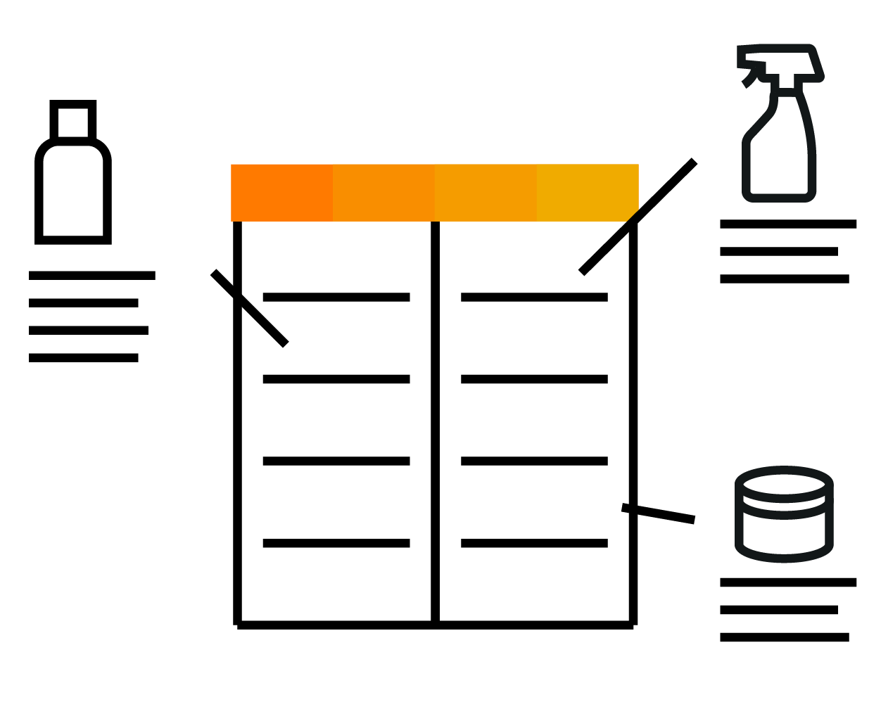
“Perfect Store Execution” Challenges
Inability to leverage best practice business processes at the retail level
Incompliant retail stores
Inability to monitor compliance of product distribution, plan-o-grams, trade promotions
Poor return on brand and promotion investments
Paper based and not integrated systems
Incomplete sales decision-making
Lost revenue and customer loyalty
Notes:
The Vision for Consumer Product companies is to achieve the ‘Perfect Store’ experience or have the ‘Perfect Store Strategy’.
The ‘Perfect Store’ is all about having the right product, in stock, at the right price, at the right time while personalizing the customer engagement and offering alternative paths to purchase. The ‘Perfect Store’ experience makes the most of right information at the right time and takes a highly disciplined approach to achieving maximum sales while delivered a personalized experience for the consumer.
Today’s best run consumer products companies have become consumer driven. Cloud for Customer’s Consumer Products value proposition is to help consumer products companies ‘win at the shelf and around it.’ The main focus will be to deliver to the consumer the right products, at the right price, at the right time. Additionally, we believe that personalizing the customer engagement and offering alternative paths to purchase enable the ‘Perfect Store’. These fundamental strategies will ensure better decision making, operational efficiency, and the omnichannel experience to drive revenue, growth, & profit, and support the perfect store strategy.
By becoming “best in class” in these areas, consumer products companies have an opportunity to distinguish themselves in the eyes of their customers and consumers. Consumer products companies position themselves to deliver – consistently – the Perfect Store experience.

Slide 9
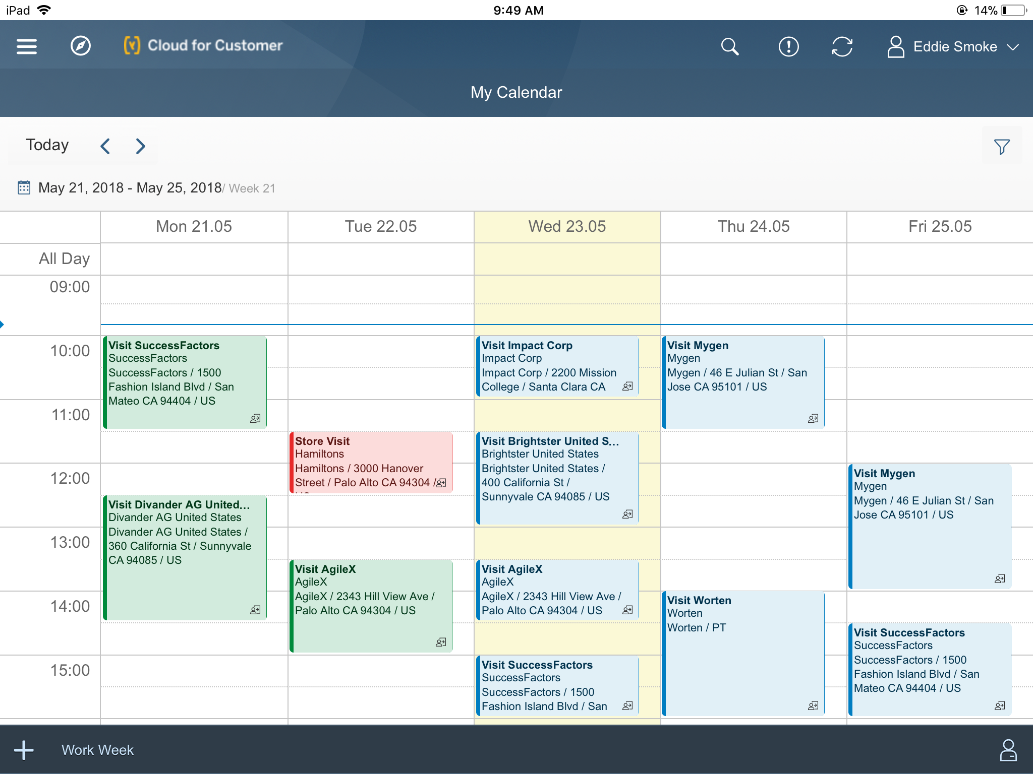
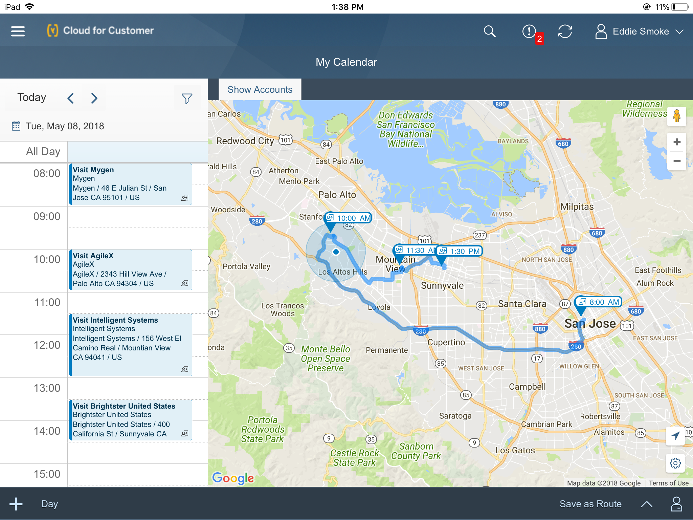
Notes:
Christian, looking at his calendar in Sales Cloud, sees a list of all the stores he needs to visit today. Another close-up of Christian looking at a map with a route of all stores he needs to visit today to set up the promotion and stock the shelves.

Slide 10
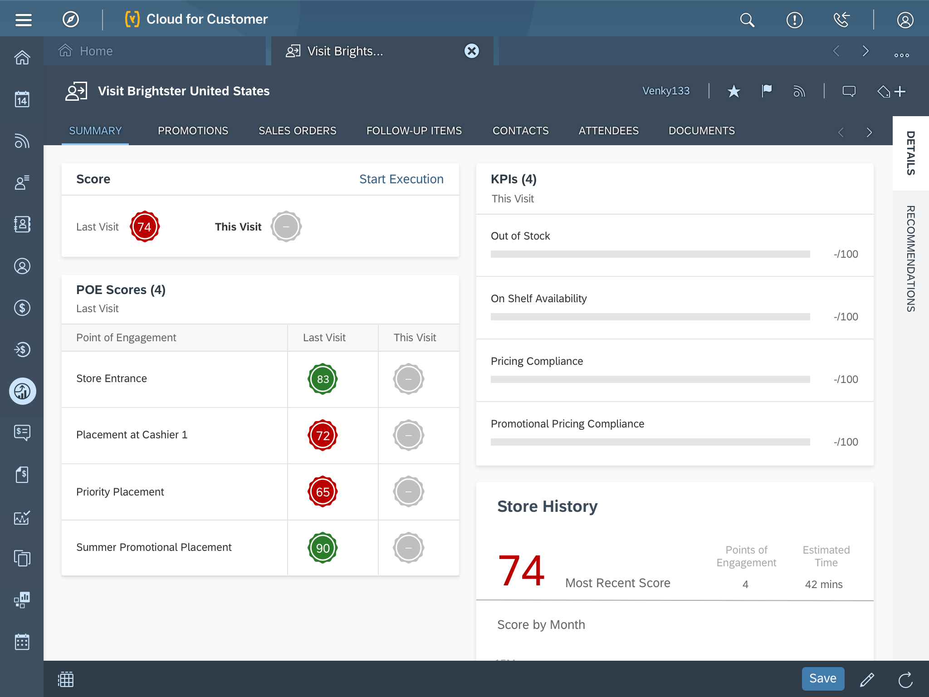
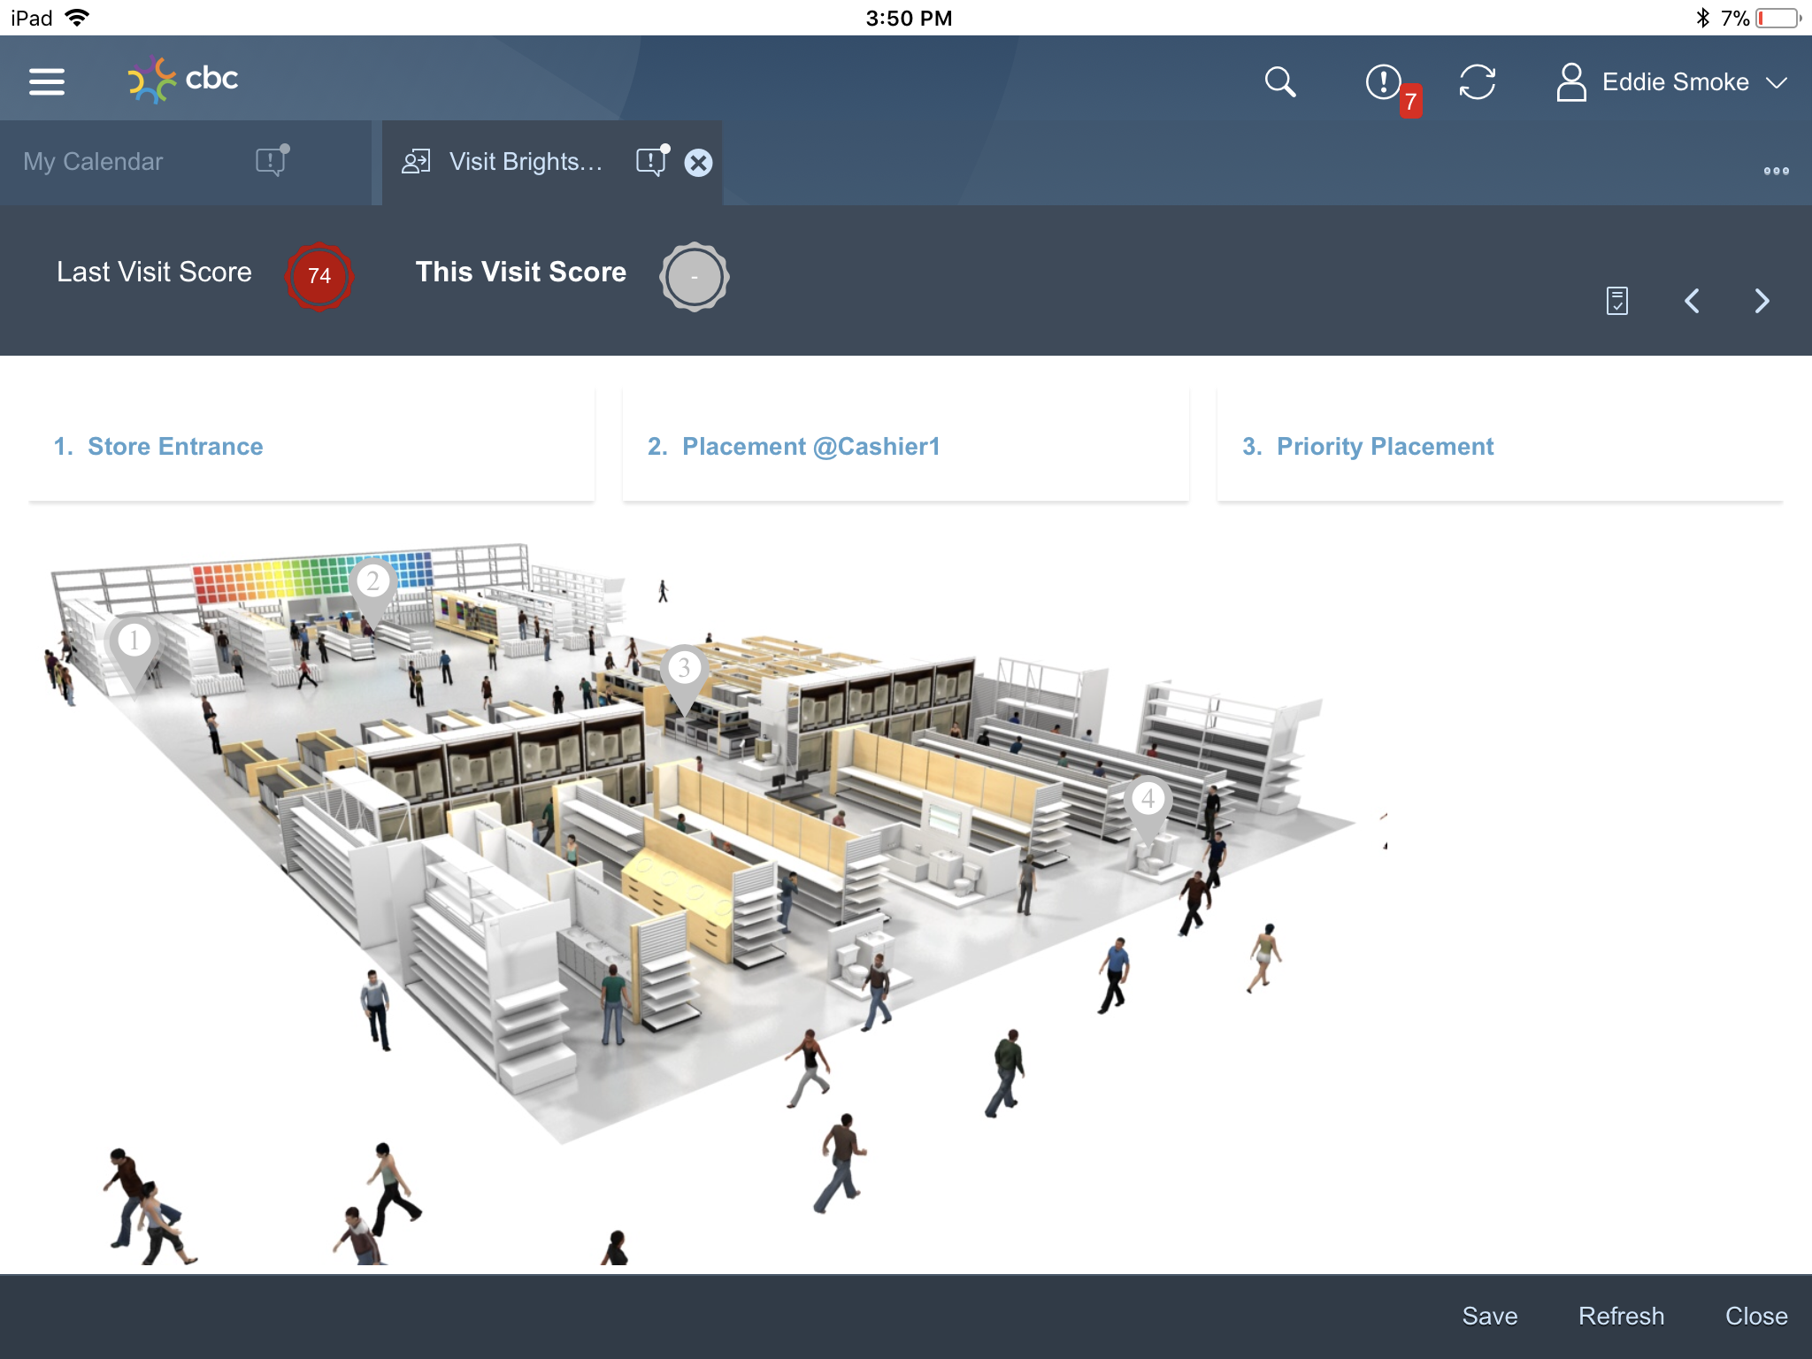

Slide 11
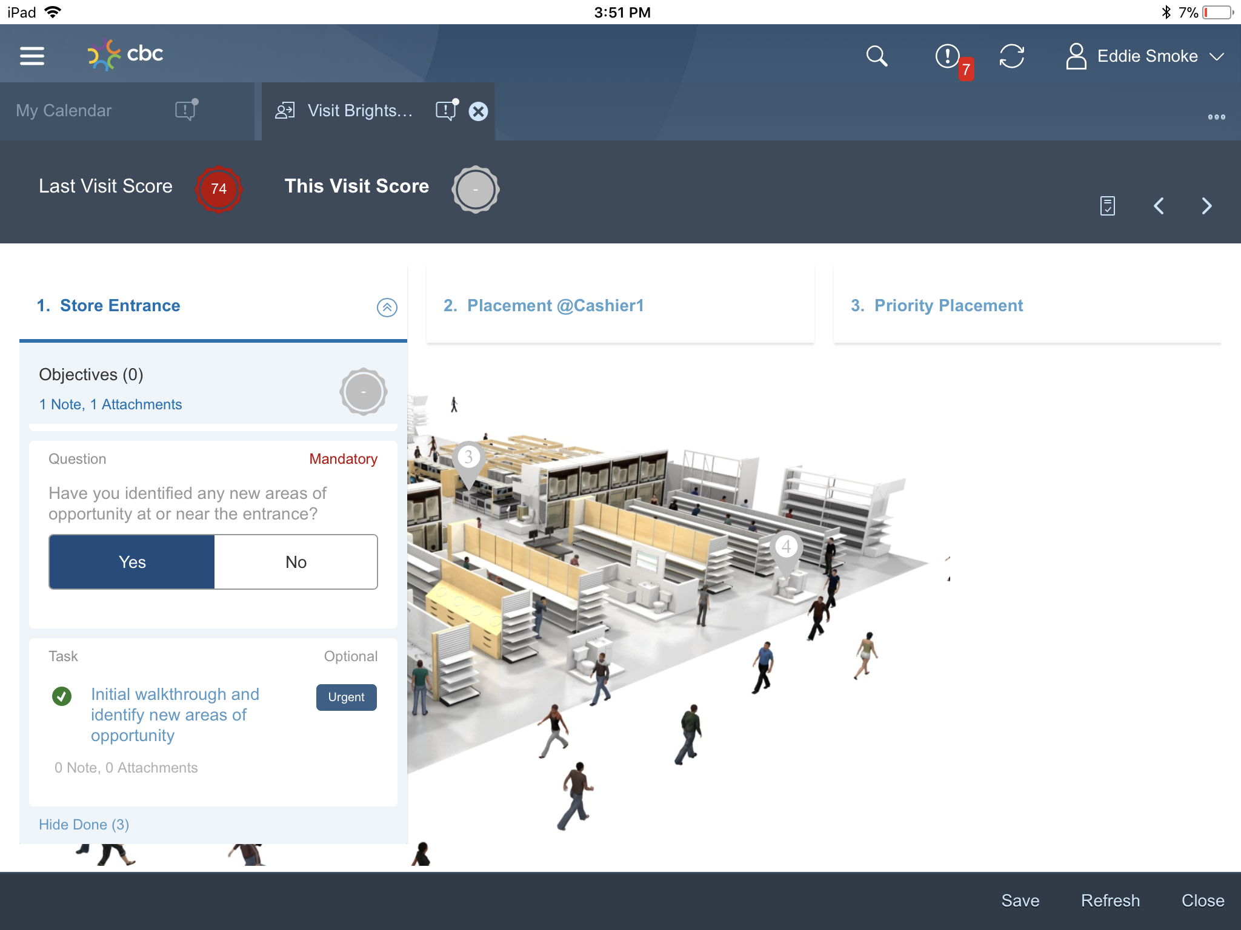

Slide 12
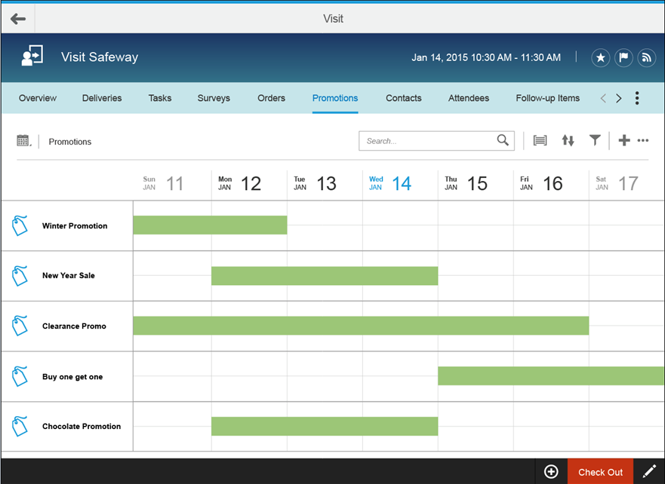
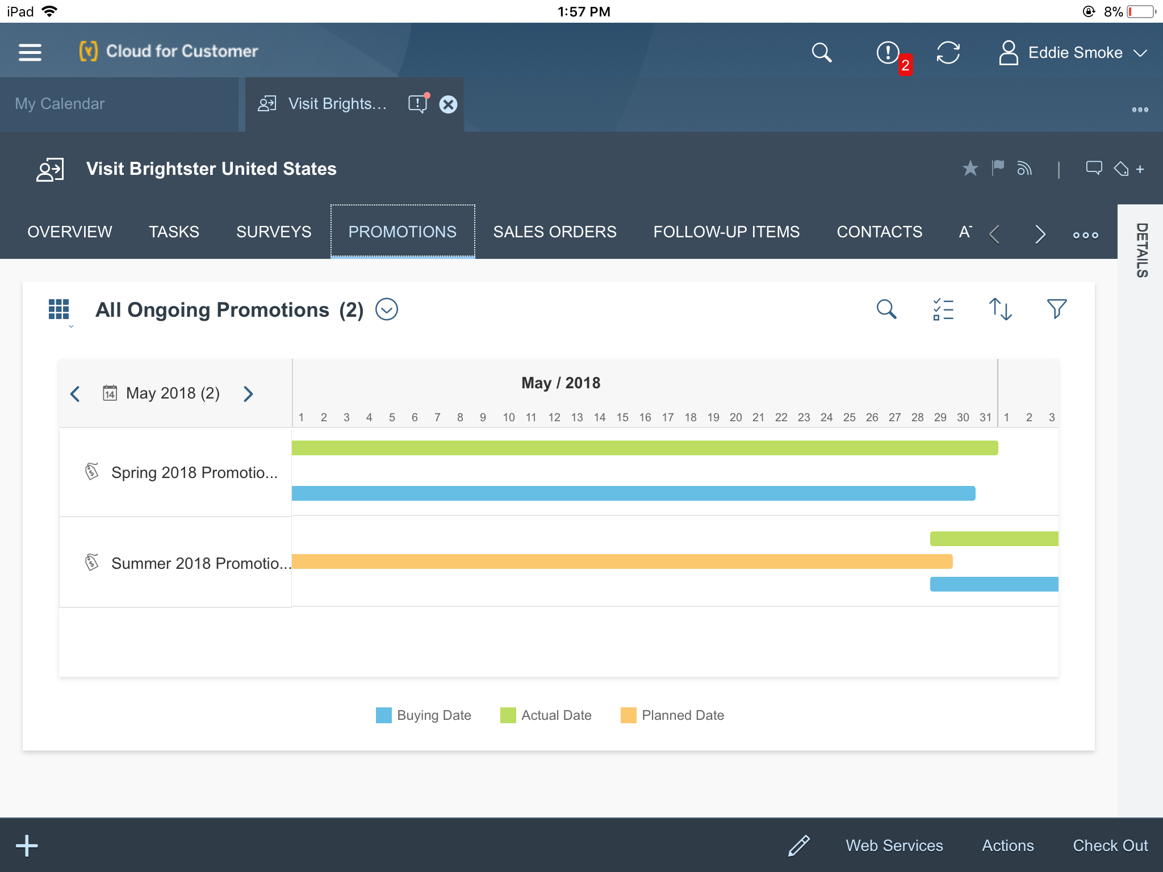
Notes:
Christian is at his first stop at ABC Store and he is explaining the new product promotion to the store manager, Philip. With Sales Cloud, Christian can explain the new promotion to Philip to ensure the store complies with the promotion. Christian is also explaining to Philip that he will be setting up the promotion in his store at that time

Slide 13
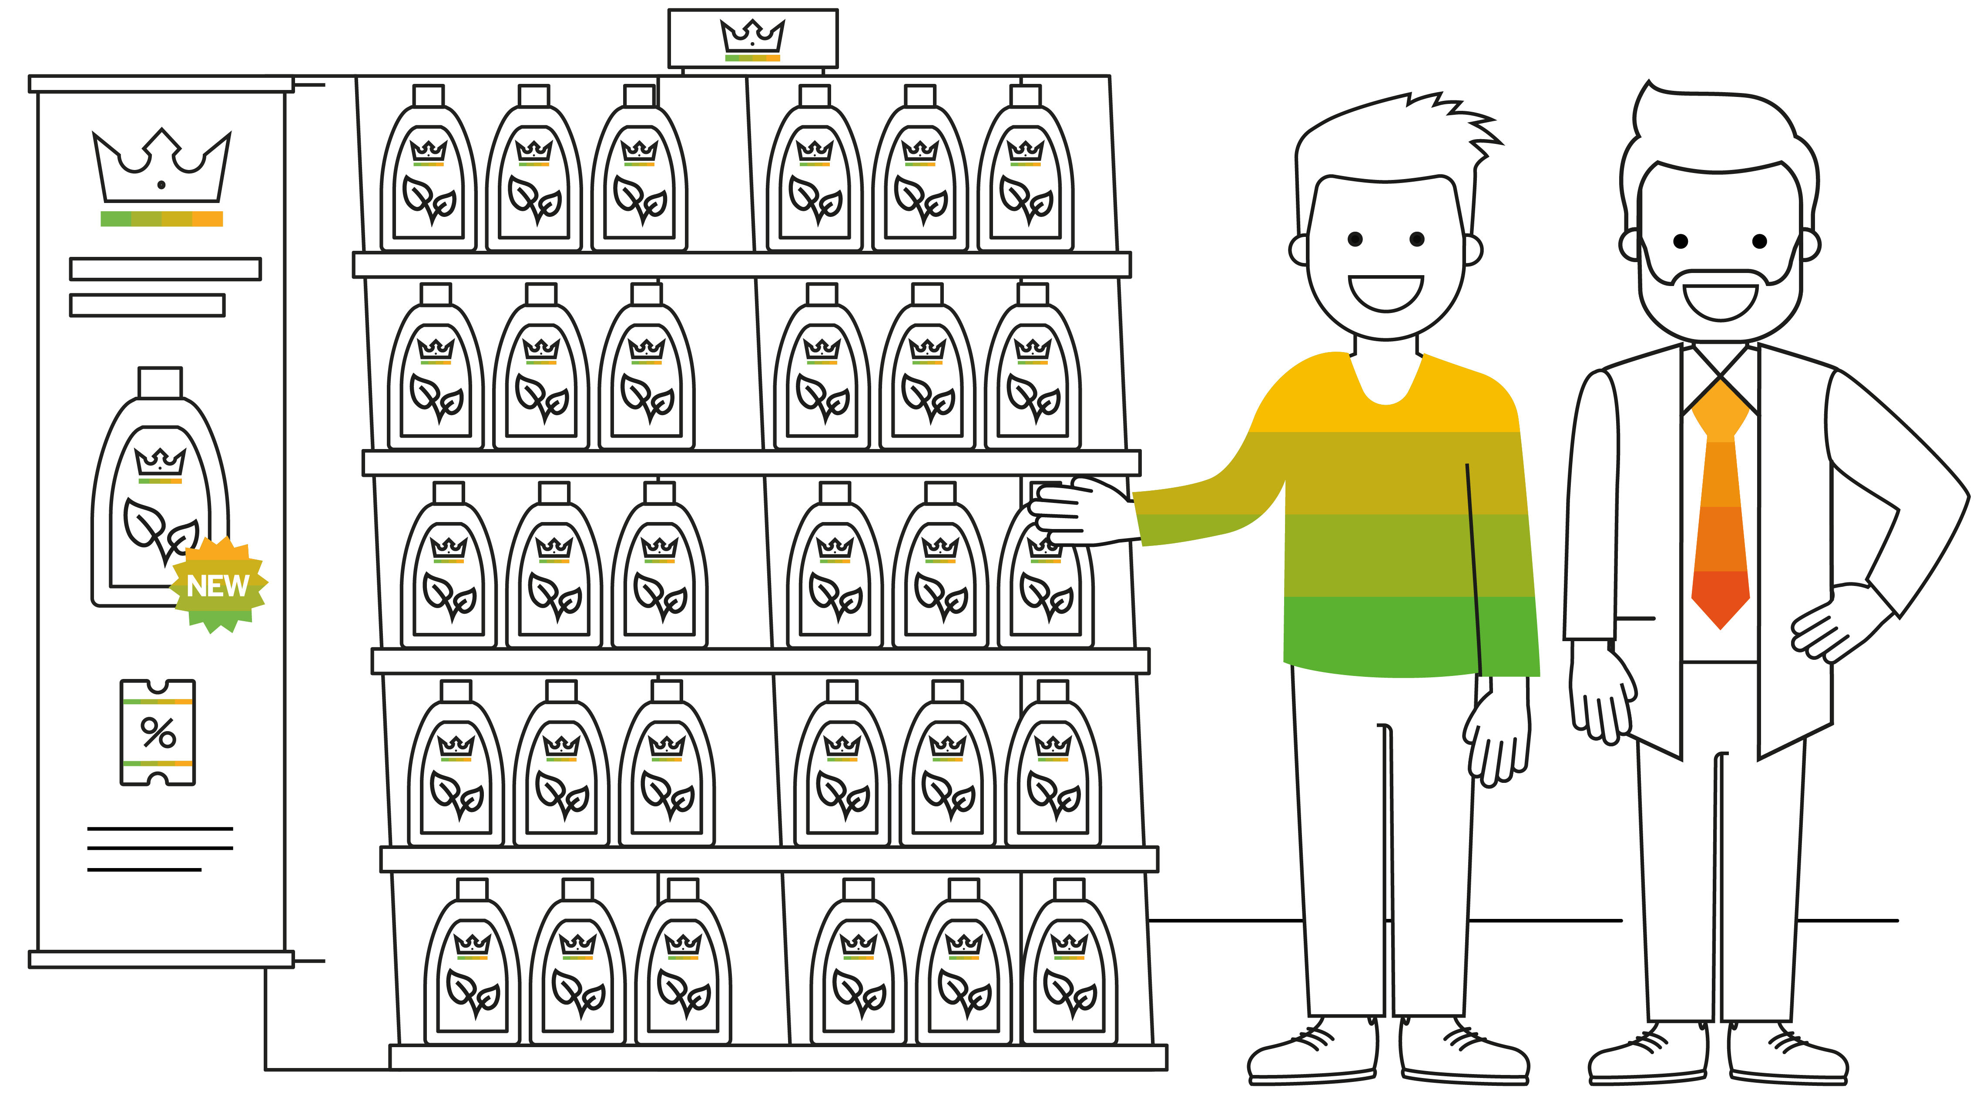
Notes:
Christian has completed his set up the promotional banner and other materials and even stocked the shelves with the new product. He has activated the promotion at ABC Store so ABC can now begin selling the product with the promotional offer.

Slide 14
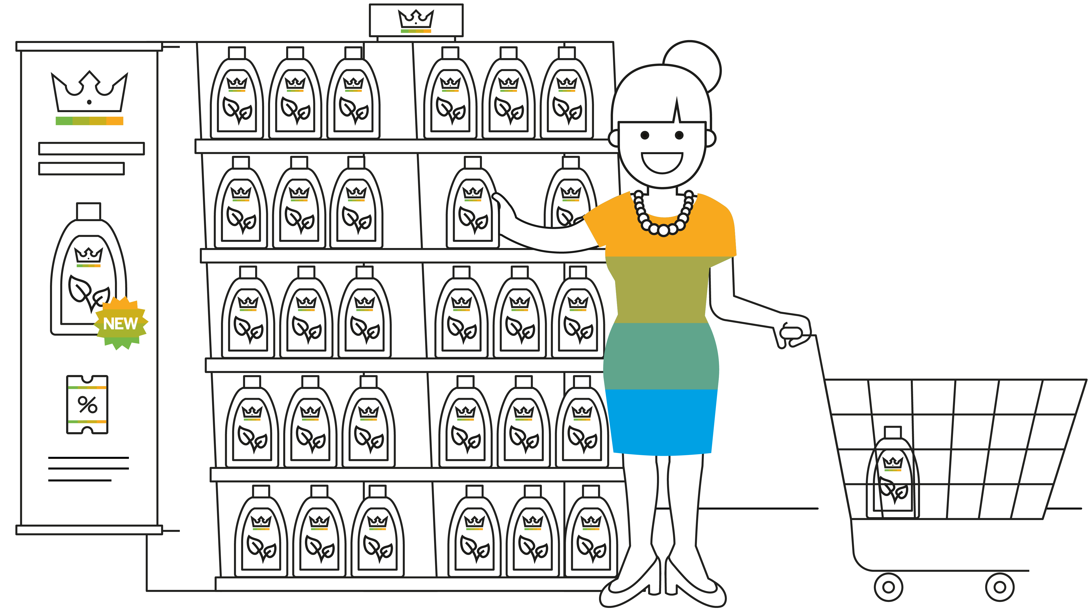
Notes:
Michelle received her promo email and is in the ABC store to pick up the new detergent and is excited she see the promotional banner with the promo price listed.

Slide 15
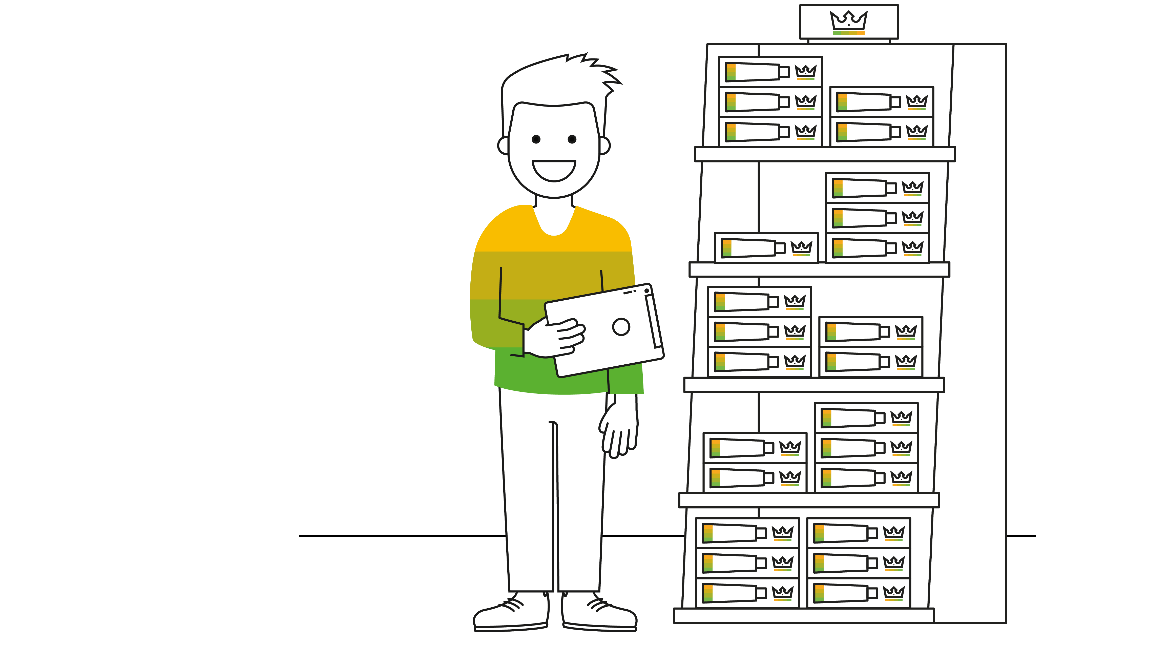
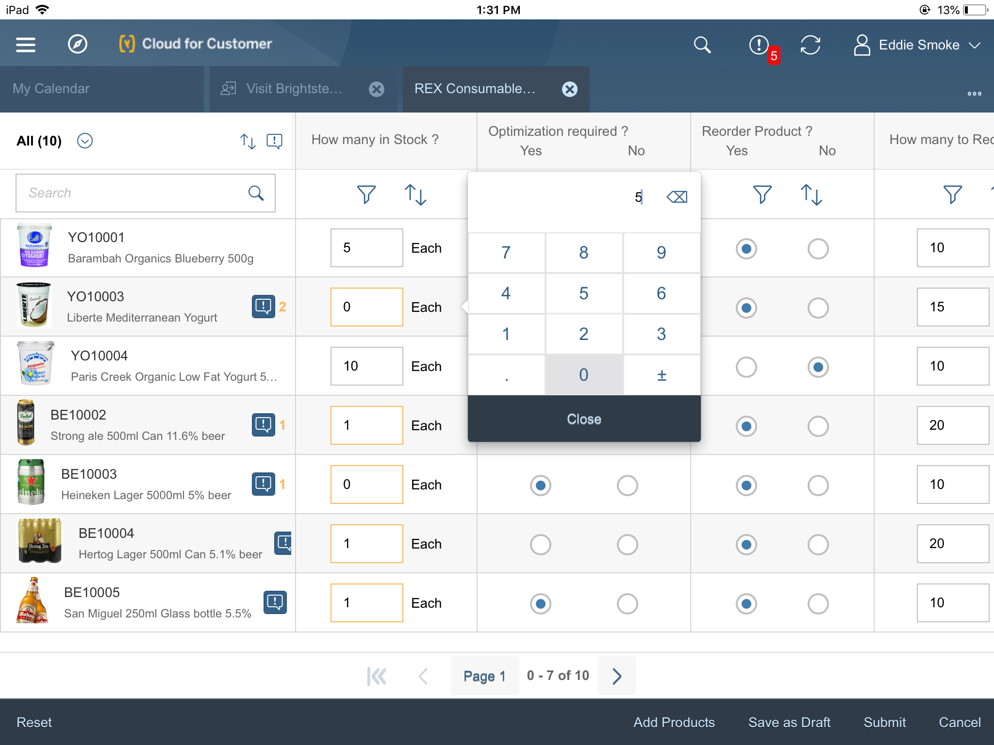
Notes:
Christian is back in the ABC store for his weekly in store checks like store compliance, inventory checks, competitor audits, surveys.

Slide 16
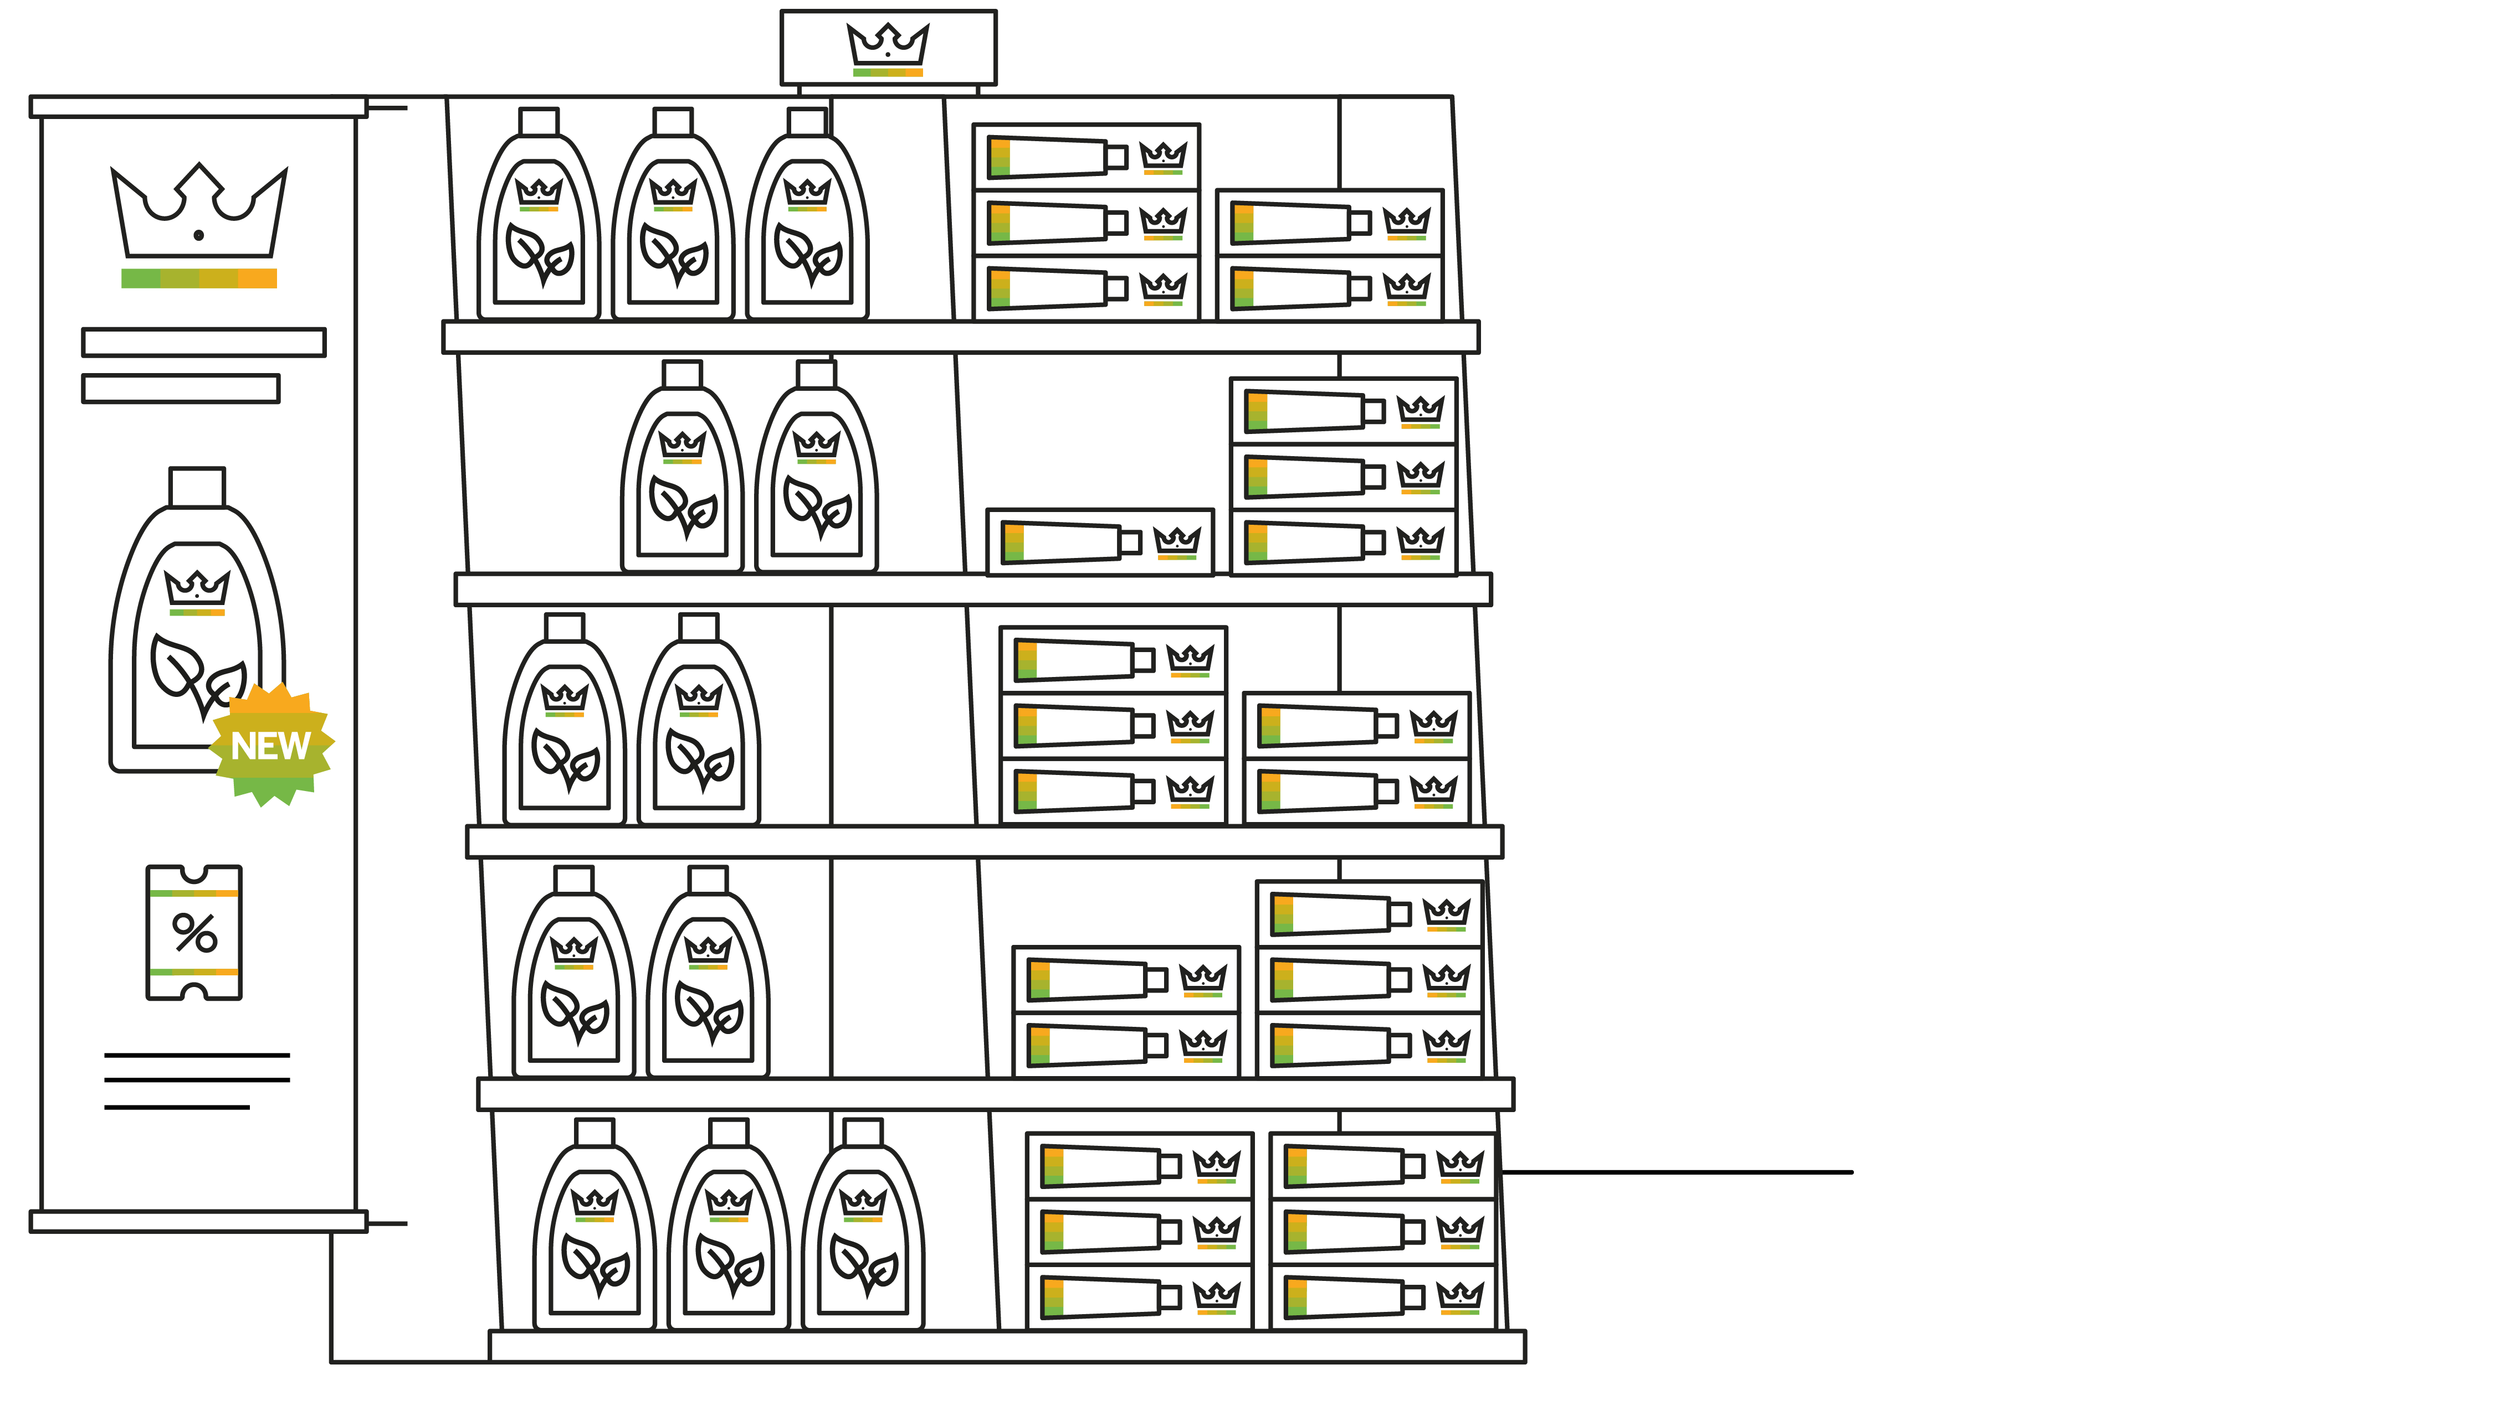
Notes:
Christian taking a picture of the promotions laundry detergent shelves with his iPad…
Sales Cloud is using artificial intelligence to analyse the real situation in the store (realogram) and the to be situation in the store (planogram) to provide Christian with corrective actions he needs to perform, to improve store performance and compliance.
Based on the results of the automatic recognition we can decide how many items will be reordered.

Slide 17
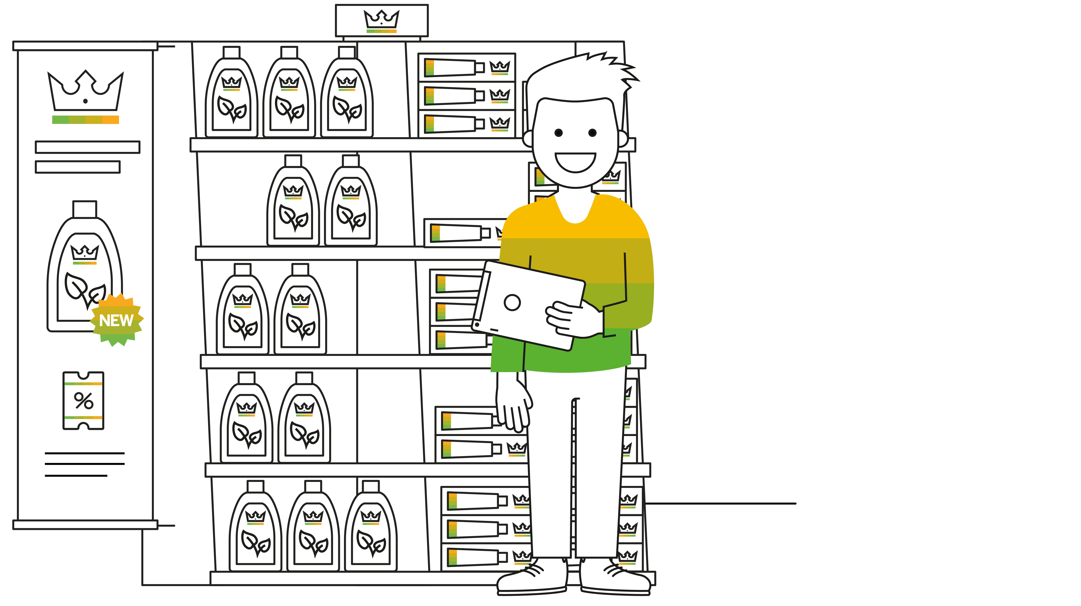
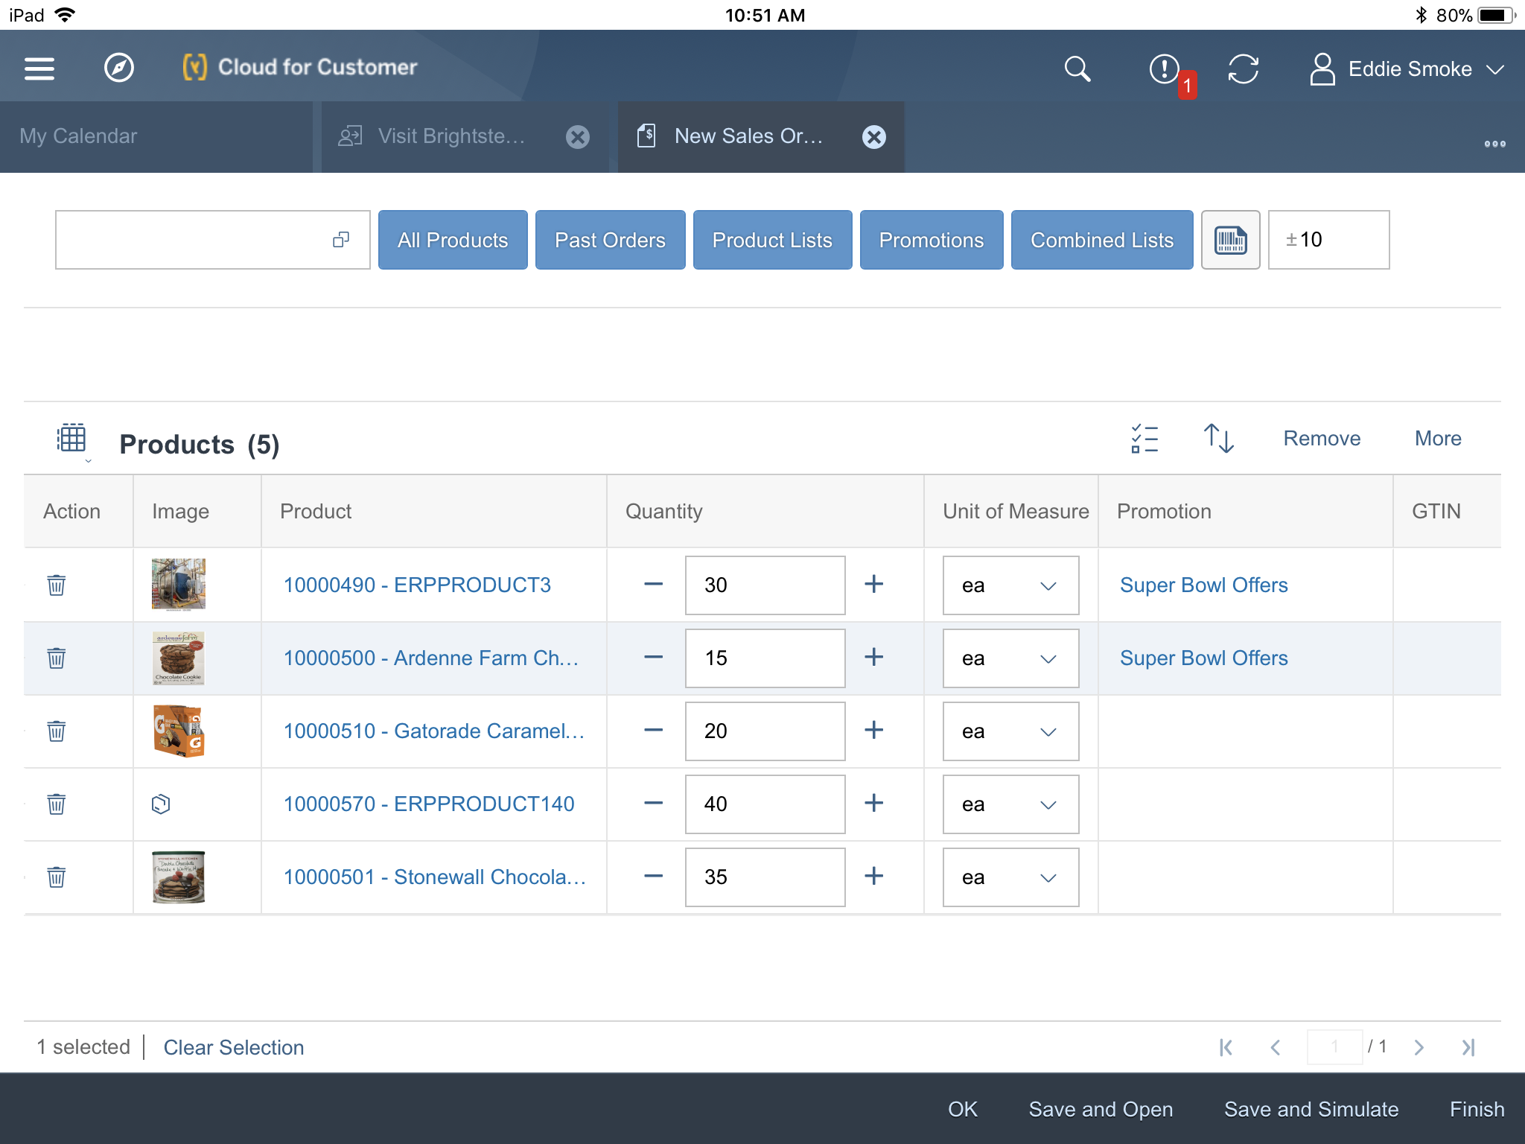
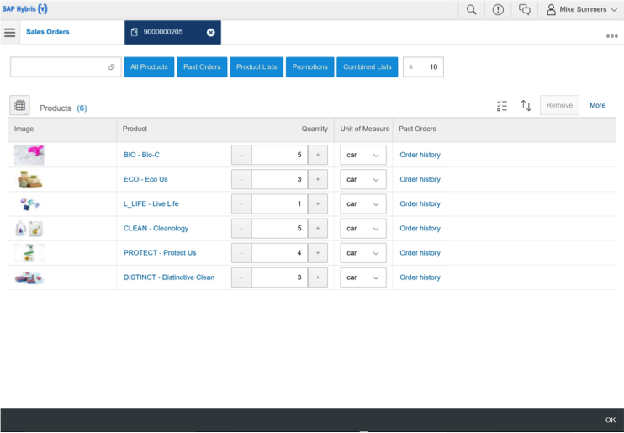
Notes:
Christian orders additional inventory (will show order form in C4C) since the promotion is still running. Show Christian ordering more inventory in front of promotional display. Due to the deep out of the box integration to SAP ERP and S/4HANA Christian can tell the store manager exactly how much the products will cost him, if there is enough in stock to deliver and when the products will be delivered. Philip signs the order right away on Christians iPad using his finger.

Slide 18
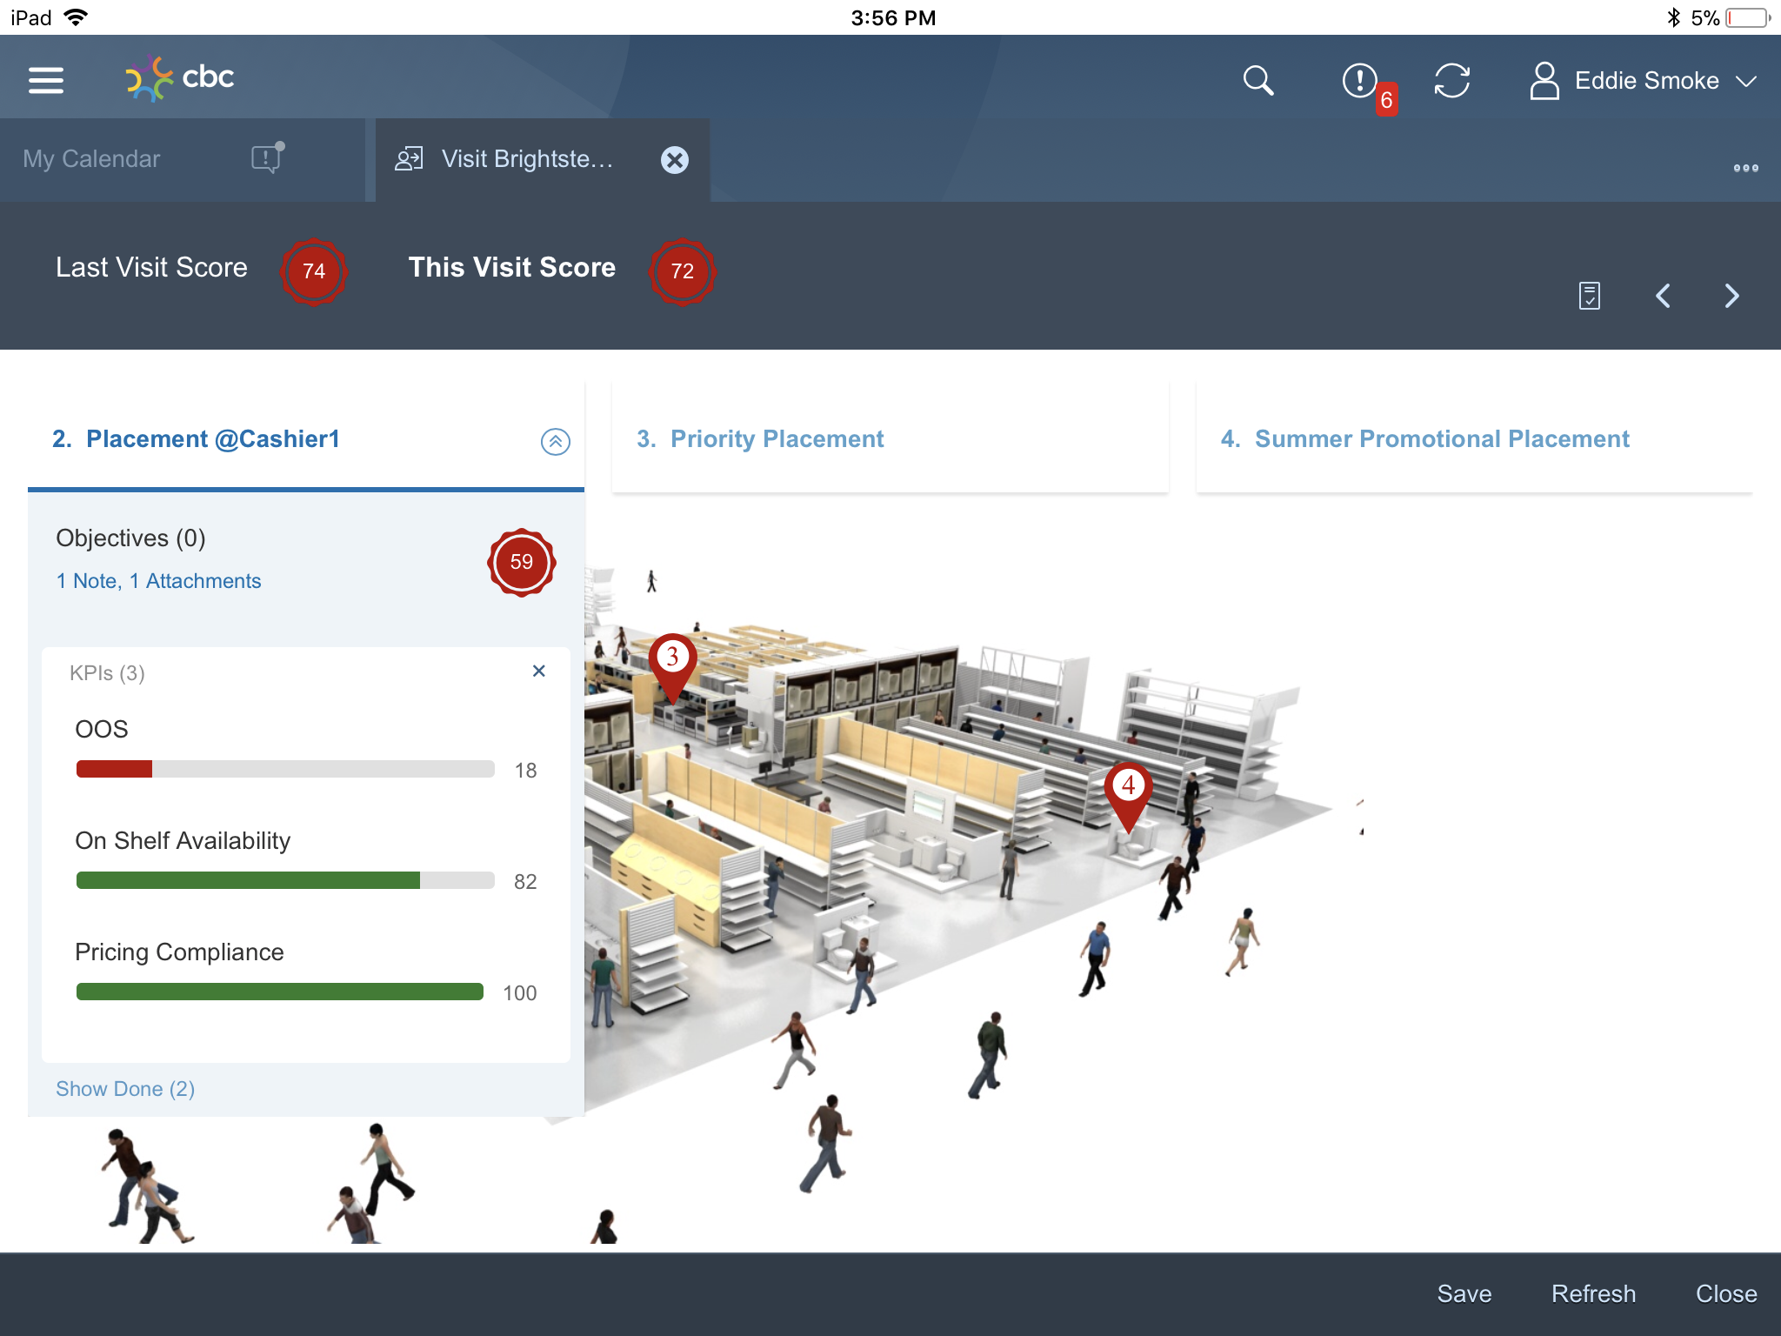
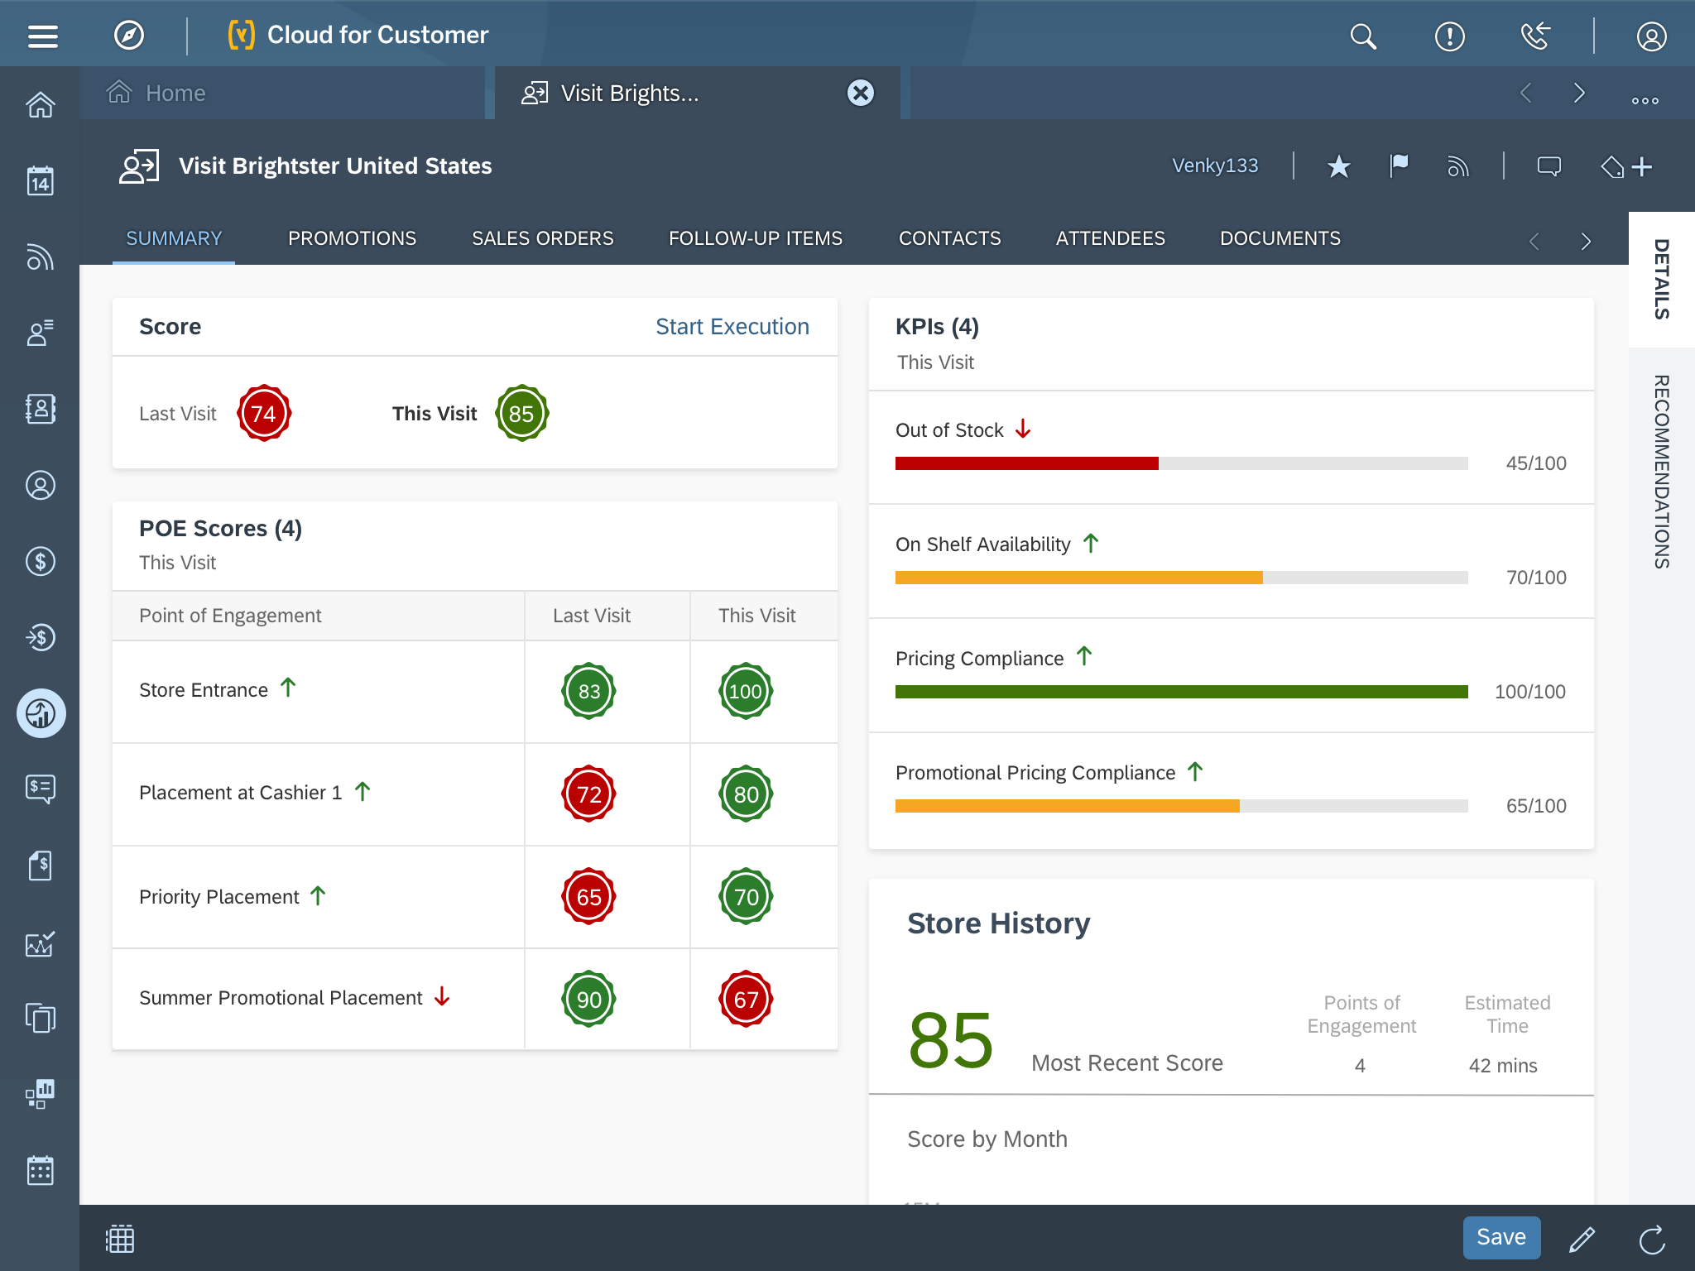

Slide 19
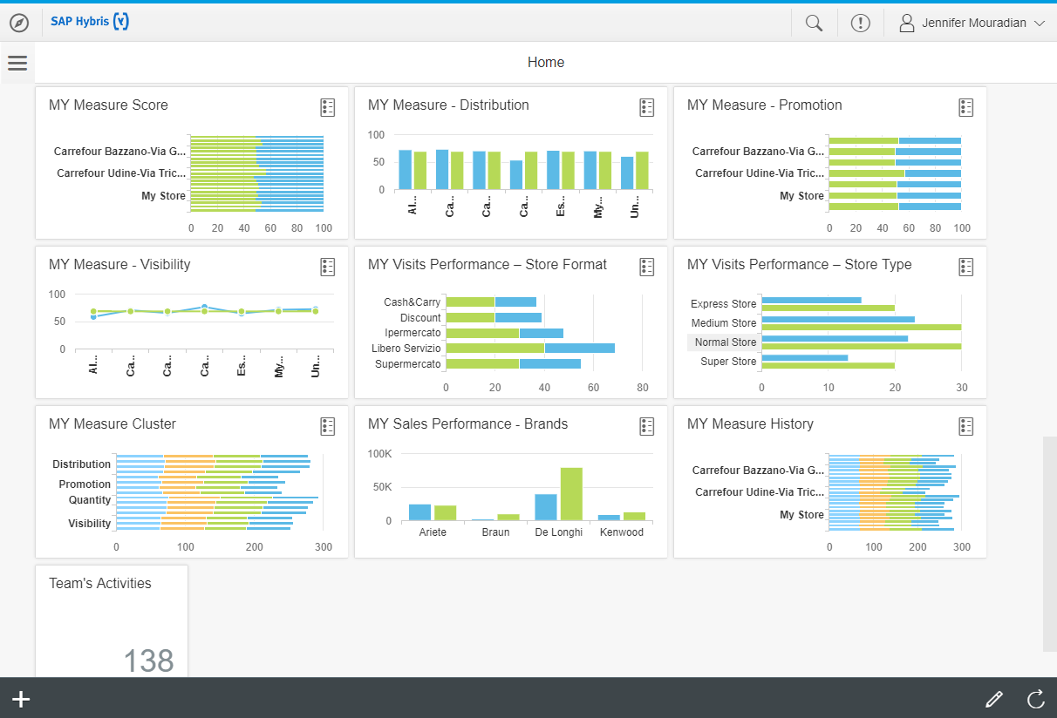
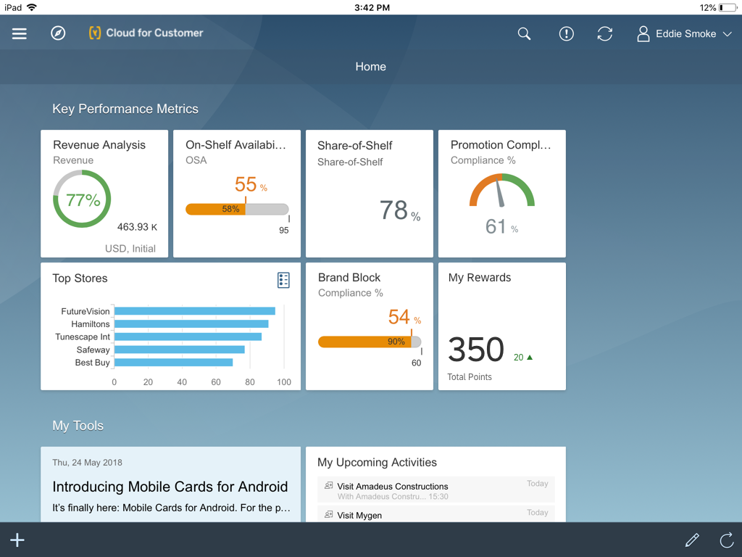
Notes:
Christian completed his ABC store visit in record time, and even sold more laundry detergent than expected due to a great system telling him what was in stock and the ability to order more quickly. Now his visit and sales performance looks great thanks to the SAP Sales Cloud application

Slide 20
SAP CLOUD FOR CUSTOMER
Retail Execution
PERSONAS:
Sales Operations, Sales Management, Key Account Management (KAM)
Sales Representative/Merchandiser or KAM
Territory planning
Survey and priority planning
Headquarter route and visit planning
Content and picture Assignment
Planning
Preparation
360-degree store view
Order history
Visit task and audit preparation
Check past notes and results
Check content and pictures
Check store performance
Drive priorities in store
Product-/ competitor product audit
Store-/ shelve checks
Imaging Intelligence
Promotional activities and documents
Manage and install POSM
Orders management (Including Pricing)
Asset check and service
Collections
Visit summary and next visit planning
Audit analytics
Survey results and scoring metrics
Perfect store analytics
Analytics
Execution

Slide 21
DEMO

Slide 22
SAP CLOUD FOR CUSTOMER RETAIL EXECUTION

Slide 23
Retail Execution Vendor Panorama
“SAP continues shows more focus in retail execution than ever before and the momentum has followed with an incremental 25,000 users since our last report. We have not previously found SAP offerings to be on par with best-of-breed but can honestly say that such is now the case”.

Slide 24
Different users one solution
Sales & Territory Management
Key Account Manager
Sales Operations & G2M
Retail Sales Representative & Merchandiser
Service Management, Service Agents, Call Center, Customer Service
Service Technicians

Slide 25
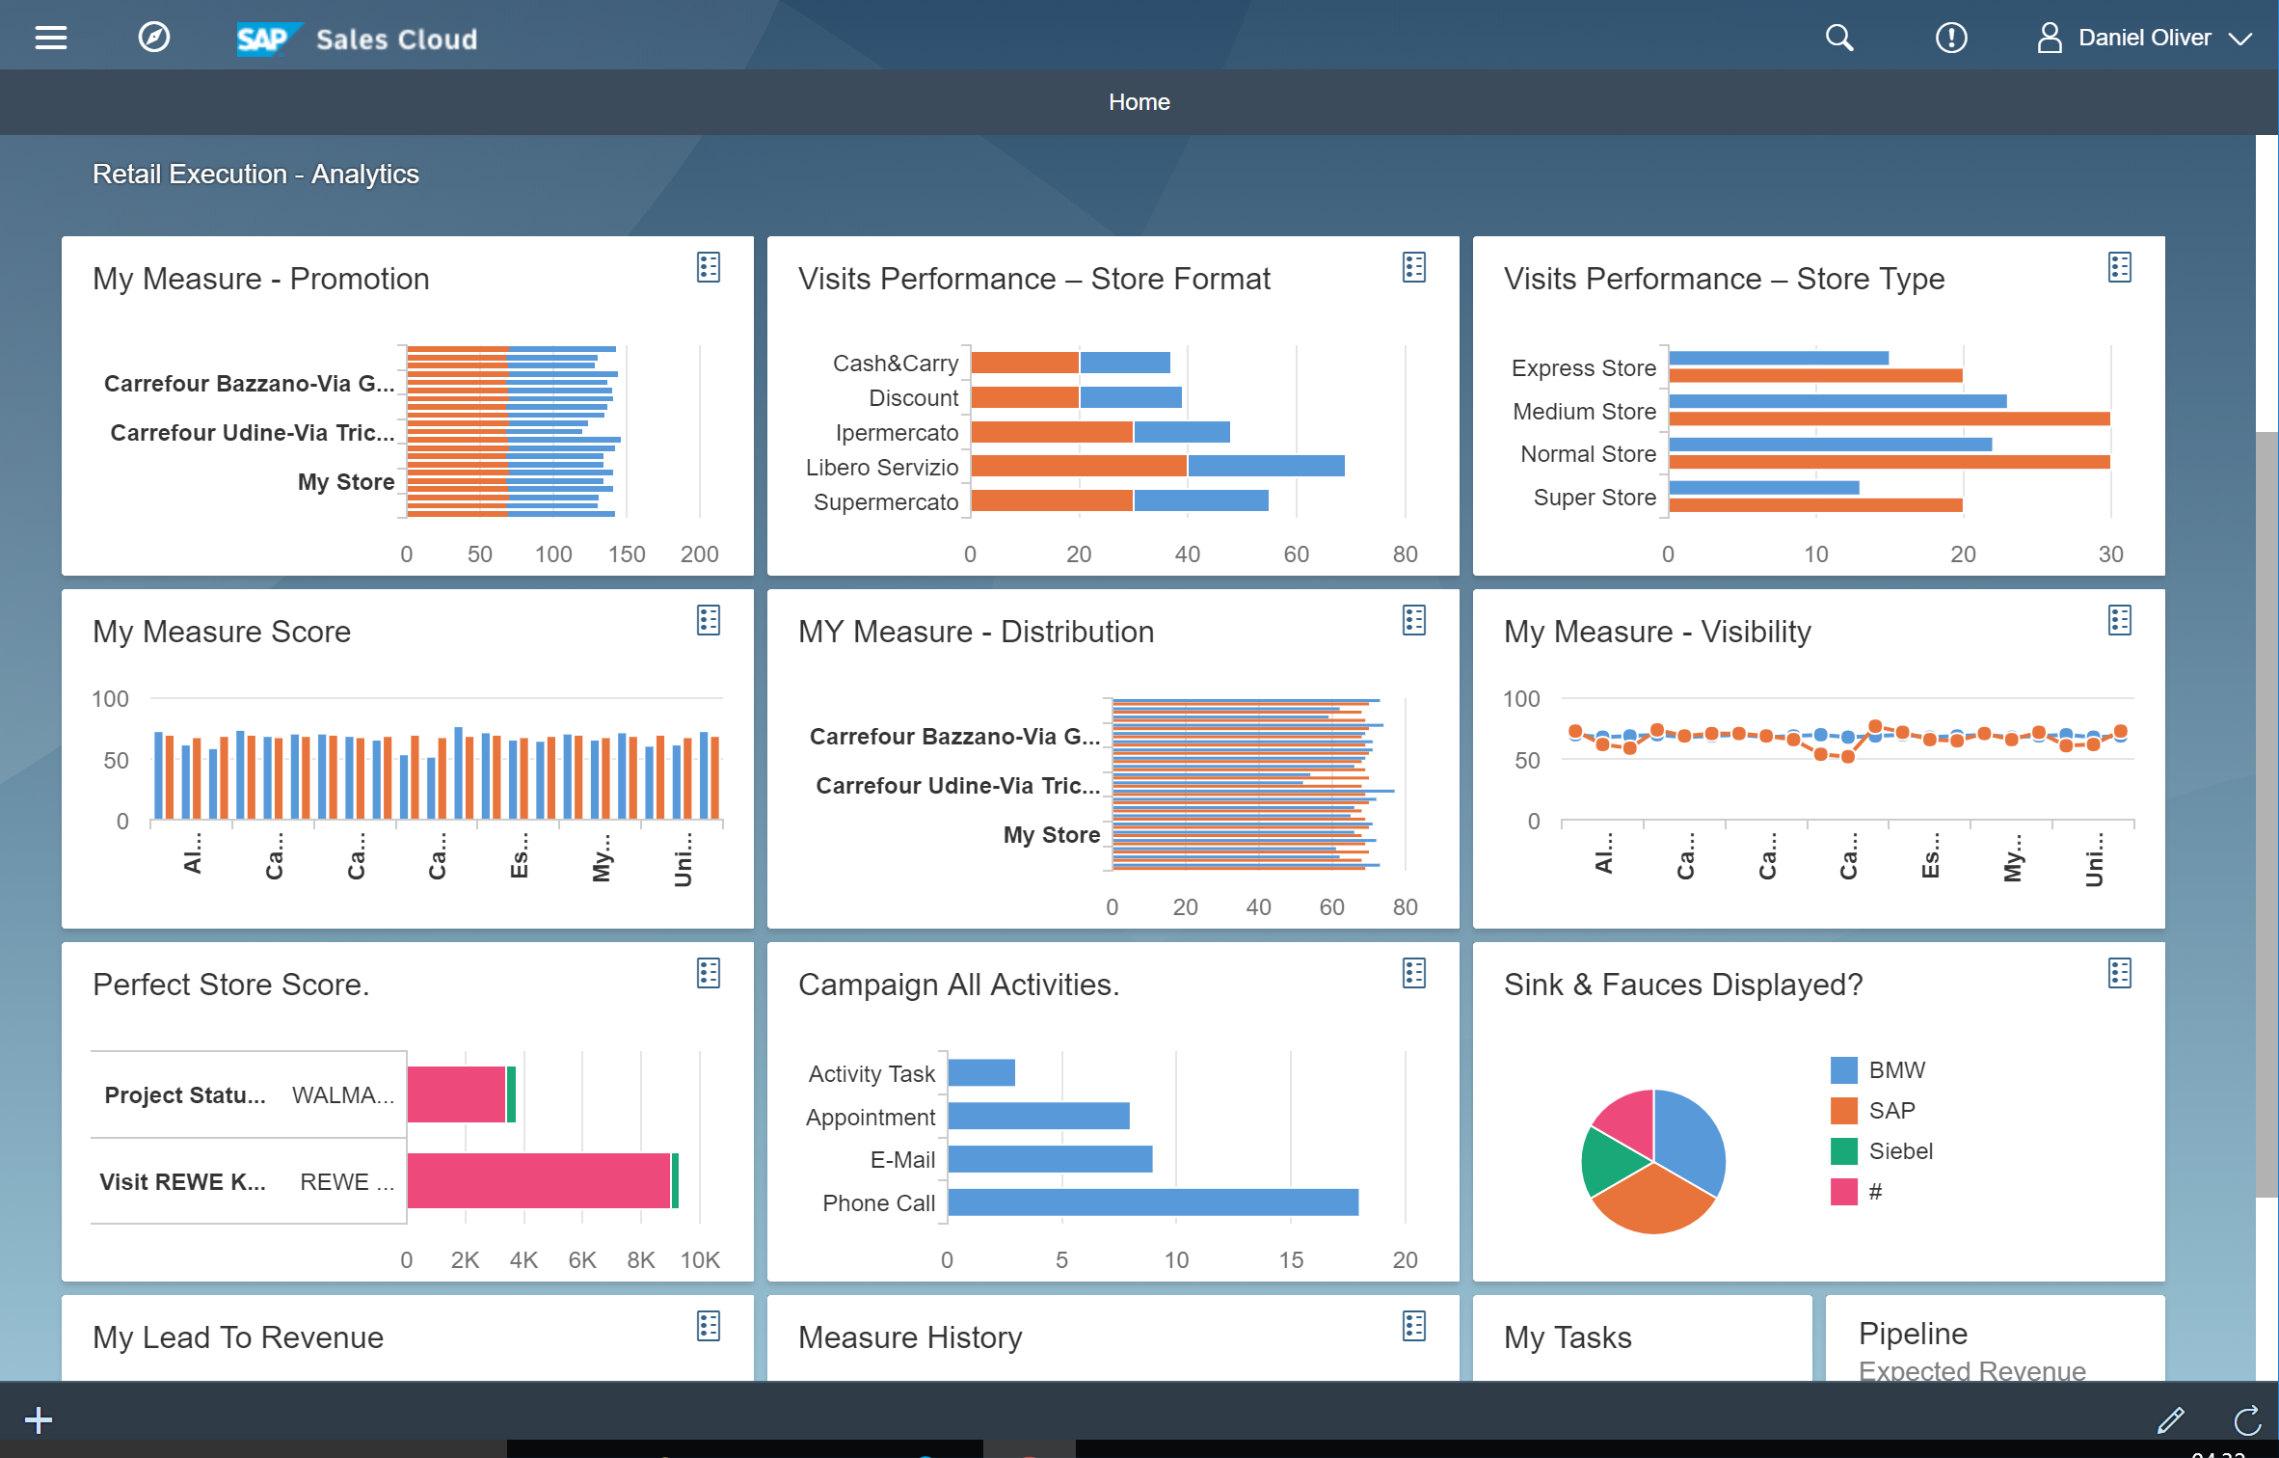
SAP Sales Cloud for Consumer Products HIGHLIGHTS
Modern User Interface
Lightning fast
UX designed for 21st century
Google like searches
Intuitive, game-like image capture interface
In-memory based database
Fast searches
Collaboration & Social
Feeds, followers, and @mentions
Internal, customers, partners
Retail Execution
Manage New Business
Visit administration
Plan and schedule visits
Calendar management
Surveys and product audits
Activities and tasks
Competitor audits
Survey and audit insights
Collections
Imaging Intelligence
Active and future campaigns / promotions
Review action item from previous visit
Order entry and history
Lead management
Opportunity management
Quotation management
Activity management
Real-Time Analytics
Dashboards & forecasting
Configurable custom reports
Account 360
Mash-ups with SAP BW and SAP BusinessObjects
Extensibility
Extend custom fields once and use them in all devices
Sophisticated key user tools
Integration
Groupware Integration
Mobile
Pre-built integration to SAP ERP, SAP CRM, SAP BW, SAP JAM, InsideView, Xactly, and more
Mashups with most other apps
Full-featured with 2-way sync
Support for Microsoft Outlook and Lotus Notes
Complete mobile apps, no extra cost
Multi device support through HTML5 based mobile app
Notes:
Sales Cloud is a combination of a Salesforce Automation application combined with a best of breed retail execution application in one single stack.
This is one of the key reasons customers decide for SAP Sales Cloud as their single stack application serving different needs and business processes beyond normal SFA.

Slide 26
Integrate Front Office (C4) to Digital Core (S4) through SAP Cloud Platform
Business
Business Objects, Services and Processes
Customer
Employee
Product
Invoicing
Consent Mgmt
Integration
Master Data
Integration
Workflow
Process Visibility
Rules
Leonardo
Analytics
Machine Learning
Blockchain
IoT
Data Intelligence
Core
Services
Tenancy
Security
Identity Mgmt
DevOps
Data Mgmt
Lifecycle Mgmt
Logging
Service Discovery
Monitoring
Connectivity
Notes:
Delivering customer experiences requires a front office suite, integrated to the back-office.
Trusted customer data is the golden record for the front office

Slide 29
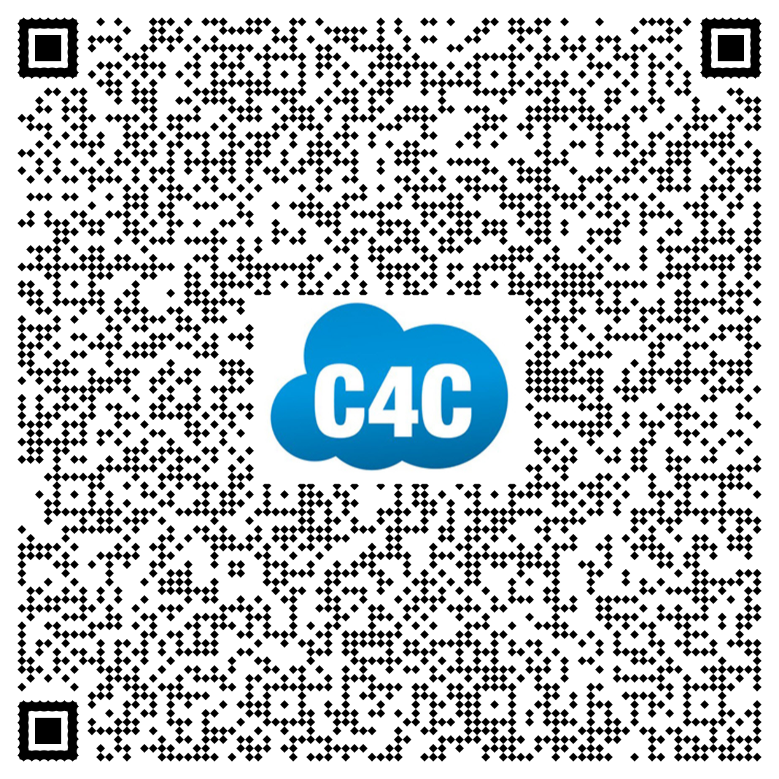
Thanks!
Contact Information:
Simon Dechent Global Market Development SAP Sales Cloud simon.dechent@sap.com +49 151 53858929

Slide 31
The Promotion Optimization Institute would like to thank the following sponsors for their support of the Promotion Optimization Institute and the Retail Execution Summit

