Slide 1
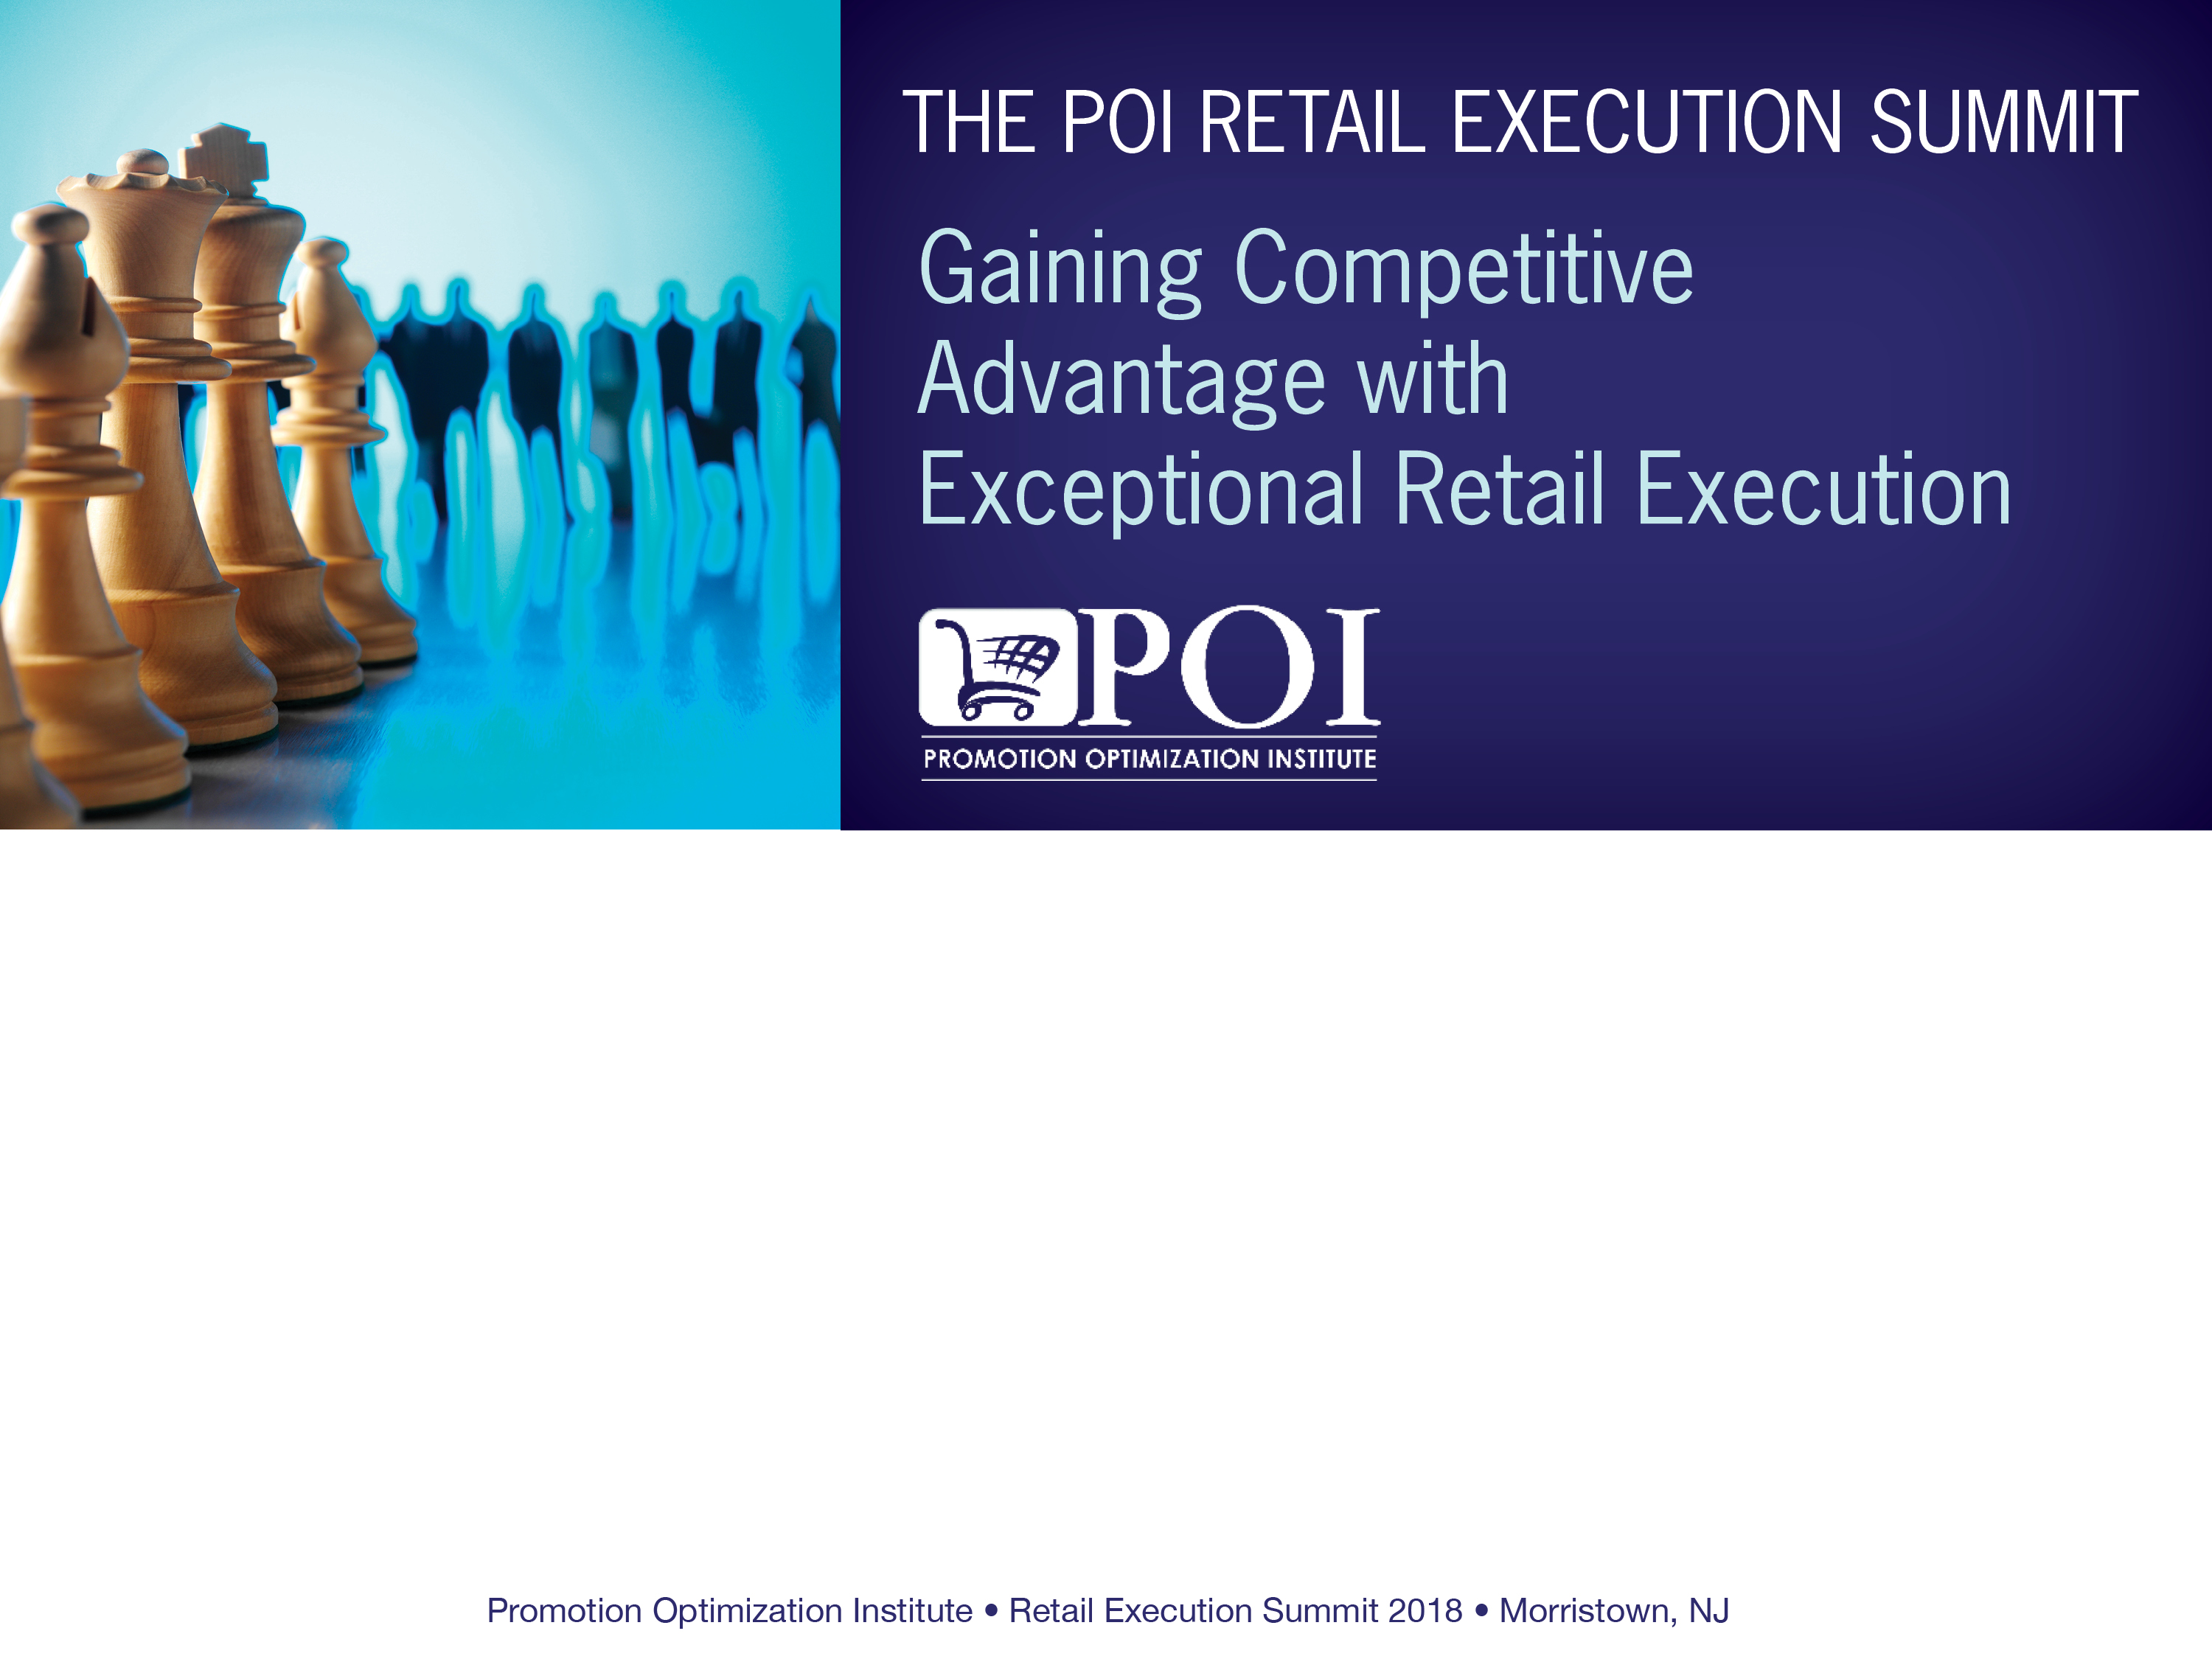
How Net Revenue Management Ties All the Pieces Together for Growth
Rich Greenlees – Global NRM Lead - Mondelez
Morristown 28th September 2018
Notes:
F4

Slide 2

Learning # 1.
Ask the big NRM question?

Slide 3



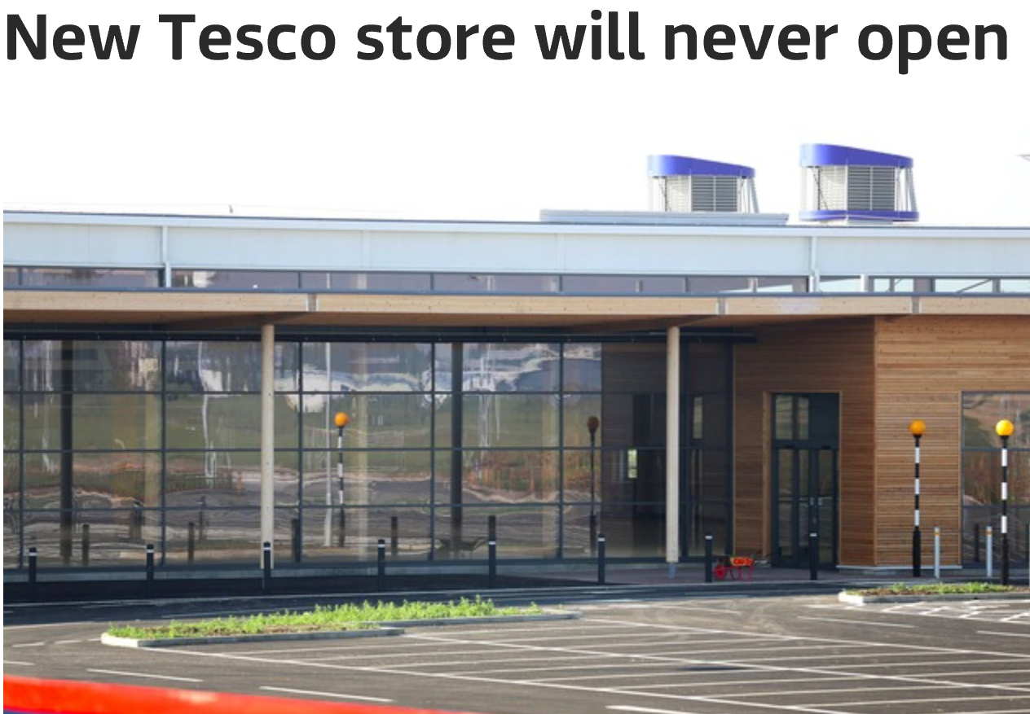



Change is constant ! Is it getting faster, am I getting older ?
Changing consumer
Demanding shoppers
Retail disruption
Macro uncertainty
health & wellness
authenticity
local sourcing
technology
Price importance
Loyalty decline
Demand for convenience
Growth of online
& discounters
The ‘Big Box’ challenge
Consolidation
Erratic growth
Input cost volatility
Legislation
Suppliers and retailers are under constant pressure

Slide 4


Learning # 2
Challenge + NRM = Opportunity
This tough environment poses a threat to us and our customers

Slide 5

Learning # 3
It is a journey requiring a LT vision

Slide 6
Learning # 4.
Think ‘PPT’ when defining vision
FROM
TO
Variable capability / heavy admin burden
Analytical, customer focussed managers
PEOPLE
Inconsistent KPIs not aligned to priorities
Standard KPIs
linked to Commercial Strategy
Lack of clarity on roles and responsibilities across functions
Clear roles embedded in organisation
Inconsistent planning, execution and evaluation processes
Standardised processes to enable powerful business plans
PROCESS
Multiple definitions used across markets/regions
One global language
Varied levels of governance and controls
Simple, consistent
governance and controls
TECH-NOLOGY
Multiple tools/spreadsheets/systems
Consistent & transparent data
enabling better decisions

Slide 7
Building out enablers . . .
Strategy & Direction
Tone from the Top
Terms Frame
PPA
Capability
Roles & Resp.
KPIs & Incentives
Commercial Competency
JBPs
Perfect Store data & KPI’s
IBP
PFP
Promo
ROI
Process
JBP Tools
Promo ROI Tools
Systems
Consistent P&L’s
External data & POP
Advanced analytics

Slide 8

Learning # 5.
NRM is highly interdependent
“It’s amazing what you can accomplish if you don’t care who takes the credit!”
Harry S. Truman

Slide 9
Learning # 6.
Have a well defined process
Evaluate & Learn
Prioritize
Define trade priorities
Update annual plan
Develop
targets
Evaluate performance
NRM
Brief Account Teams
Manage trade accruals
Customer business plans
Execute & track activity
Execute
Develop JBP
Plan
Confirm activities
Define activities

Slide 10
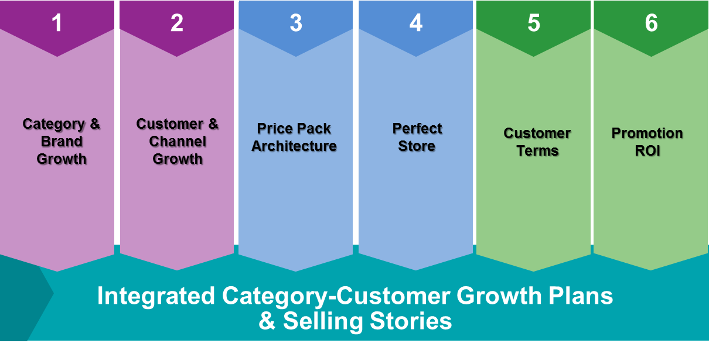
Learning # 7.
Take a holistic approach to NRM
Done Well - NRM ties all the elements together to drive EXCEPTIONAL RETAIL EXECUTION
Typically proposed models use 5,6,7 pillars of NRM / RGM / RM

Slide 11

Thank you !
Questions?

Slide 12






The Promotion Optimization Institute would like to thank the following sponsors for their support of the Promotion
Optimization Institute and the Retail Execution Summit

