Slide 2
How Trading Partner Collaboration Drives Superior Retail Execution
DIANA SHEEHAN
VP Retail & Shopper Insights,
Kantar Consulting Americas
diana.sheehan@kantarconsulting.com

Slide 3
Shoppers: What to know
Getting Big Box Right
Going Big with Small Format
Smaller is better? What’s next?

Slide 4
Shoppers: What to know
Getting Big Box Right
Going Big with Small Format
Smaller is better? What’s next?

Slide 5
Shoppers expanded retailer sets and shopping lists in 2017
The retailer rationalization and category contraction trends look to have bottomed out in 2015 and 2016
Average Number of Retailers Shopped in Past Four Weeks
(inclusive of visits to stores and websites; averages are for Q1-Q3 for each year)
Average Number of Categories Purchased in Past Four Weeks
(inclusive of consumables and general merchandise categories)
N/A
N/A

Slide 6
Which retailers are returning to shoppers’ consideration sets?
Two paths to ‘winning’ back shoppers
BROADENING APPEAL
DEEPENING LOYALTY

Slide 7
Three types of ‘winners’ emerge in this environment
Deepening Loyalty | Winning Big
Lagging | Broadening Appeal
DEEPENING LOYALTY
BROADENING APPEAL

Slide 8
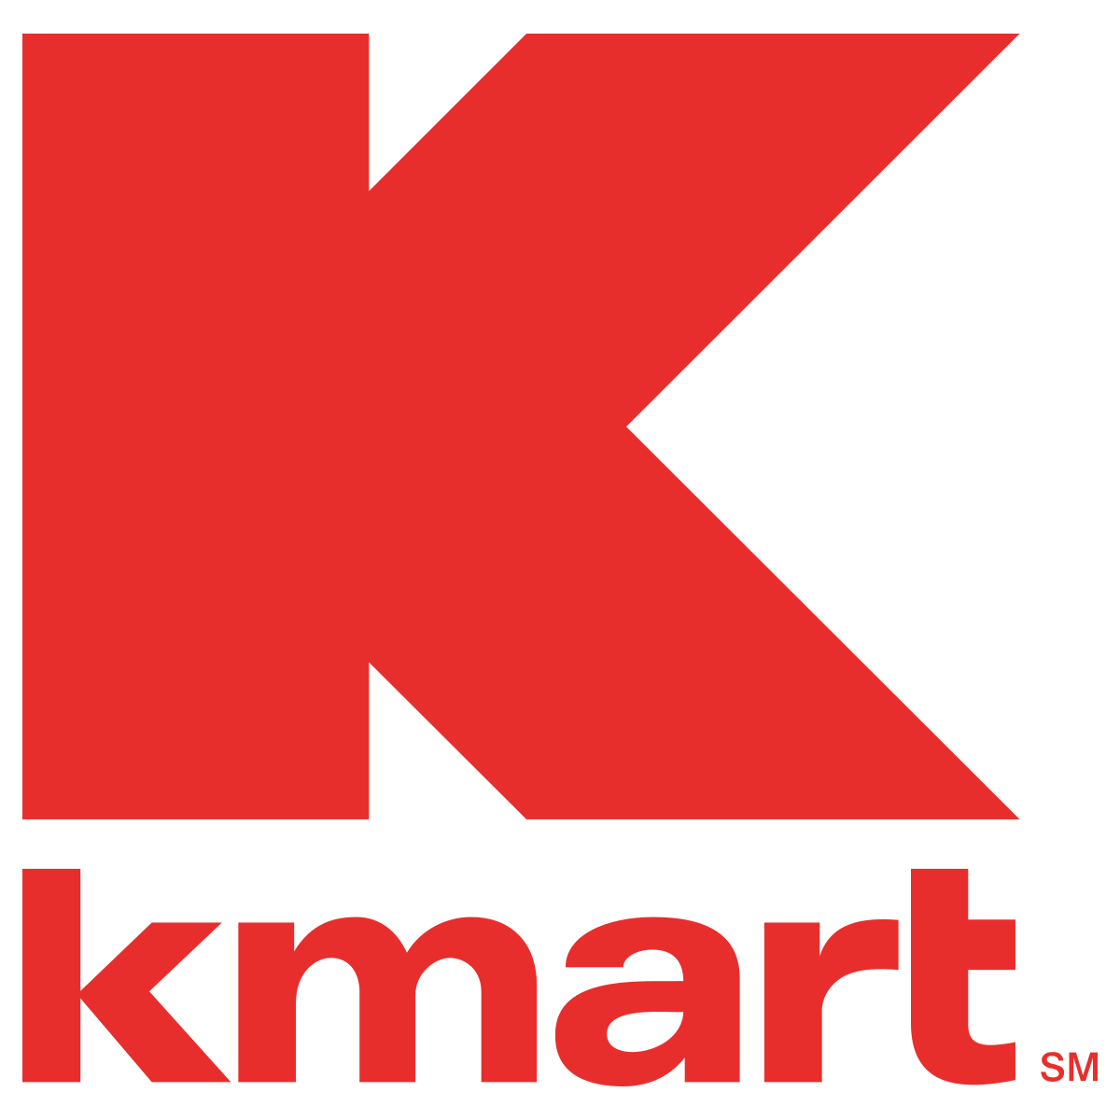
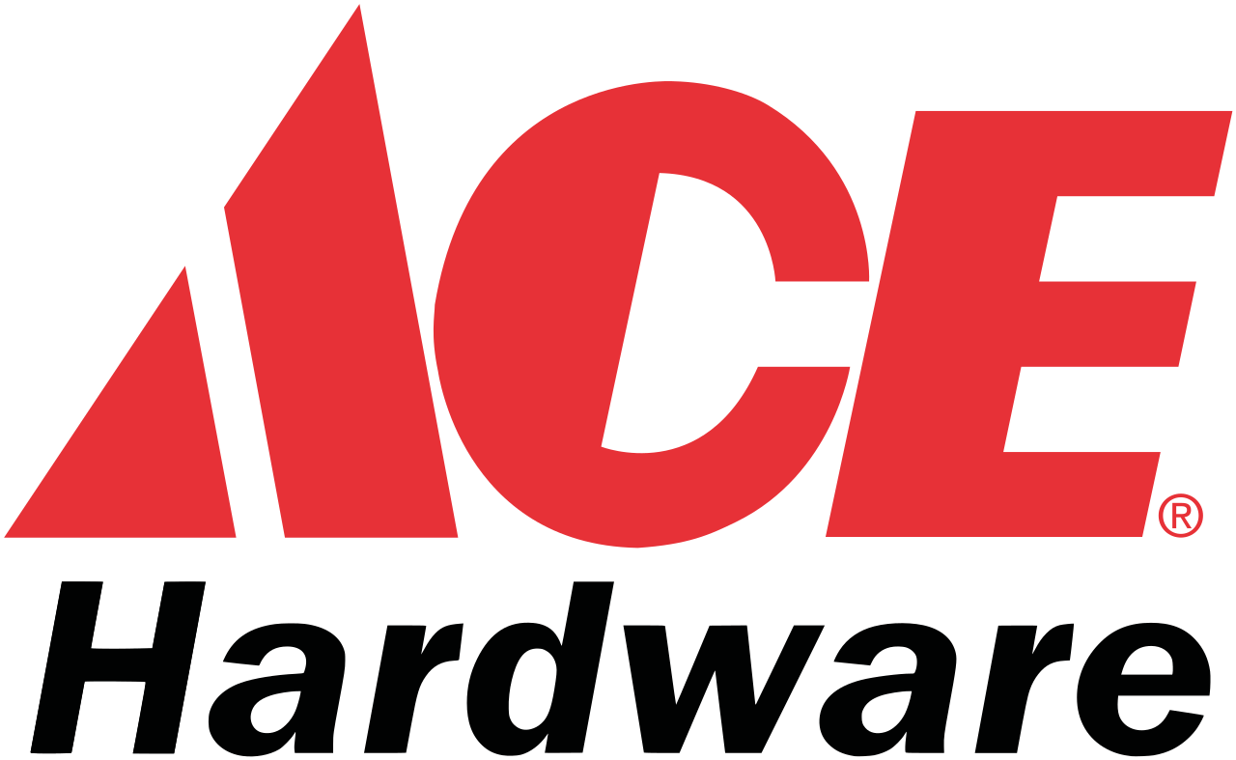
Three types of ‘winners’ emerge in this environment
DEEPENING LOYALTY
BROADENING APPEAL

Slide 9
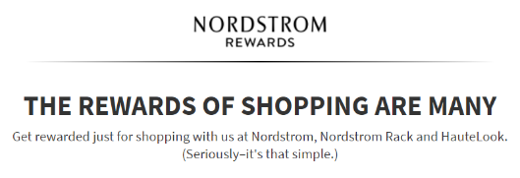
Deepening loyalty: Nordstrom expands rewards for loyal shoppers by offering tender-neutral options

Slide 10
Broadening appeal: Dick’s Sporting Goods connects with shopper values
Dick’s Sporting Goods Shopper Penetration
“
We don’t want to be a part of this story any longer. [We] have to help solve the problem that’s in front of us.
“
EDWARD STACK
CEO, DICK’S SPORTING GOODS
FEBRUARY 2018

Slide 11
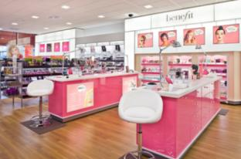
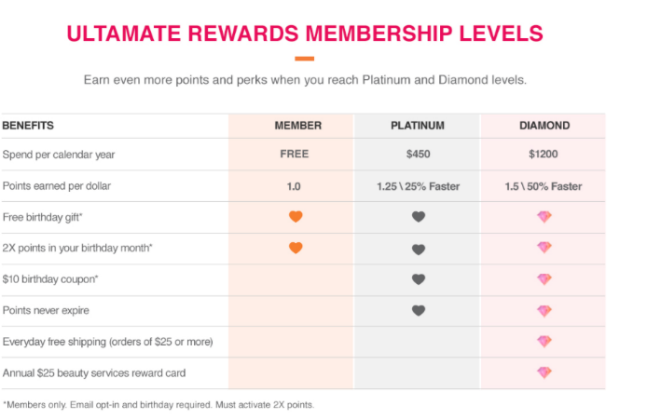
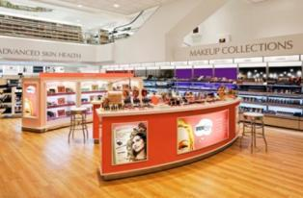
Winning big: Ulta expands its footprint, continues value focus, and offers personalized experience in a big box

Slide 12
Preference for online over physical stores grew sharply from 2015 to 2016
But plateaued in 2017; is this trend temporary?
Shoppers Who Indicate Online (vs. Physical Store) Is Best Venue for Key Aspects of Shopping
(among all primary household shoppers)
Note: Online comprises computer, smartphone, and tablet.

Slide 13
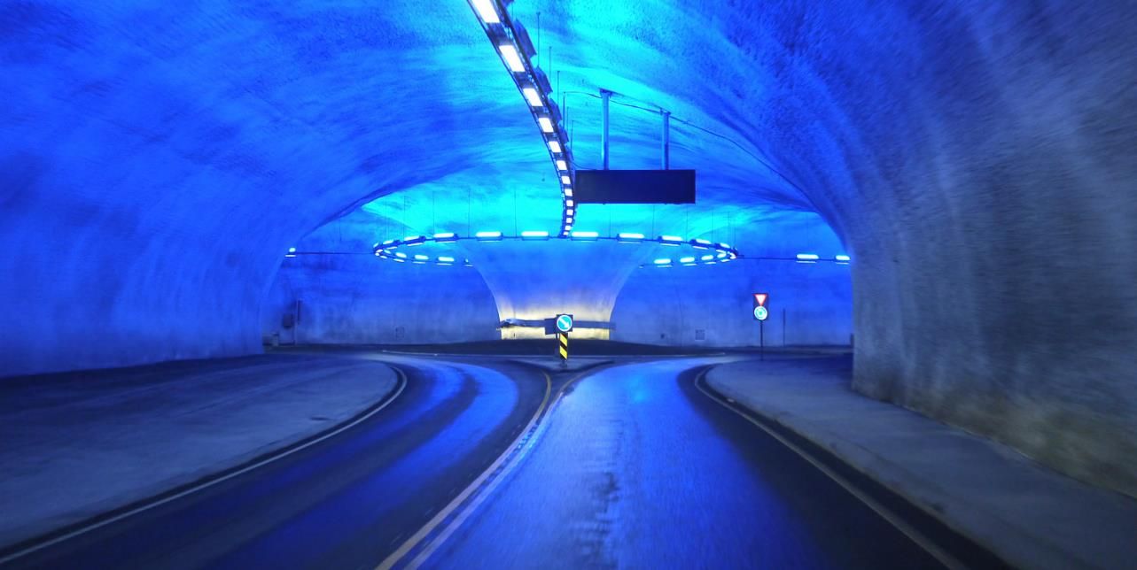

Slide 14
Shoppers’ preferences for stores vs. digital shifting into a nuanced picture
STORES GAINING FOR …
ONLINE GAINING FOR …
And that picture is a portrait of a savvy omnishopper
Delivering value
Discovering new products/brands
Having access to info
One-place shopping

Slide 15
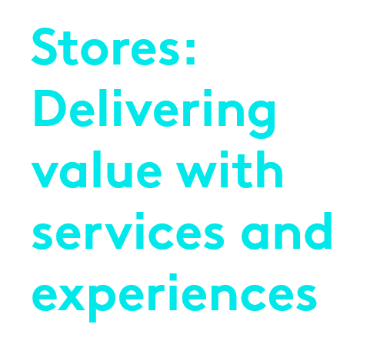
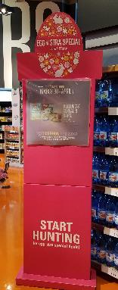
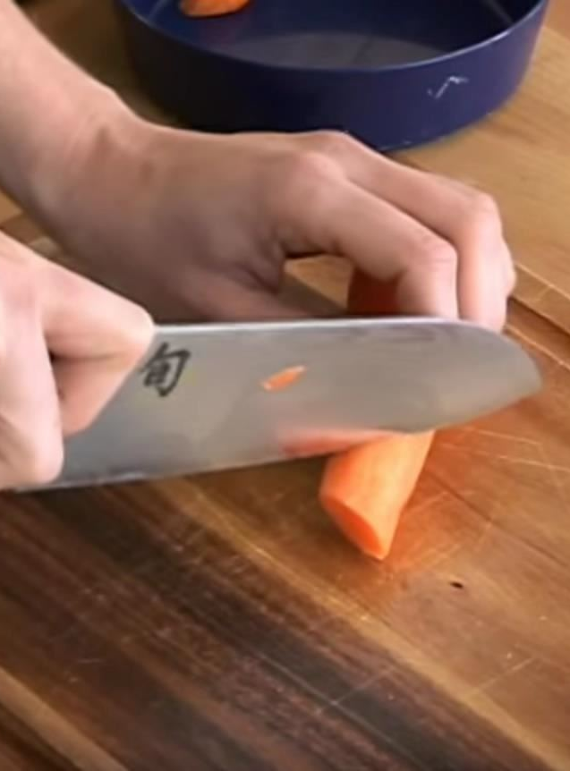
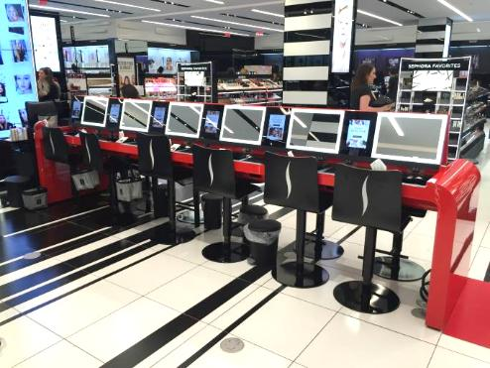

Slide 16
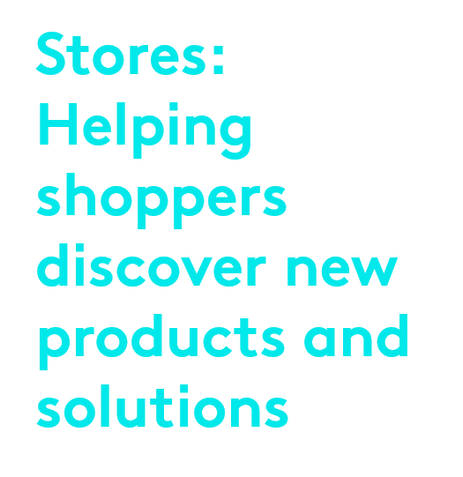
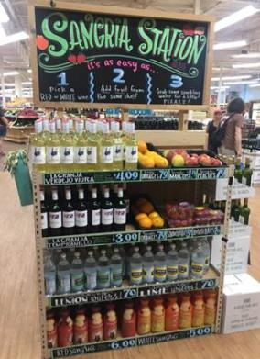
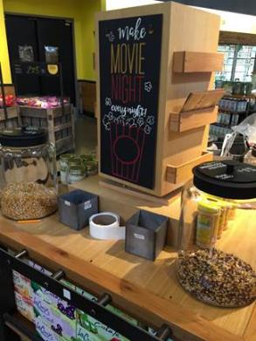
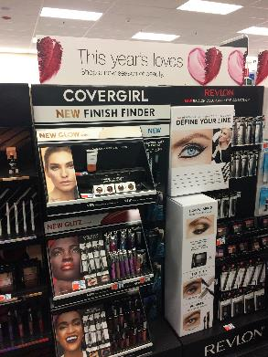

Slide 17
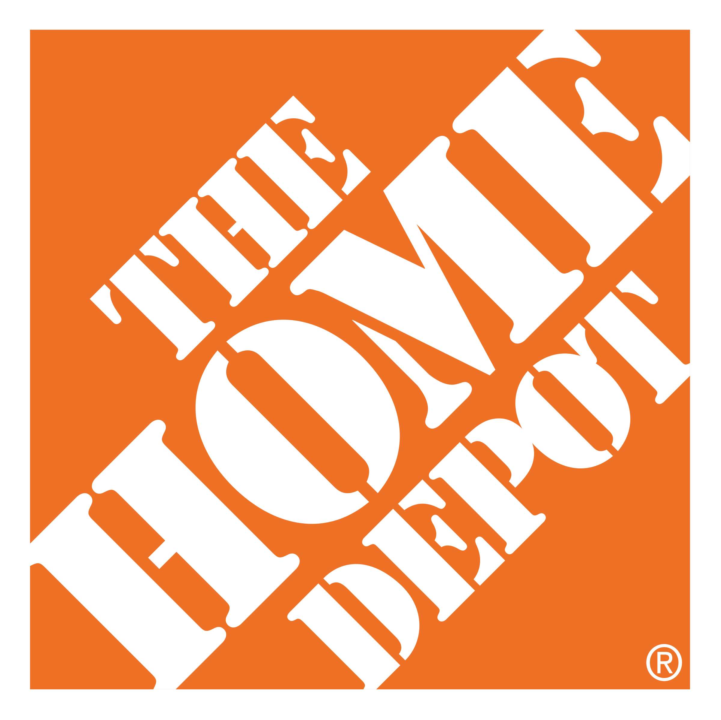
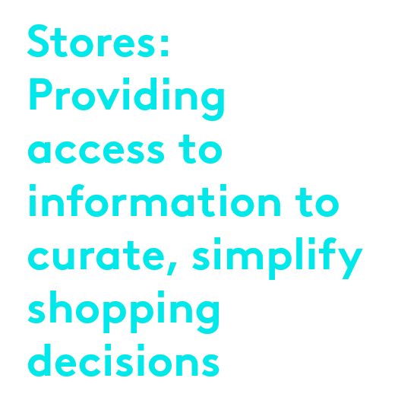
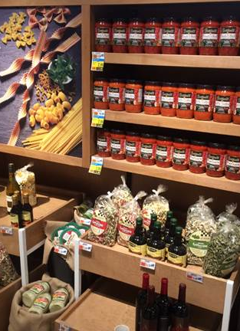
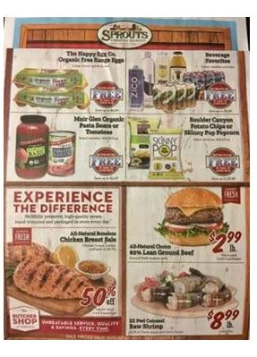
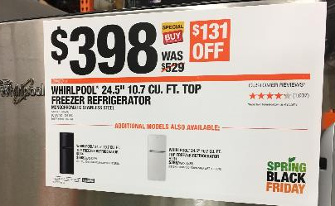

Slide 18
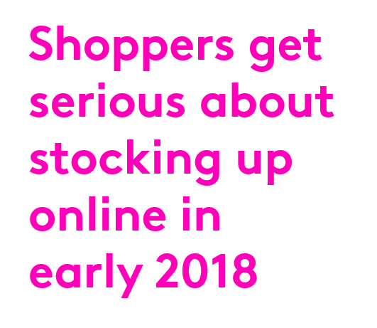
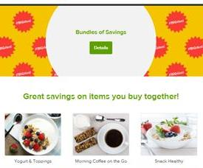
Online grocery will further shape shoppers’ preferences and expectations for consumables shopping
Primary Mission on Last Grocery “Trip” to Online-Only Retailer
Note: Arrow indicates statistically significant year-to-year difference (95% confidence level); online-only retailers include Amazon and Peapod.

Slide 19
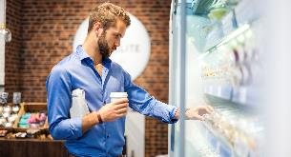
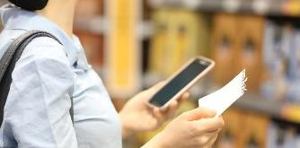
Besides moving commerce online, online grocery will impact retail more broadly in several important ways
ALTERS IN-STORE BEHAVIOR
SHAPES EXPECTATIONS
AFFECTS RETAILER CHOICE
ACCELERATES ROLE OF MOBILE
28%
11%
11%
51%
Spending less in store
Have become more impatient with the in-store experience
Go to physical stores that offer nicer shopping experience
Use mobile device to build basket

Slide 20
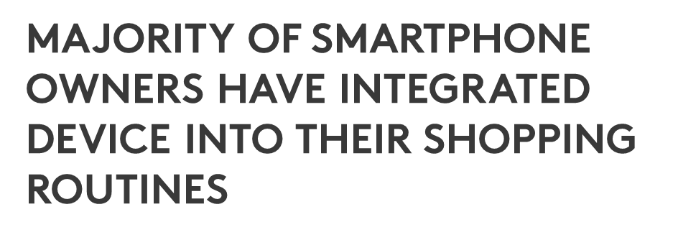
62%

Slide 21
Shoppers: What to know
Getting Big Box Right
Going Big with Small Format
Smaller is better? What’s next?

Slide 22
Welcome to the new world of commerce
Suppliers must place strategic bets to help retailers increase online conversion and offline trips
eCommerce
Brick-and-Mortar Retail
TECHNOLOGY
TRIPS
LOGISTICS
Small Box
Big Box
DATA

Slide 23
Across shopping objectives, shoppers rely on a mix of store and online resources
Stores still hold sway in most cases, but online is shaping shopper expectations
Venue Shoppers Say Is Best for Key Aspects of Shopping (among all primary household shoppers)
Stores the preferred venue

Slide 24
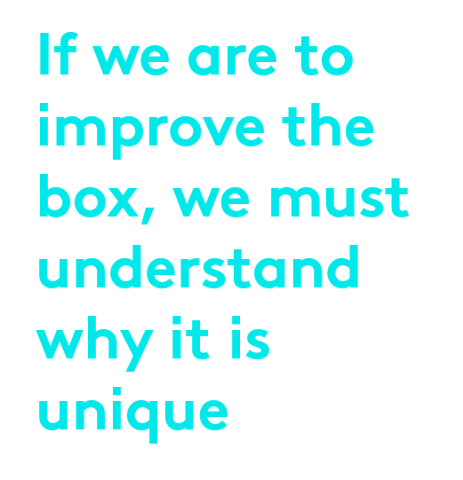
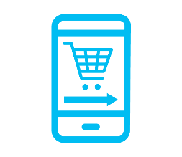
Value Leadership
Frictionless Experiences
Product Expertise
Problem Solving

Slide 25
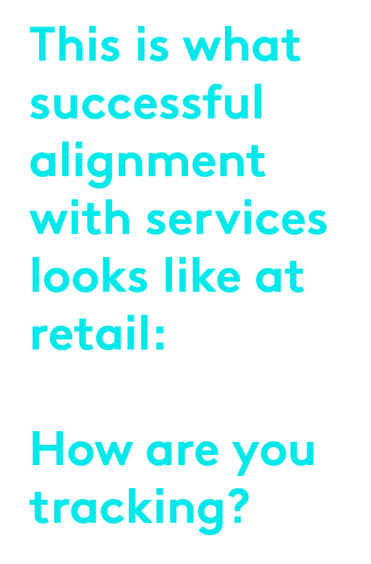
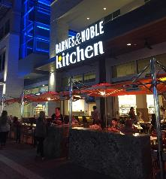
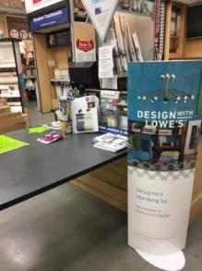
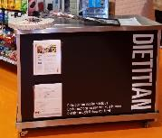
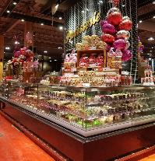
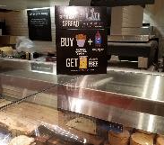

Slide 26
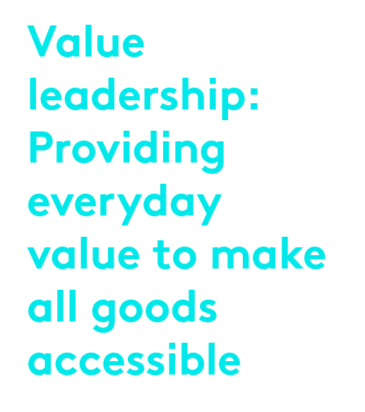
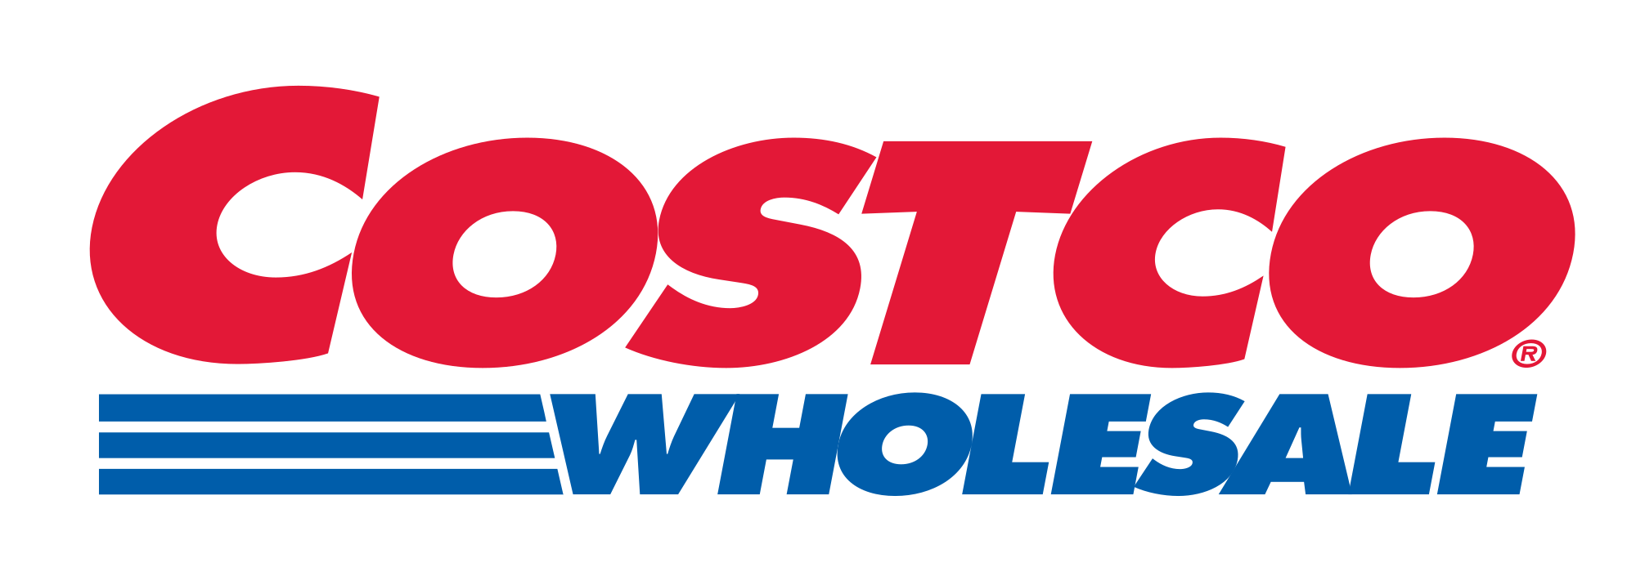
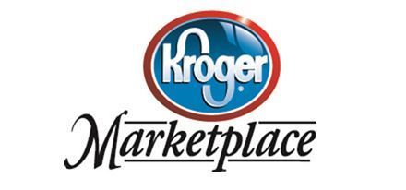
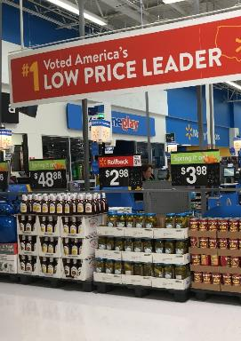
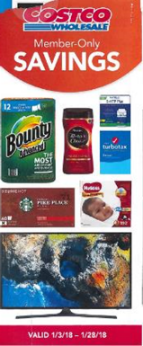
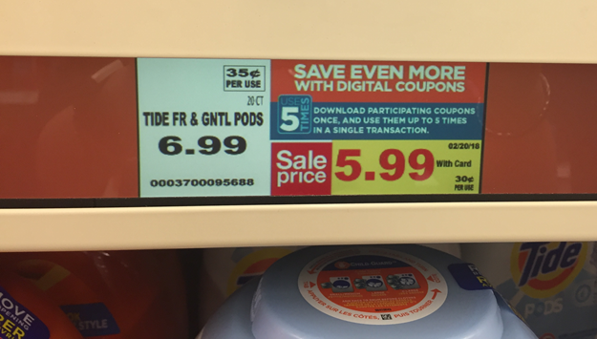
Mass, club, and grocery approach price leadership in a variety of ways: price point, exclusive savings, and hi-lo promotions

Slide 27
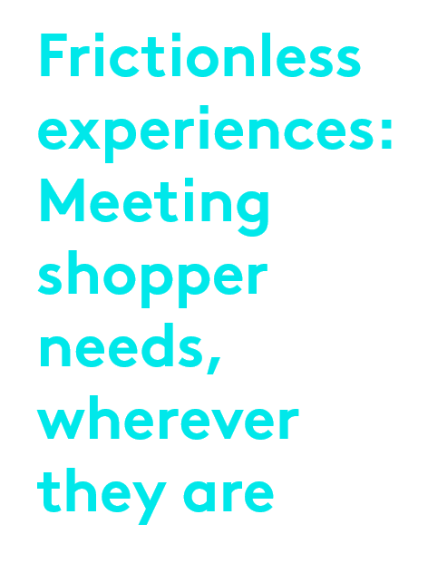
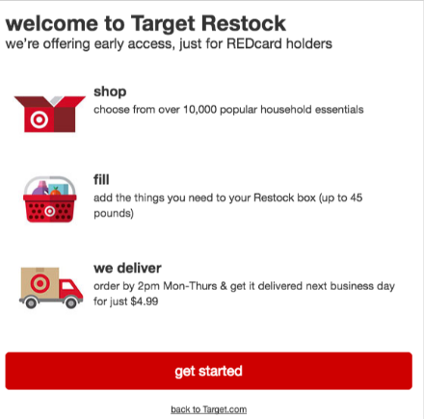
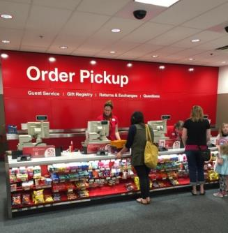
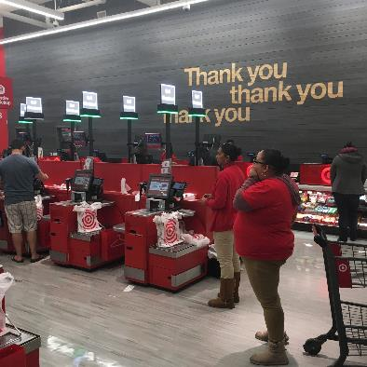
Target leveraging order pickup, the click-and-collect experience, and innovative replenishment tools to redefine ease and increase engagement in store

Slide 28
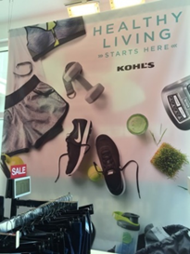
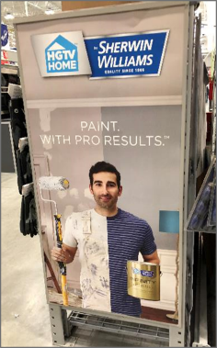
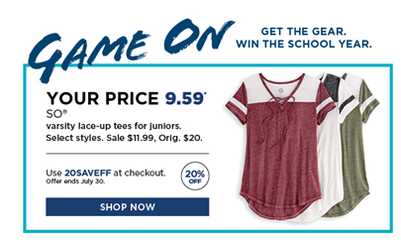
Leading apparel retailers driving value through personalized brand portfolios, while home improvement focuses on building expert image with well-known brands
Over 90% of Kohl’s
Inventory is localized
at the store level.

Slide 29
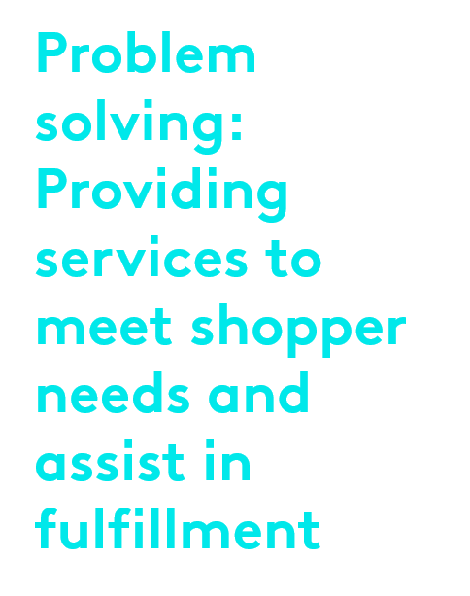
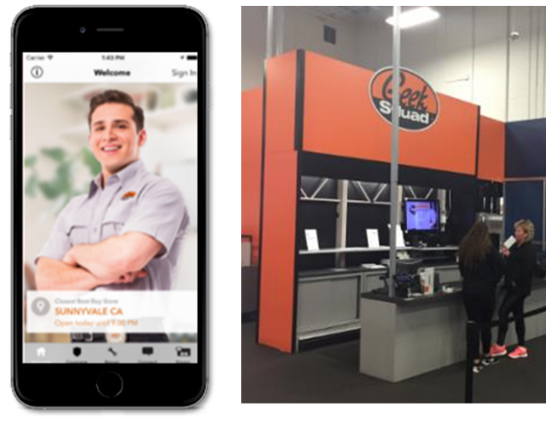
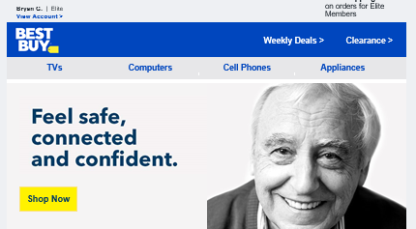
Best Buy is aiming to be shoppers’ ‘technology expert’ via services at home, digitally, or in store, which leads to product. This expertise results in incremental opportunities to convert shoppers in store.

Slide 30
Key takeaways: Why we must continue to invest in big-box retail
Maintains the purpose for the store, even in a digital-first world
Provides shoppers flexibility and influences repeat purchases
Provides shoppers with the ranges they want or don’t know they need
Establishes trust, drives trial, and accelerates auto-replenishment

Slide 31
Where are big-box retailers overinvesting?
 | Value Leadership | Frictionless Experiences | Product Expertise | Problem Solving
Mass | n | n |  | n
Supermarkets | n | n | n
Clubs | n |  | n
Department Stores |  | n | n
Home Improvement |  | n | n | n
Category Specialists |  | n | n | n

Slide 32
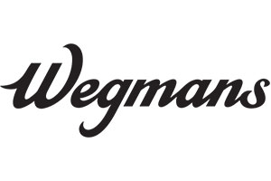
Value leadership: Build exclusives
Wegmans is looking for suppliers to expand their family pack ranges across categories. Private label ranges will expand if brands don’t lean in with them.
Strategic priority
If you won’t build,
the store brand will be the solution

Slide 33
Frictionless experiences: Create incentives
Unilever is doing a great job incentivizing Pickup, while Bonobos shows how Walmart is looking to make the future in-store experience more seamless
If you pick up in store, you pay less.
If you subscribe to this product, you pay less.

Slide 34
Product expertise: Build transparency
Sam’s Club is leveraging Member’s Mark and H&W to forge better connections with shoppers
Intrinsic: Function
Extrinsic: Values
Emotion
Price, value
Quality
Convenient
Healthy lifestyle
Natural, fresh, organic
Fun
Unique
Better for the environment
Community involvement
Charity
Sustainable sourcing
Internal company practices
Humor
Personal
Historical
Shopper ownership
Curated trust
Conversation
Eye-catching

Slide 35
Problem Solving: Create partnerships
Home Depot and Tesla are leveraging the Home Depot service network to coordinate home consultations and installations. Home Depot is evolving into a retailer that leverages service to drive product purchases.

Slide 36
Actionable insights: How do we accelerate big-box retailer growth?
Align to the retailer’s strategic priorities.
Be flexible and accelerate investment in new business models.
Be personal, authentic, and informative.
Leverage services to drive fulfillment in store.

Slide 37
Shoppers: What to know
Getting Big Box Right
Going Big with Small Format
Smaller is better? What’s next?

Slide 38
They feel local and cozy
They are increasingly targeted to be better for you
They have less stuff

Slide 39
‘Small’ stores are under 40,000 square feet
Urban and college stores are approximately 20,000 square feet; some neighborhood sites are larger
Kantar Consulting’s Forecast for Small-Store Growth
Small-format store growth
CAGR 2018E-2023E: 23.4%

Slide 40
Target’s assortment changes according to a local area’s needs

Slide 41
Dollar General’s category strategy focuses on elevating the better-for-you offering
“Better-for-you” snacks and frozen receiving more store space
BETTER-FOR-YOU
Dollar General is introducing an expanded assortment of “better-for-you” products, with a focus on higher protein and lower salt choices.
HEALTH AND BEAUTY
Dollar General will continue to expand its health and beauty selection in 2018 with more impactful displays, more consistent in-store messaging, more marketing in print and digital media, and enhanced quality.
PRODUCE
Dollar General sees fresh produce as a growth opportunity. One-third of all new remodels will include a fresh produce assortment, bringing the total number of Dollar General stores with produce to approximately 450 by the end of the year.

Slide 42
Small formats have “less stuff” and provide a more tailored experience
Tailored Assortment
Prepared Food
Options
Private Label Prominence

Slide 43
And in some cases… they even have no stuff…!
Nordstrom Local carries no inventory
The store serves as a service and pickup location, were shoppers can easily interact with stylists and pickup orders.
Key features and services include:
Personal stylists
Buy Online Pickup In Store
Alterations and Tailoring
Same Day Delivery
Trunk Club and Trunk Club Custom
Curbside Pickup
Nail services
On-site refreshments including beer, wine, and cold-pressed juices

Slide 44
With practical and premium shoppers, smaller formats deliver on experiences

Slide 45
Anchored in technology
With a changing checkout
As a source for testing new models

Slide 46
Digital extends the smaller aisle to the endless aisle
Shoppers no longer limited to the four walls of the box
Target is licensing the technology for visual search in its app, connecting shoppers to the product detail pages of items related to objects in the real world. Others, including Kraft Heinz, Nordstrom, and The Home Depot, are embedding Pinterest Pincodes in stores or on products to link shoppers to a wider assortment and online content. This technology has the power to make the entire physical environment virtually shoppable.
Walmart is testing touch-screen kiosks that allow shoppers to shop in-store and online inventory.

Slide 47
Evolving the checkout
Retailers are finding new ways to facilitate the checkout experience
Walmart canceled Scan & Go, but opted for Check Out With Me,” continuing to focus on redefining checkout convenience.
As scanning tools and technologies evolve, the opportunities to grab a share of mind and wallet at the checkout counter are being significantly impacted.

Slide 48
An opportunity to test out new models
Kohl’s store strategy redefines its traditional approach to its physical real estate
TWO CENTRAL PILLARS TO KOHL’S RECENT STRATEGY:
RESULTING IN:
Traffic: 8.5%
With estimated 56% new or not-recent shoppers
Reduce the store size and improve inventory management
Rethink the role of the store and create new partnerships

Slide 49
For Walmart, smaller formats allow testing last-mile delivery
Defining new approaches to last-mile delivery:
Using “crowdsourced” delivery services — Uber, Lyft, Deliv
Automated pickup kiosks
Pickup and fuel tests
Orders picked by Walmart personal shoppers; delivered by drivers

Slide 50
Small formats deliver on convenience and experiences by aligning to new shopper expectations
SPACE, NAVIGATION
SERVICES
FRESH & CONVENIENCE
LABOR & EFFICIENCY
TECH INTEGRATION

Slide 51
Shoppers: What to know
Getting Big Box Right
Going Big with Small Format
Smaller is better? What’s next?

Slide 52
Building on opportunities from key gaps in eCommerce and further aligning to shopper expectations
Driving in-store traffic in innovative ways
MORE CREATIVE PARTNERSHIPS TO FACILITATE RETURNS
THE ABILITY TO FEEL PRODUCTS
FILLING AN IMMEDIATE NEED
GETTING A UNIQUE EXPERIENCE

Slide 53
Amazon Go
“Just walk out” technology that leverages computer vision, sensor fusion, and deep learning to detect when shoppers take or return products to the shelves
Redefining convenient, brick-and-mortar shopping
Amazon Go is intended to elevate the stress-free and timesaving shopping experience. In addition to easy mobile check-in and checkout-free technology, numerous employees ensure easy access to assistance while a food-prep and eating area allows shoppers to eat the meal they have just bought.

Slide 54
The unmanned store offers a solution for immediate-need occasions
Implemented in smaller, convenient locations, these stores offer a tailored selection of essentials for on-the-go shoppers
Launched in 2014, BingoBox is an unmanned store. Shoppers open the door, register, and use their mobile devices to pay via WeChat or Alipay. BingoBox claims that a human worker can take inventory and refill a store in 20 minutes, with just four employees needed to support 40 stores.
The Moby-Store, designed by Wheelys, is a 24-hour store run entirely by technology. Moby Mart plans to launch production in China by 2018. Each store, which is expected to cost less than USD100,000, can be franchised, with a low operating cost.
Wheelys envisions a future in which self-driving buses will auto-replenish stores from nearby warehouses when supplies run low and maximize sales by moving inventory based on local demand.
“Shoppers will scan their hands to enter a quiXmart retail pod, and once inside, camera tracking and biometrics will track whatever they pick up and place in their bag. At checkout, an array of cameras will scan the selected items and, with a simple push of a button, the AI system will seamlessly calculate the total item value, charge their account, and open the pod door ...”

Slide 55
While online will continue to see the rise of small formats as well

Slide 57
Provide solutions that meet new space requirements

Slide 58
Align with new inventory management needs and flexible merchandising

Slide 59
Find new ‘space’ where shoppers congregate and merchandise there
With the checkout experience evolving, rethink new spaces where shoppers pause in their in-store journey.

Slide 60
Shift dollars to impact mobile blinders
Focus on creating educational and inspiring content delivered at shelf.
Deliver ads and promos to capture a share of in-store mobile time.
Align to retailers’ mobile checkout strategies.

Slide 61
THANK YOU
DIANA SHEEHAN
VP Retail & Shopper Insights,
Kantar Consulting Americas
diana.sheehan@kantarconsulting.com

