Slide 1
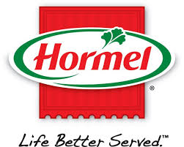
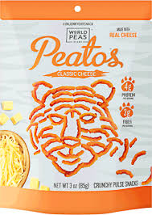
A 2020 Vision of Growth!
Getting Strategy, Teams, and Capabilities Right for Changing Times
Chris Boever
Fmr EVP and Chief Customer Officer, Pinnacle Foods

Slide 3
Pinnacle Foods Evolution & Portfolio Strategy
2001
2004
2006
2007
2009
2013
2014
2016
2018
Founded through purchased assets from Vlasic
Merged with Aurora Foods
Armour from Dial Corporation
Acquired by Blackstone
Birds Eye Foods
Made Initial Public Offering &
Wish-Bone
Centralia Plant (Duncan Hines)
&
Gardein
Boulder Brands
ACQUIRED
BY
CONAGRA

Slide 5
GROWTH?

Slide 6
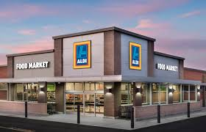
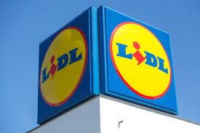
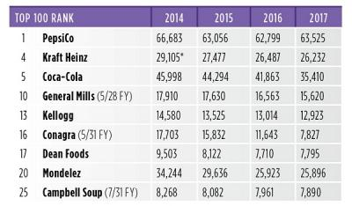
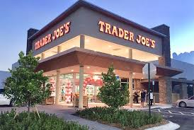
WHERE IS THE GROWTH
The aggregate top 100 CPGs -2.2%
The $760 Billion US CPG Industry Still Struggles to Sprint

Slide 8
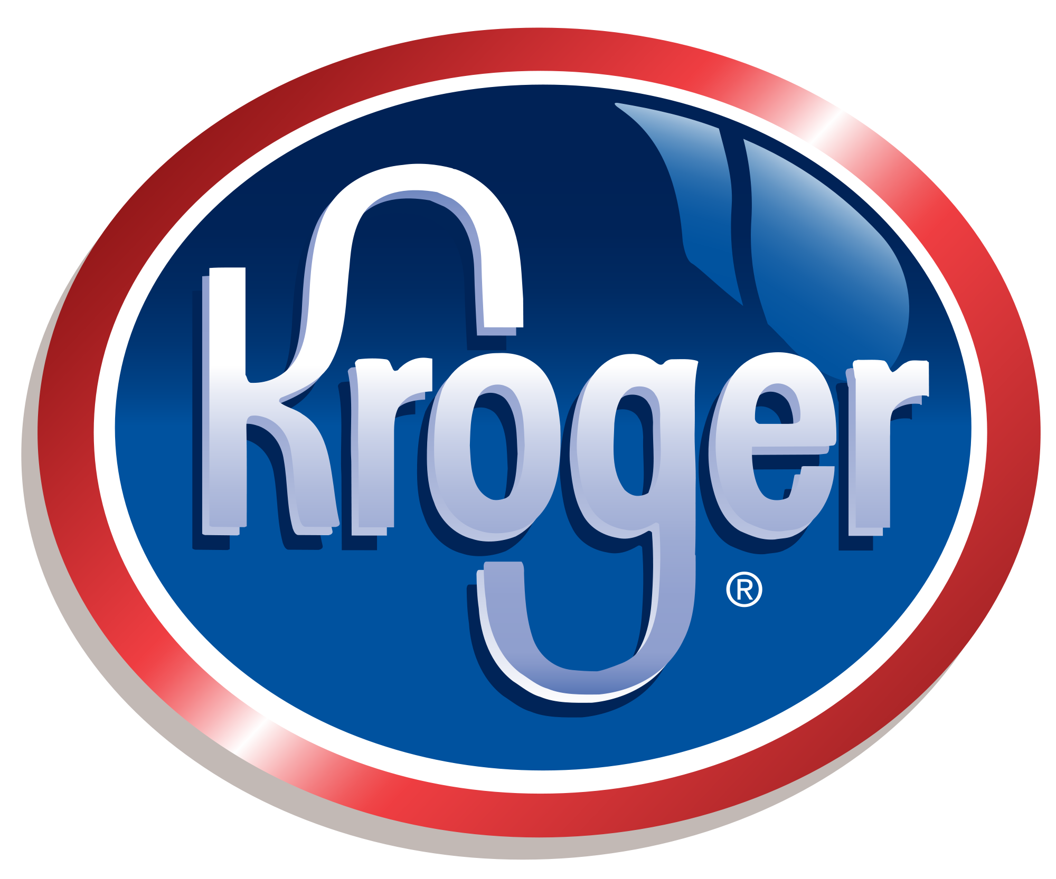
GAME PLAN
GENERAL
MANAGEMENT
CUSTOMER
DEVELOPMENT
STRUCTURE
& HIGH
PERFORMING
TEAMS

Slide 9
SCOREBOARD
Net Sales
Share
& Profit
Mix
NRP

