Slide 1
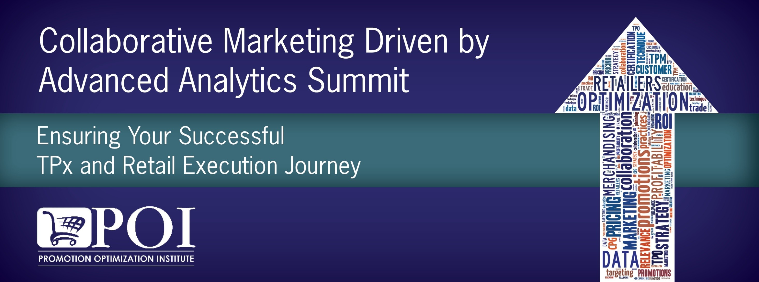
Balancing the Art & Science –
Delivering Profitable Revenue Growth
A Continuation from POI Spring Summit 2018

Slide 2



RGM Panel Practitioners
Moderator
Panelists
Gurkan Munsuz
Sr. Director
Revenue Growth Management & Trade Strategy
Bimbo Bakeries USA
Ken Dickman
EY Principal,
Global Commzercial Transformation lead
Tim Barnes
Director
Revenue Growth Management
The JM Smucker Company
Mike Milanowski
Sr. Manager
Data Science & Enterprise Alytics Solutions
The JM Smucker Company

Slide 3
Profitable Growth is Getting Harder
Consumers are changing
Growth looks different
Costs are harder to control
Operating models are out of date
73%
struggle with changing consumer behaviour
73%
are rating growth as much more difficult
75%
are struggling with rising labour costs
72%
need to make
significant changes to business models
“Profitable growth is the defining issue for our industry today” – global CPG CEO.

Slide 4
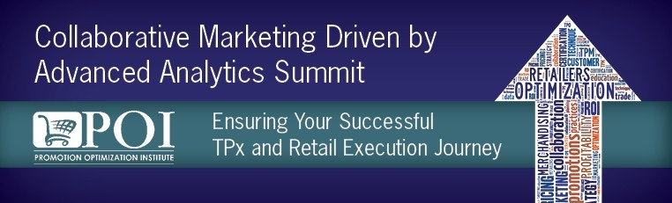
Shift in Share and Innovation
Market share 2018, %
CAGR 2013-18, %
Growth and innovation coming from smaller cap companies
$21Billion aggregate share shift from established large-caps to smaller, more nimble disruptors / category killers
Market share shift, $b
54%
26%
20%
+$18b
5%
3%
+$3b
1%
Source: IRI
Small
<$1b
Middle-market
$1b-$5b
Large
>$5b
-$21b

Slide 5








Increasing Demand & Occasion Fragmentation
Example
Consumer snacking demand
Eating occasions
 | Work or school | Social event | Replace a meal | Viewing time | Treat after a meal | Eat with a meal | On the go
Carefree Indulger
Snack Explorer
Plain Ritualist
Value Hunter
Conflicted Compromiser
Nutrition Seeker
Clean Label Enthusiast
Snack Minimizer
Carefree Indulger | Snack Explorer | Plain Ritualist | Value Hunter
Consumers who like snacks that fit with their admittedly “unhealthy” lifestyle | Consumers who love variety and consume most snacking categories | Consumers who usually eat the same foods every day, but avoid “healthy, bland” options | Consumers who are always looking to save money on snacks
Consumer segments
Conflicted Compromiser | Nutrition Seeker | Clean Label Enthusiast | Snack Minimizer
Consumers who are willing to make some health trade-offs yet still prioritize taste | Consumers who read nutrition labels and have a desire for a specific health benefits | Consumers who look for clean labels, simple ingredients and natural food | Consumers who tend to stick to main meals and “real” food
More volume
Less volume

Slide 6
… fueled by the digital impact
Impact of digital on shopping
Evolution of the consumer journey
% of consumer spend
Old
Reach consumers through mass media
Deliver good assortment & price in the store
e-Commerce
Meet consumers at their point of need
Deliver on multiple selection and purchase drivers
F&B: ~10%
New
Identify the need
Define the need
Assess options
Make decisions
Purchase the product
Experience the product
Digitally influenced
  Triggered by experience, recommendations, mass media or online interactions
  Most efficiently done through online research and/or social networks
  Online product search and reviews help narrow down options
  What and where to buy is frequently decided before going into a store
  Best combination of price, purchase convenience and delivery method
  Comments posted on social networks and review sites
Mass media
Brick & mortar
Social media
Social media
No digital influence
Informational websites
Search engines
e-commerce sites
Manufacturer websites
Direct to consumer marketing

Slide 7
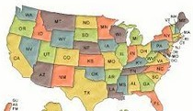



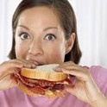


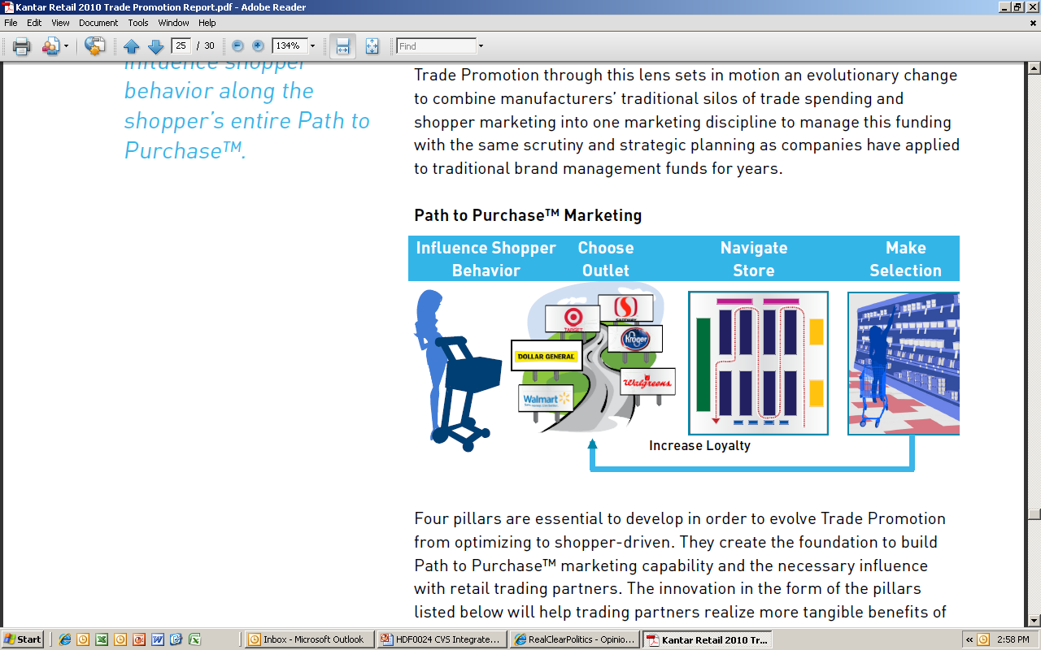



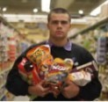


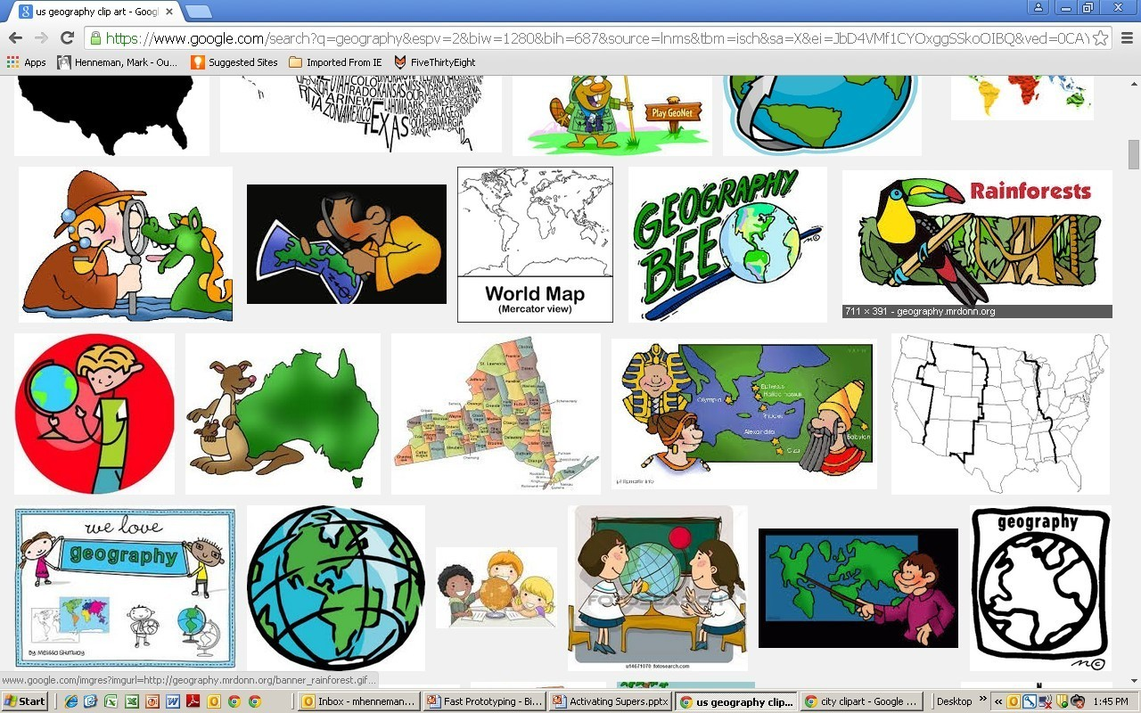


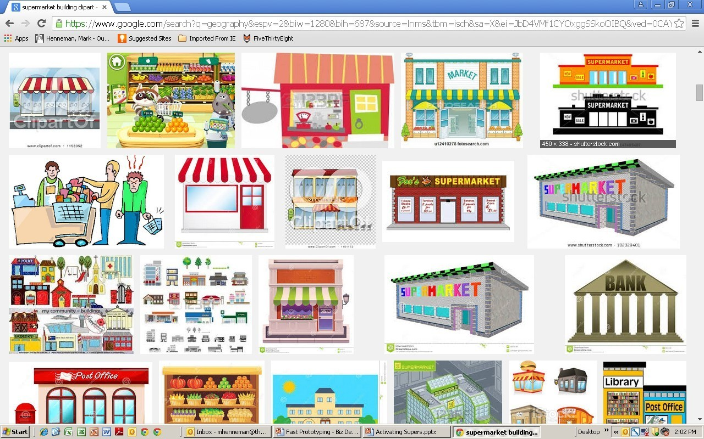




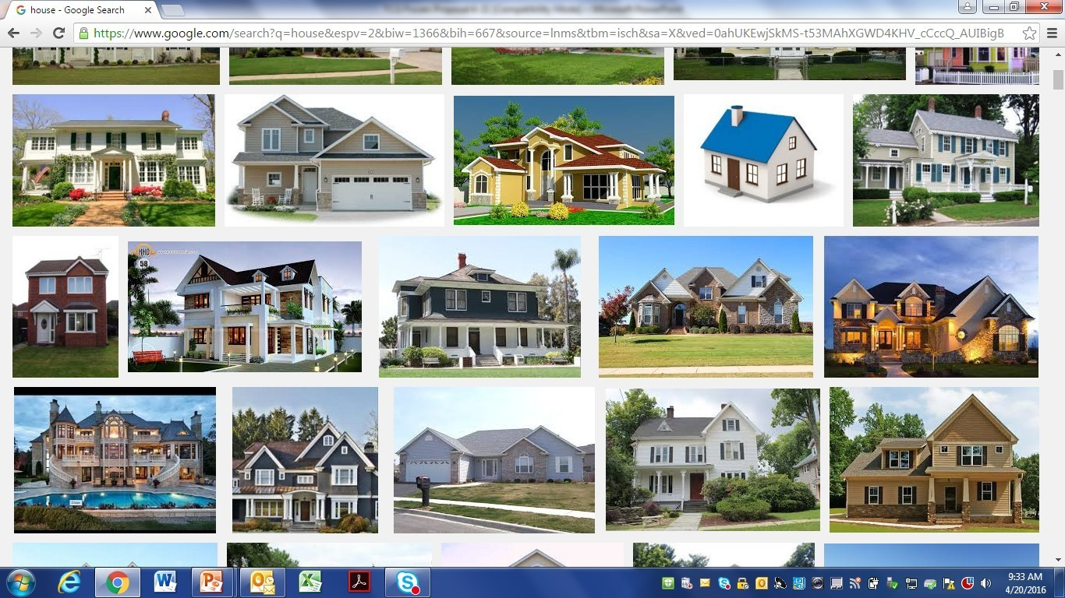
… driving need for common view of customer
Differing internal views of demand …
… to a common view …
… activated at all levels of engagement
Geography
Media
Consumer promotions
Product innovation
Marketing
Trade promotions
Shopper marketing
Prod. and pack innovation
Brand loyalists | Variety seekers | Health-oriented | Taste-oriented
Retailer
Segment A | Segment B
Local market
Consumer promotions
Sponsorships
Sales
Shopping enthusiasts | Price shoppers | Time crunched | Routine followers
Segment C | Segment D
Store
Assortment
Merchandising
Media
Segment E | Segment F
Women 25-49 | Millennials | Hispanics | Boomers
CRM
Loyalty programs
Product and service innovation
Household

Slide 8
… and a greater need for advanced analytics
Why Data & Analytics Maturity Matters
Leading (7%)
Analytics strategy well-established and central to overall business strategy – competitive ability in data and analytics is market-leading.
Share of respondents achieving each outcome
Revenue
Growth
15% or more
Operating
Margin
15%+ or more
Risk
Profile
Improvement
Challenging (45%)
Analytics strategy is established and starting to be viewed as a key strategy.
70%
66%
63%
Developing (38%)
60%
60%
Analytics strategy is established for specific lines of business, but it’s not fully aligned across the enterprise.
50%
40%
31%
29%
30%
25%
24%
30%
13%
13%
18%
13%
Lagging (10%)
20%
Lagging organizations lack an analytics vision or strategy at this time – rate themselves well behind competitors in some areas.
10%
Source: EY Survey

Slide 9
Art & Science Implications for RGM Practitioner
Widening the D&A Aperture
Using the
Art of the Story
Becoming Chief Dot Connector
Expansion beyond price and promotion analytics
  Customer / shopper # 1
  Occasion
  Assortment incrementality
  Innovation
  Brand, channel, customer growth drivers
Comfort with and proactive use of D&A for competitive advantage
Embedding D&A across functions and at the point of joint decisions and actions
65 to 70% of information shared through stories is retained while only 5 to10% is retained through D&A presentation
Story telling have been proven to drive greater understanding, adoption, and action
Story telling is often not included in RGM training
RGM practitioners are at the nexus of Marketing, Sales, Supply Chain and Finance decision and action
Leading-class RGM practitioners become the chief dot connector coordinating decisions and workflow across functions
Balanced score-cards measure operational speed to action relative to right product, right price, right place, right time,

