Slide 2
The world’s frontrunner TPx solution with applied AI capabilities

Slide 3
What makes us unique?
We have deeps roots in the CPG business
Frontrunner in the use of Applied AI
Capacity and speed of data processing makes us highly scalable
Financial simulation orientation and post event analytics
Unlimited users
Kept our Agile, startup attitude
Bring the power in the hands of the people, Unleash your Excellence!
THE WORLD’S FIRST TPM SOLUTION WITH APPLIED AI CAPABILITIES

Slide 4
Integrate all systems, workflows and AI to plan promotions in minutes

Slide 5
Plan promotions in minutes
Standard interfaces SAP, JDA and other systems
Efficient approval workflow and dashboard priority worklist
Our unique database structure brings the power to perform predictive analysis of billions of data points in seconds
THE WORLD’S FIRST TPM SOLUTION WITH APPLIED AI CAPABILITIES

Slide 6
Get instant, accurate insights into the promotions that work (and those that do not)

Slide 7
Get instant, accurate insights
Collaborative planning scenarios for manufacturer and retailer
Evaluate and reduce unprofitable promotions and increase effectiveness of investments
Improved Revenue and Contribution Margin
Increased forecast accuracy resulting in reduced working capital
Financial orientation simulation
THE WORLD’S FIRST TPM SOLUTION WITH APPLIED AI CAPABILITIES

Slide 8
Use advanced AI models to predict future, winning promotions

Slide 9
Predict future, winning promotions
80% of promotions developed with applied AI machine learning have a more accurate prediction when compared to human developed promotions
Zero touch predictions combine the blend of science and art, enabling the business to focus on material exceptions, customer strategy and relationships
Deployed AI machine learning & predictive capabilities with leading manufacturers across the globe
THE WORLD’S FIRST TPM SOLUTION WITH APPLIED AI CAPABILITIES

Slide 10
visual fabriq has been awarded POI 2018 Vendor Panorama Best in Class Status for: Predictive Analytics Financial Orientation Simulation
THE WORLD’S FIRST TPM SOLUTION WITH APPLIED AI CAPABILITIES

Slide 11
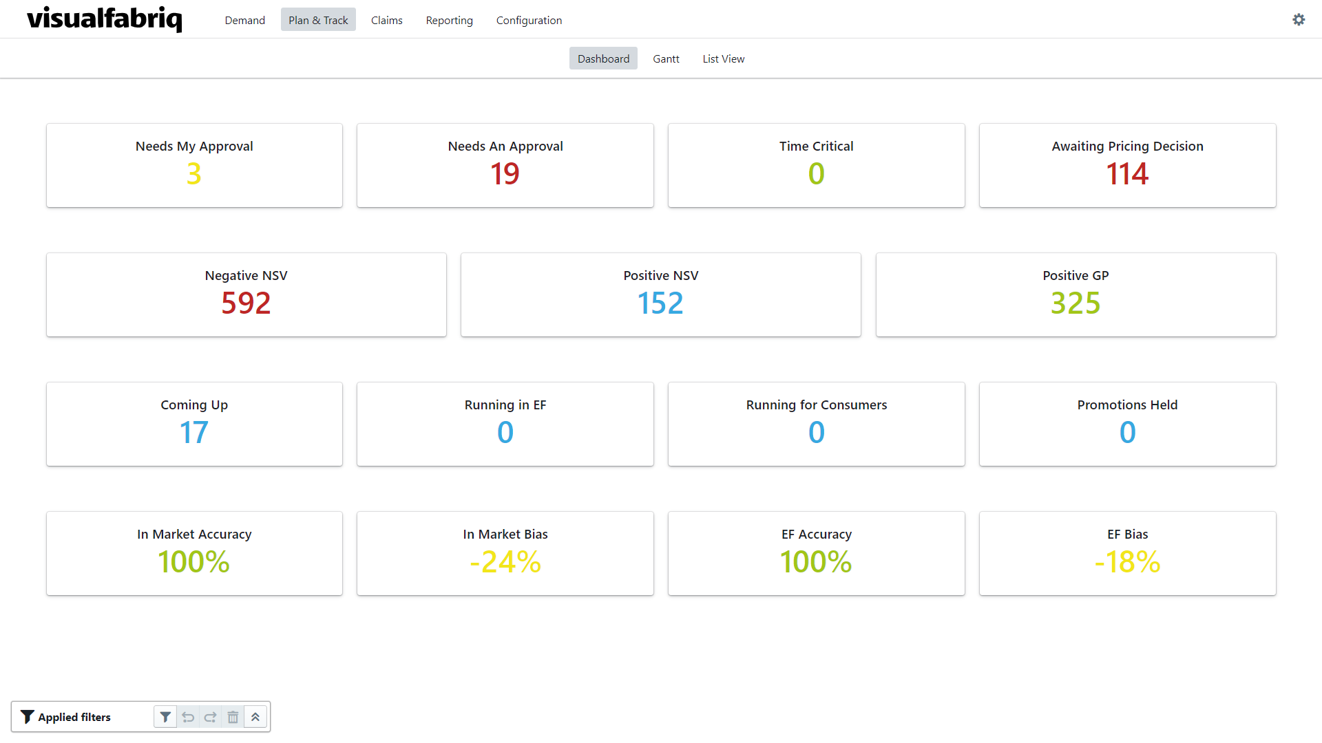
Are you ready to lead your company’s drive to excellence? Come meet with visualfabriq and learn more…

