Slide 1






AI and Advanced Analytics need people
3-point agenda to enable advanced analytics led decision making
Leaders have rapidly grown data science teams, others can catch up
Highlighted by WSJ in a recent article
Internet beating the traditional players
+40,000
~40% CAGR
1
Legacy technology will not help
+8,000
~30% CAGR
+6,000
~20% CAGR
2
Use existing data, its the king!
Challenge for CPG is aggravated by shortage of right talent
Impact Analytics is enabling retailers to build the advanced analytics & A.I. based decision capabilities without investing in big teams in short time period
3
Personalisation is becoming the competitive advantage

Slide 2
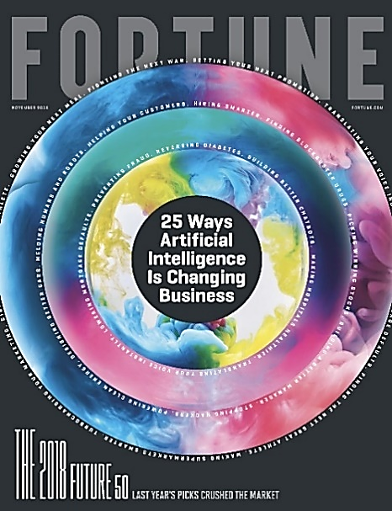
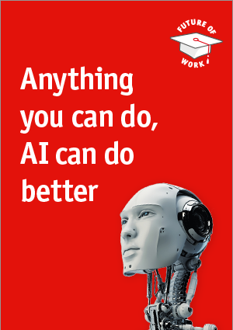
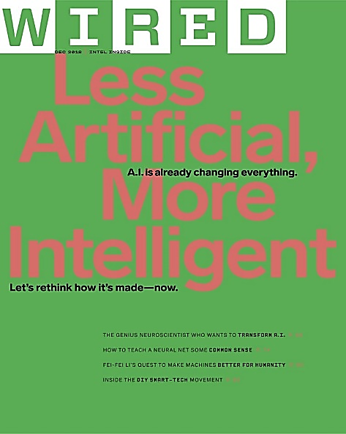

A.I. is not a distant future but a thing of ‘Today’

Slide 3
Gartner
Through 2020, 80% of AI projects will remain alchemy, run by wizards whose talents won’t scale widely in the organization. It’s ironic that AI has the potential to deliver real-time insights anywhere in an organization at any time and improve performance, yet the majority of organizations stay in silo-based complacency. For AI projects to break through, C-level execs must take ownership and support these to full production, making it clear they are essential for the future of the business

Slide 4




Highly customized analytics & A.I. models
Impact Analytics is enabling the future today for key CPG & Retail clients
End to end work-flow integration
Highly customized and tuned for the business users
Advanced methods to clean & structure data for long term

Slide 5
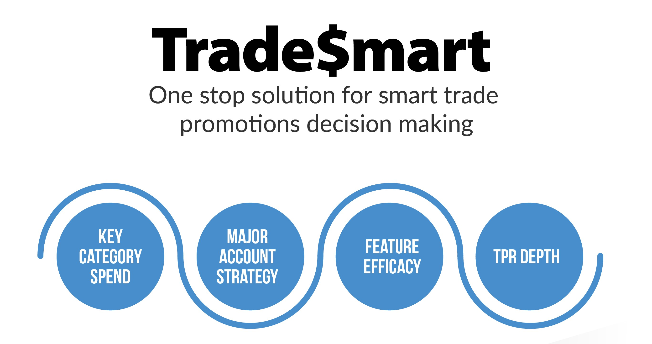
Our products help solve key problems for CPG / Retail companies
+$12Mn
Bottom-line impact for a leading foods company

Slide 6
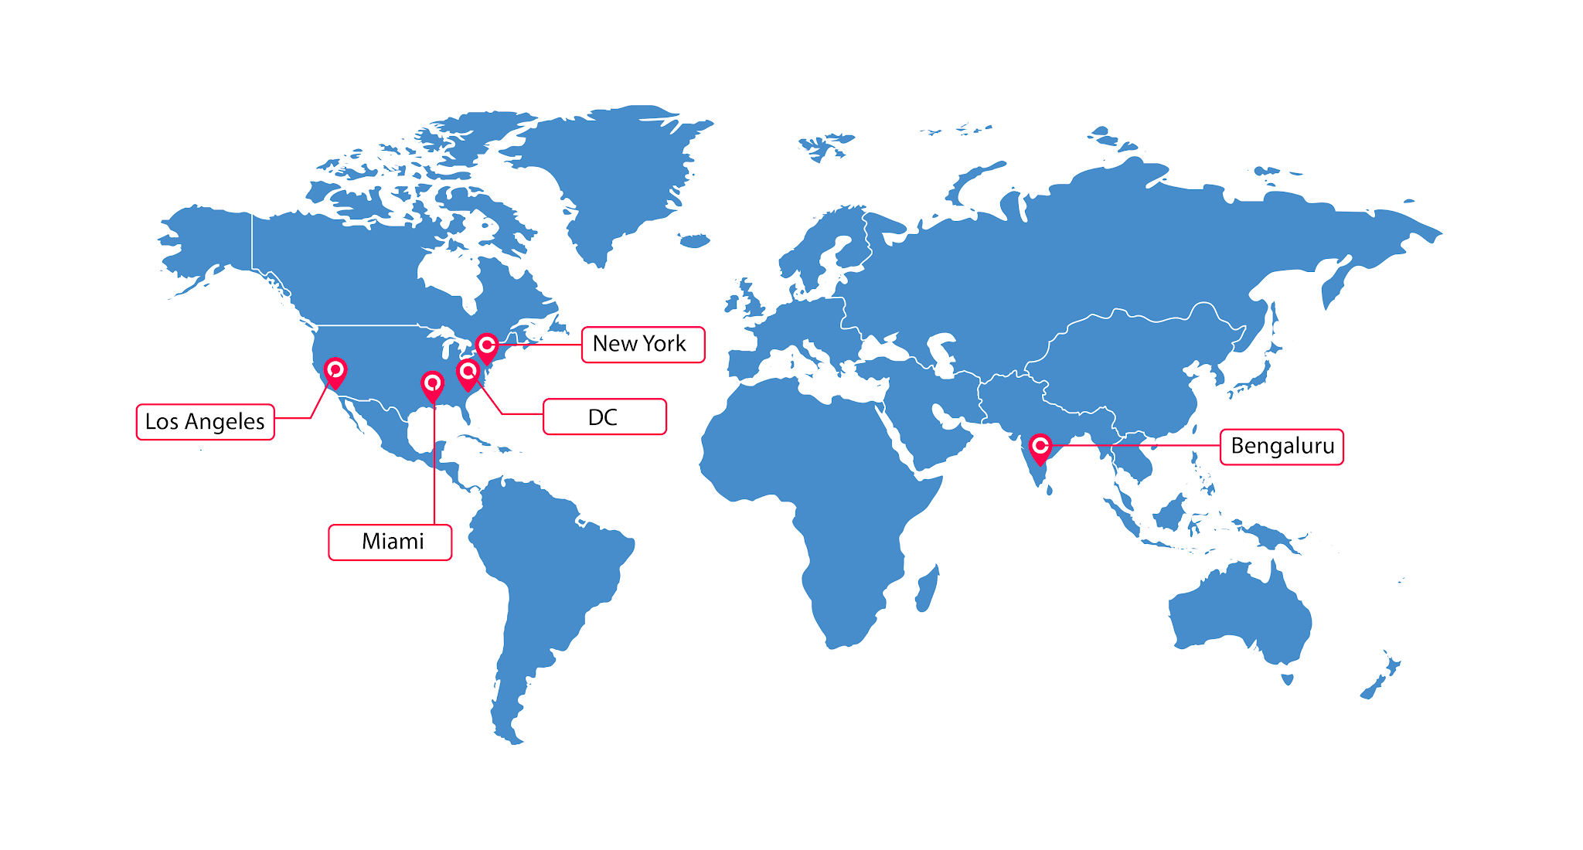
IA is a +200 global team for deploying business relevant A.I. solutions

