Slide 1
Wipro Promax POI Tech lightning talk
Brian Eustace

Slide 2
Solutions, innovation & delivery on a global scale
Leveraging the global scale, innovation & partner eco-system of Wipro

Slide 3
Delivering business outcomes for leading consumer goods companies for 30+ years
$3 Million
18%
24%
Incremental Revenue across 3 markets in first 6 months of implementation
Improvements in Forecast Accuracy
Reductions in Loss making Promotions
$1 Million
500bps
4%
Margins Improvement in 1 market during the first 3 months of going live
Improvement in Event ROI
Supply Chain efficiency Improvements
Notes:
We have been delivering outstanding benefits for 30 years.
We can cater to all the business scenarios.

Slide 4
Promax Advanced
Holistic TPM/O solution
Notes:
Promax Advanced is a very modular out of the box solution meeting both regional and global needs.

Slide 5
Promax Optimize
Bolt-on ROI & TPO Solution
Notes:
Built on the philosophy of quick user adoption and outstanding business benefits.

Slide 6
RGM
Complementary Analytics & Solutions
Notes:
Promax solutions have emerged as key pillars in the RGM strategy

Slide 7
User experience
Functionality & User Adoption
Notes:
Continue to leverage Desiginit which is a leading UX experts and continue to invest & evolve to meet the latest trends.

Slide 8
AI & Machine learning
Driving Insights, Automation & Analytics
Notes:
Cutting edge latest technologies

Slide 9
Introducing Wipro's
latest solution Auto Claim –
Powered by Wipro Holmes
Bolt on solution
Streamline deductions processing by using a workflow
Seamless integration with your Trade Promotion Management system

Slide 10
Wipro Video
https://vimeo.com/304371591/41090eeaf8

Slide 11
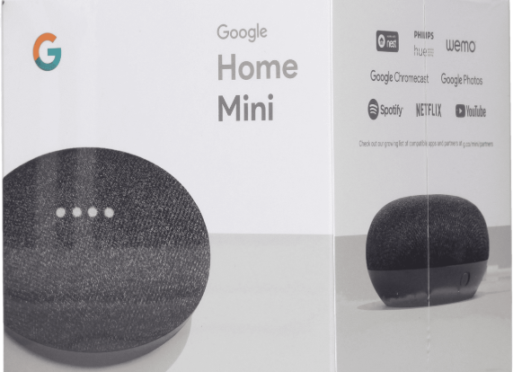
Are you lucky today?
Drop your card for Lucky Draw

