Slide 1
The Omni-Channel Imperative!
An Interactive Discussion on Best Practices

Slide 2
EVERYTHING HAS CHANGED…
THE OLD RULES NO LONGER APPLY
CONSUMER…it’s not about loyalty
YOUR OFFER…
delivering more than a product
CHANNELS…
they’re everywhere. It’s not longer a value ‘chain’
TECHNOLOGY…
it’s not your father’s ERP
COMPETITORS…
now have a level playing field thanks to funding & technology

Slide 3
“Millennials are not promiscuous; They are polygamous”
TODAY WINNING BRANDS EMBODY:
Authenticity, Agility, Relevance in the moment
Notes:
The consumer is polygamous….they are willing to date multiple brands at the same time.
They want a brand that is relevant in the moment!

Slide 4
consumers have new sources of influence on their purchase decisions
How consumers decide what to buy
TRADITIONAL MEDIA (TV, PRINT, RADIO)
FRIENDS & FAMILY
INFLUENCERS & BLOGGERS
Source: Accenture Global Customer Journey Survey 2016
Notes:
Our clients can’t rely on traditional methods to reach and influence purchase decisions.
The influencers that are relevant are constantly changing.

Slide 5
The offer…they are looking for more than product… value, experience, service
HEALTH & WELLNESS
PERSONAL DISCOVERY
Farm to Fork/ Face
Quantified Health
Made for Me/ By Me
Experiment/ Teach Me
Good for the Earth (and Me)
Easy Nutrition
Audience Participation
Robot Servant
Help Me
Never Run Out
“X” On-Demand
Bringing Brands to Life
CONVENIENCE
EXPERIENCE
Source: Accenture Research analysis, CB Insights, Capital IQ
Notes:
Consumers aren’t just looking for products – they are looking for far greater.
And as this shows, they’re getting it.
New experiences
New ways to get things done (services)
New distribution channels to get my goods
Tailored to meet my values – health & wellness, personal discovery, convenience, etc…

Slide 6
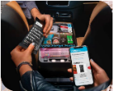
Channels… they’re everywhere. And it’s not a value ‘chain’ anymore.
Hotel
New Points of Sale Created Everyday
Shifts from traditional channels to experience platforms
Unilever footprint over 10 years
Modern Trade: 65% to 50%
Exp Platforms & eComm: 15% - 20%
Ever increasing touchpoints and content intrusions
Every two days we create as much information as we did from the beginning of time to 2003
Smart Car
Web
Social
Ad Display
Store
Wearable
The Home
Mobile
Source: Accenture Research analysis,
Notes:
Our clients can’t rely on a traditional value chain, nor on a clear definition of channels.
There are new points of distribution & interaction
They have to anticipate and adjust to new packaging, product formulation, partners, skills –
Cargo installs mobile-operated kiosks inside ride-sharing vehicles, selling snacks, beauty products, and other items. So far, it partners with Uber in the US and Grab in Asia. It focuses on gathering user data through its mobile app for CPG brands.

Slide 7
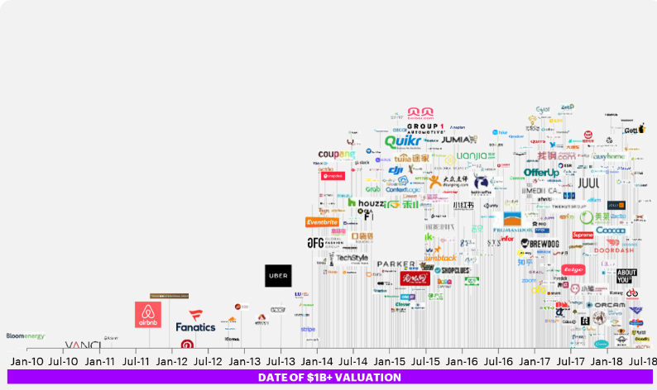
Technology and funding have leveled the playing field
leading to The rise of new competition
Source: CB Insights 2018
Notes:
15 years ago in Smart Store, we predicted a level playing field. One where CPG companies wouldn’t have the benefit of scale.
That time has come.
The pace of competitive innovation has increased
Capital, technology, communication – and democratized innovation – now result in an environment where an everyday consumer, recognizes a need, gap or opportunity
And turn it into a business.
Begs the question – are our clients /large CPG companies in touch with the people. Do they know the consumer experience?

Slide 8
THE MIGHTY ARE FALLING
OVER THE PAST 10 YEARS
The struggle for growth intensifies.
There is growth in the industry, but that growth is coming from the small to medium players.
Being a leading brand does matter, but need to be the right brands for the matter at hand.
Coca-Cola
Colgate-Palmolive
Diageo
InBev
PepsiCo
P&G |  | Diageo
Reckitt-Benckiser |  | PepsiCo
SABMiller |  | Reckitt Benckiser
Anheuser-Busch |  | ABInBev |  | ABInBev
Carlsberg |  | Carlsberg |  | Coca-Cola
Danone |  | Coca-Cola |  | Colgate-Palmolive
Heineken |  | Colgate-Palmolive |  | Danone
Henkel |  | Danone |  | Diageo
Kellogg |  | Heineken |  | General Mills
Kimberly-Clark |  | Henkel |  | Heineken
L’Oreal |  | Kimberly-Clark |  | Henkel
Nestlé |  | Kraft |  | Kellogg
Unilever HPC |  | L’Oreal |  | Kimberly-Clark
General Mills |  | P&G |  | L’Oreal
Kraft |  | SABMiller |  | Nestlé
Unilever Food |  | Unilever HPC |  | PepsiCo
 |  | Kellogg |  | Reckitt Benckiser
 |  | General Mills |  | Unilever Food
 |  | Nestlé |  | Unilever HPC
 |  | Unilever Food |  | Carlsberg
 |  |  |  | Kraft Heinz
 |  |  |  | Mondelez
 |  |  |  | P&G
HIGH PERFORMERS
AVERAGE PERFORMERS
LOW PERFORMERS
Source: Accenture Research analysis,
Notes:
This chart is very simple:
In 2006, we had a large number of high performers in our industry and many of them are the companies which we would know and respect.
By about the late 2011, things had gone down and, you get a situation where there were no high performing businesses in consumer goods. That realization started to coincide with clients coming to Accenture because they realized they were running out of ideas. Continuing to do tech sufficient supply chains, global brands, procurement, etc was pretty ironed out and most of our clients had tackled those topics, so there wasn’t much incremental value coming from that. So, this changed the rules of the game

Slide 9
Future view
A world of relevance @scale

